Slide 1
PCA Data

Slide 2
PCA Data minus mean

Slide 3
Eigenvectors

Slide 4
Compressed Data

Slide 5
Spectral Data

Slide 6
Eigenvectors

Slide 7
Fit Error – 2 Eigenfunctions

Slide 8
Singular Value Decomposition (SVD)
A matrix A_{mxn} with m rows and n columns can be decomposed into
A = USV^{T}
where U^{T}U = I, V^{T}V = I (i.e. orthogonal) and S is a diagonal matrix.
If Rank(A) = p, then U_{mxp}, V_{nxp} and S_{pxp}
OK, but what does this mean is English?

Slide 9
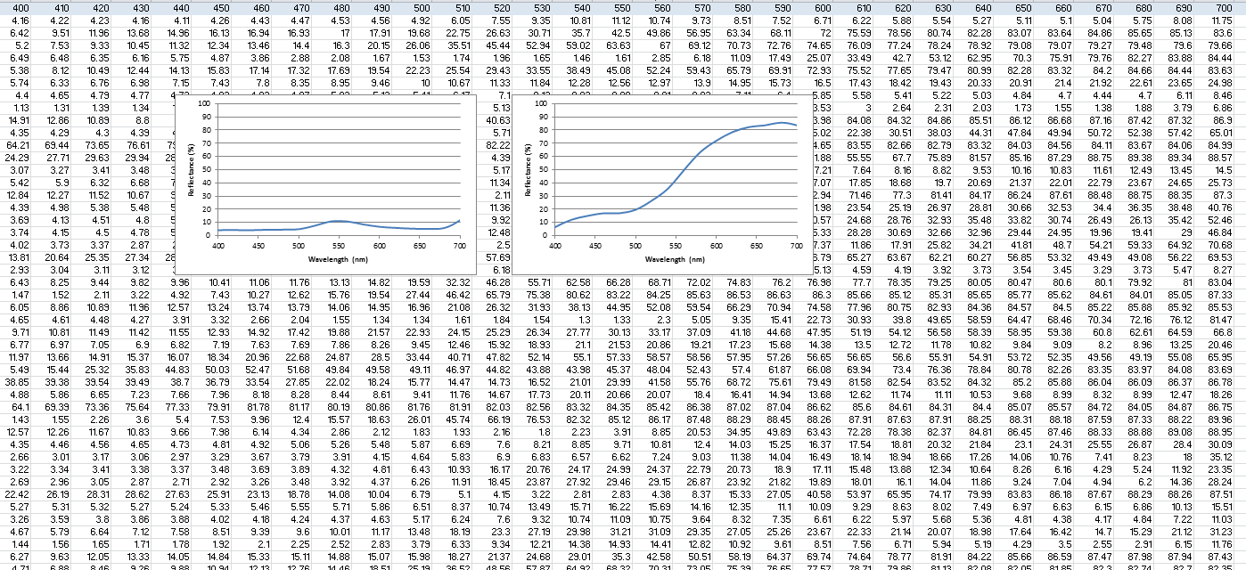
SVD by Example
A_{404x31}=
Keele Data on Reflectance of Natural Objects
m = 404 rows of different objects
n = 31 columns, wavelengths 400-700 nm in 10 nm steps
Rank(A) = 31 means at least 31 independent rows

Slide 10
SVD by Example
A_{404x31}
=
U_{404x31}
S_{31x31}
V^{T}_{31x31}
U^{T}U = I means dot product of two different columns of U equals
zero.
V^{T}V = I means dot product of two different columns of V (rows
of V^{T}) equals zero.

Slide 11
Basis Functions
V_{31x31}=
Columns of V are basis functions that can be used to represent
the original Reflectance curves.

Slide 12
Basis Functions
First column handles most of the variance, then the second column
etc.

Slide 13
Singular Values
S_{31x31}=
The square of diagonal elements of S describe the variance
accounted for by each of the basis functions.

Slide 14
SVD Approximation
A_{404x31}
~
U_{404xd}
S_{dxd}
V^{T}_{dx31}
The original matrix can be approximated by taking the first d
columns of U, reducing S to a d x d matrix and using the first d
rows of V^{T}.

Slide 15
SVD Reconstruction
Three Basis Functions
Five Basis Functions

