Slide 1
Whirlwind History of Geometrical Optics
Jim Schwiegerling PhD
College of Optical Sciences
University of Arizona
Tucson, Arizona

Slide 2
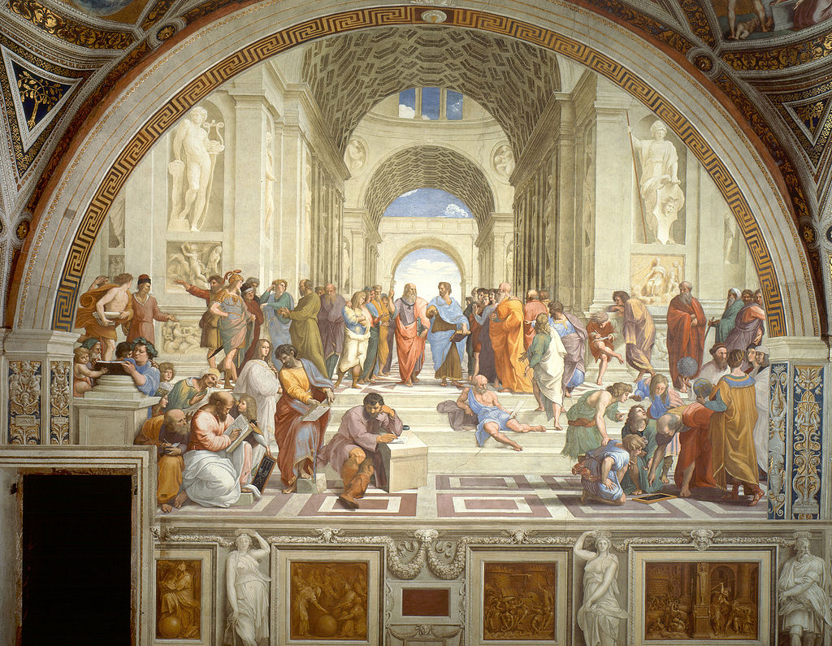
Euclid
Raphael’s School of Athens

Slide 3
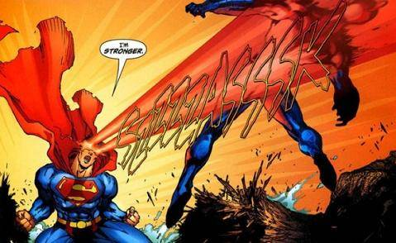
Euclid ~300BC
Greek mathematician
His book Elements used to teach geometry for over 2000 years.
Also wrote about optics of the eye, but thought rays exit the eye and we “see” whatever these rays fall on.

Slide 4
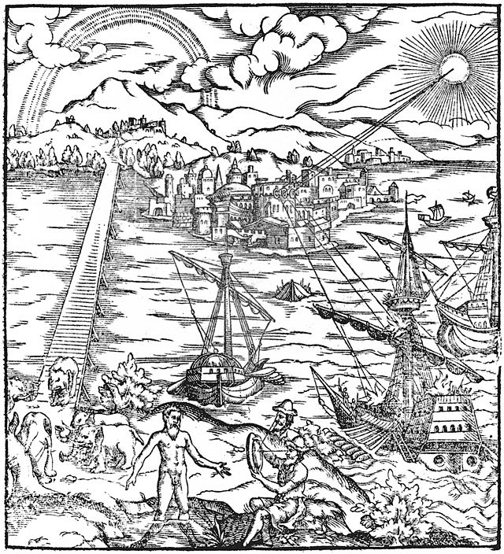
Archimedes ~250BC
Attributed with a “heat ray” which would focus sunlight onto enemy ships and set them on fire.
Mythbusters “busted” this theory in 2006.

Slide 5
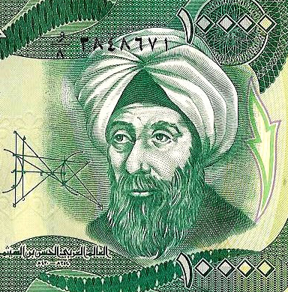
Alhazen ~1000AD
Born in modern day Iraq and called the father of modern optics.
His Book of Optics was translated into Latin and later influenced European scholars.
Described magnification in
lenses, as well as spherical
and parabolic mirrors.
Rays from objects enter the eye.

Slide 6
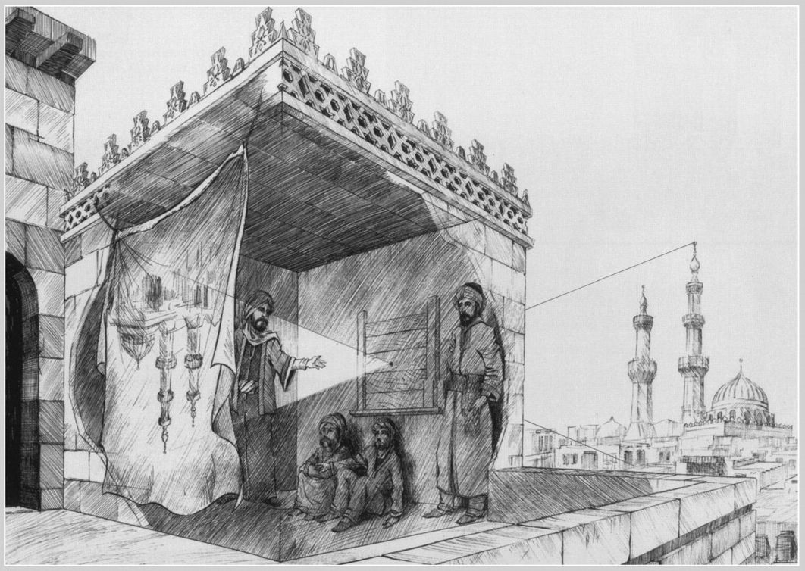
Alhazen - Camera Obscura

Slide 7
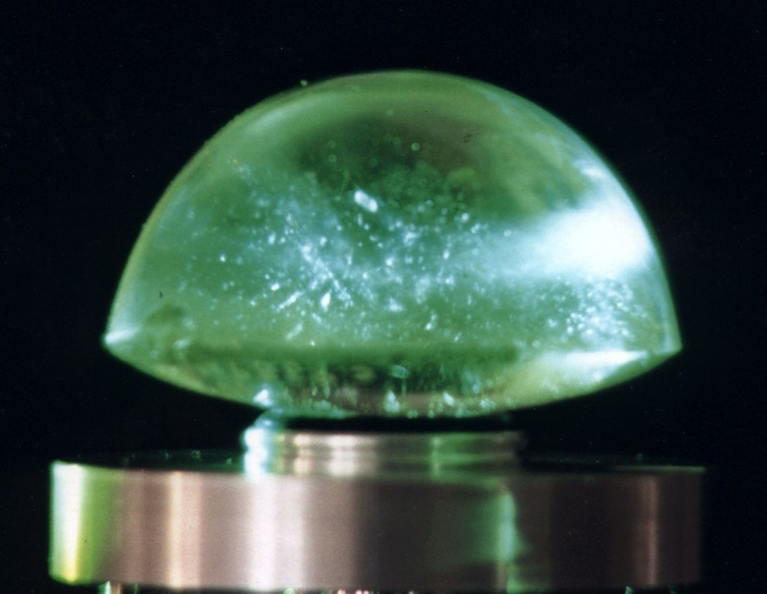
Visby Lenses ~11-12th Century
Found in modern Sweden.
Possibly used as magnifiers or to start fires.

Slide 8
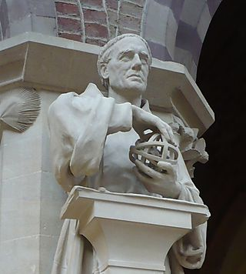
Roger Bacon - 1262AD
English Philosopher and Franciscan Friar.
Studied math, astronomy, optics, alchemy.
Studied the refraction of light by lenses.

Slide 9
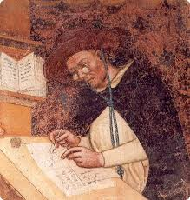
Spectacle Lenses
Roger Bacon definitely wrote about burning lenses.
He is sometimes attributed with inventing spectacles, but evidence is scarce.
Marco Polo may have seen spectacles in China in 1270.
Italians may have developed spectacles in late 1200s.
Fresco by Tommaso da Modena, 1352

Slide 10
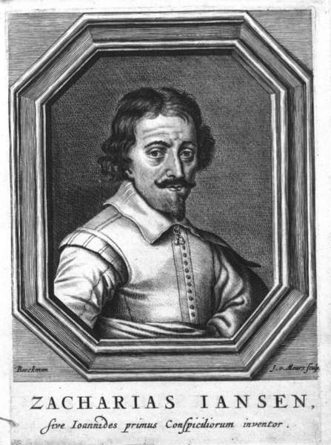
Zacharias Janssen ~1590AD
Dutch Spectacle maker
First compound microscope attributed to him in 1590.
First telescope sometimes attributed to him.
Caught counterfeiting coins in
1618.

Slide 11
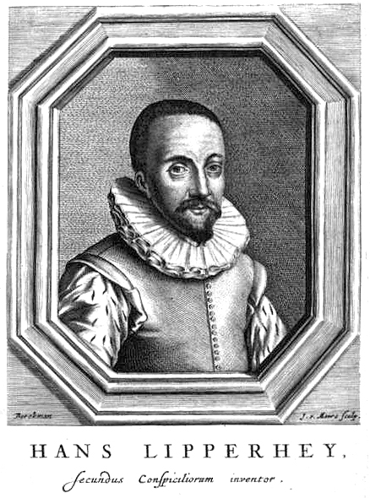
Hans Lipperhay ~1608AD
Dutch Spectacle maker
Next door neighbor of Zacharias Janssen.
First telescope is attributed to him in 1608.
Telescope has positive and negative lens and upright image.

Slide 12
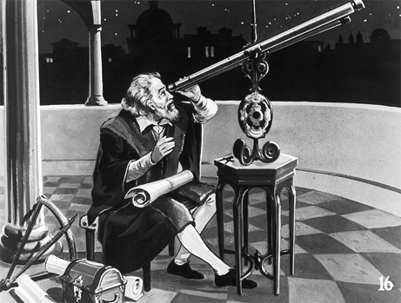
Galileo 1609AD
Constructs in 1609 one of Lipperhay’s telescopes.
Father of observational astromnomy.
Observed phases of Venus, sunspots and moons of Jupiter.
Got in trouble for heliocentric views.

Slide 13
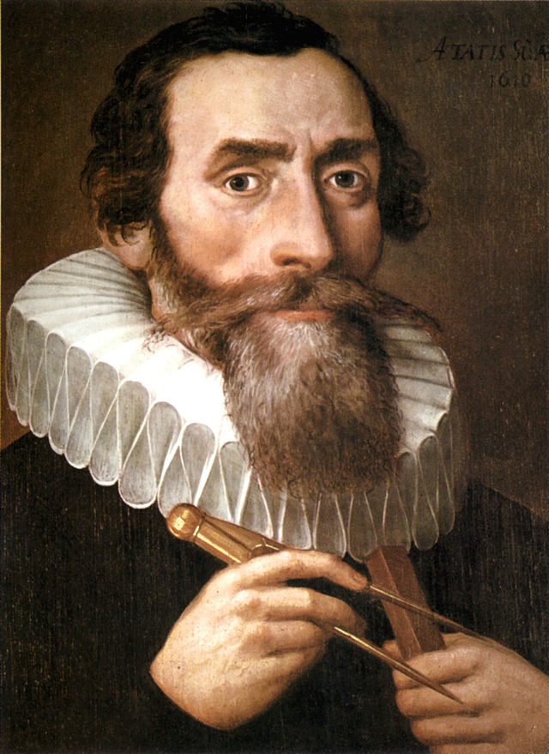
Johannes Kepler 1611AD
German astronomer
Describes telescopes and microscopes in his book Dioptrics.
Proposes telescope with two positive lenses and upside down image.

Slide 14
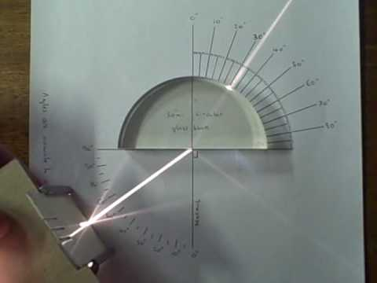
Willebrord Snellius 1621
Developed “Snell’s Law” of refraction n₁sinθ₁ = n₂sinθ₂, although Ibn Sahl describes this effect in 984 and by Harriot in 1602 who corresponded with Kepler about it.

Slide 15
Pierre de Fermat 1657
Fermat’s principle says that rays follow paths that take the least amount of time. Modern description is the ray path is stationary.
Can get Snell’s law and the law of reflection directly from this.

Slide 16
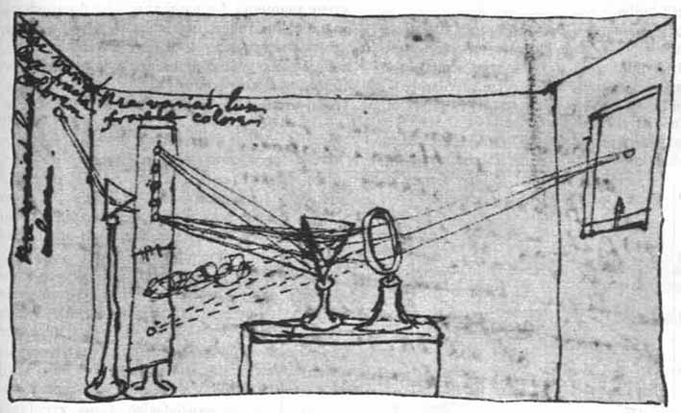
Isaac Newton
1666 showed white light is composed of all the colors of the spectrum.
1668 suggested all reflective telescope to avoid chromatic aberration. Didn’t think lenses could be made to correct chromatic aberration.

Slide 17
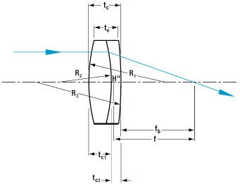
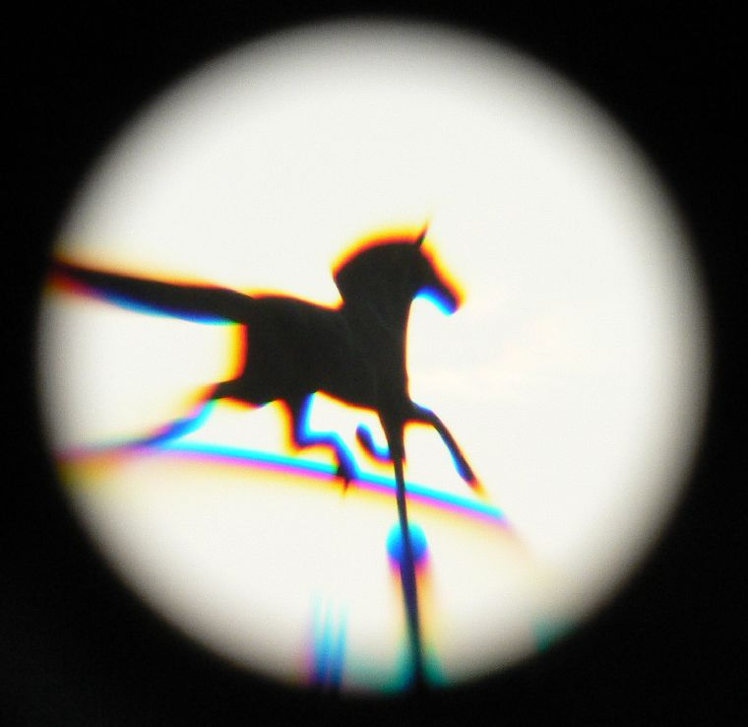
Chester Moore Hall ~1729
Developed achromatic doublet, or two lenses that correct chromatic aberration when used together.
Demonstrated telescope with achromatic lenses that corrected chromatic aberration.
www.tlc-systems.com

Slide 18
John & Peter Dolland 1758
Patented Achromatic lenses well after Hall’s invention.
Hall used an optician George Bass to fabricate lenses.
Bass told Dolland about the lenses and Dolland was able to reproduce the effect.
John (Father) didn’t enforce the patent, but Peter (son) did after father’s death.

Slide 19
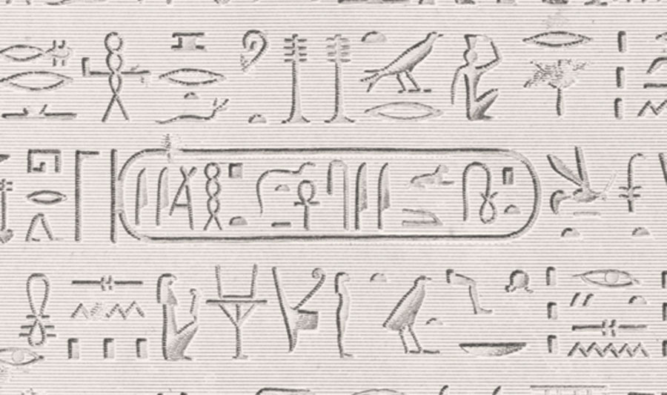
Thomas Young
British physician who had significant impact in medicine, vision, mechanics, wave theory of light and even Egyptology.
1801 Proved light acts like a wave by demonstrating interference.
1814 Realized a Cartouche represented a name in Hieroglyphics.

Slide 20
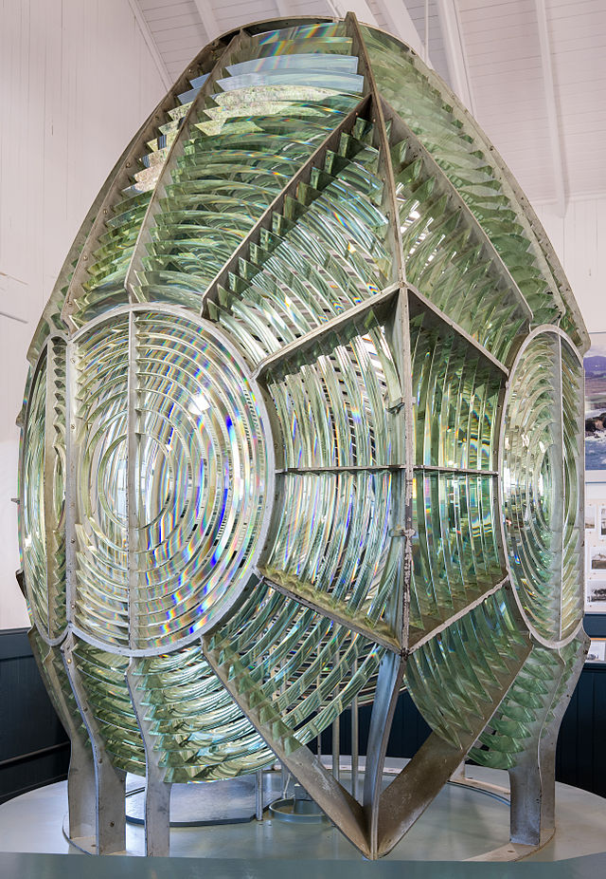
Augustin-Jean Fresnel
~1818 Developed the concept for a Fresnel lens for lighthouses which have large aperture and short focal length.
Major impact in areas of wave optics including polarization and diffraction theory.

Slide 21
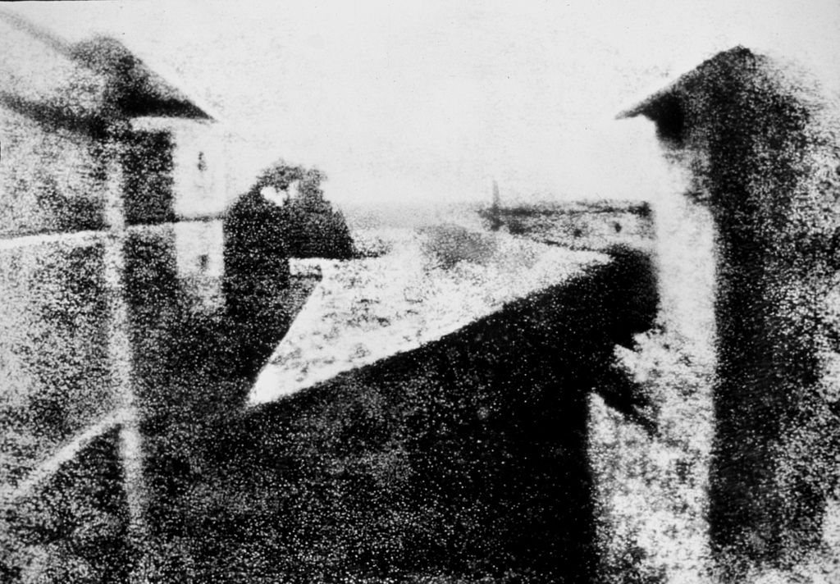
Nicéphore Niépce ~1826
Developed heliography, earliest known photographic process for recording images in a camera obscura.
Required several days to expose.

Slide 22
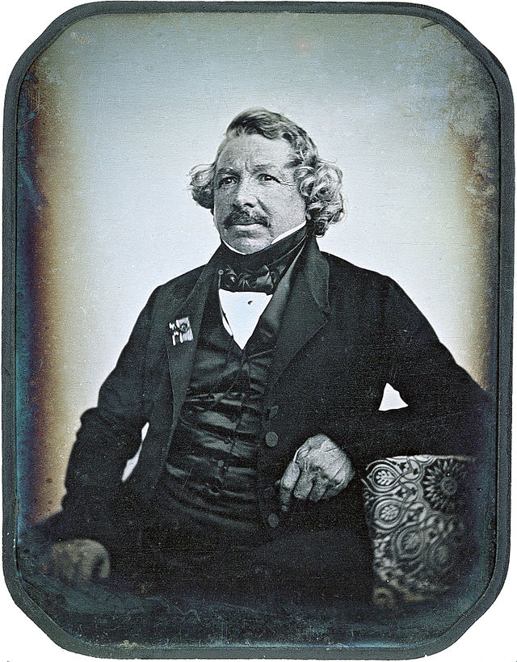
Louis Daguerre ~1839
First practical and commercial demonstration of photography.
Worked with Niepce until Niepce died in 1933.
Required several minutes to expose.

Slide 23
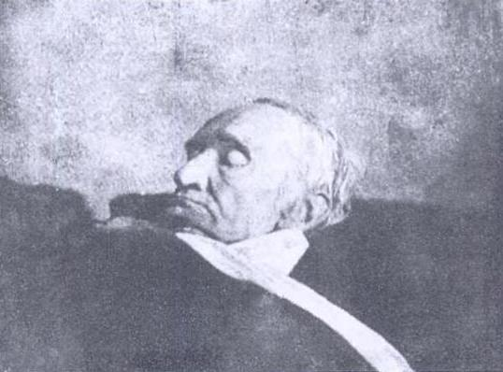
Carl Friedrich Gauss 1840
German mathematician
Published Dioptrische Untersuchungen which describes the paraxial or Gaussian theory of optics.
Imaging properties of lenses can be determined by their cardinal points.
Death in 1855

Slide 24
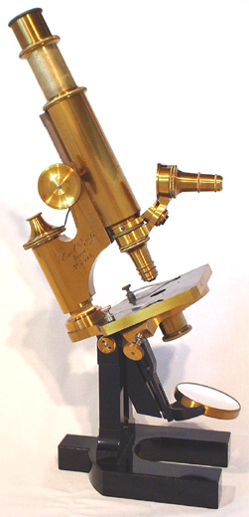
Carl Zeiss
German Instrument Maker
Developed high quality microscopes and later camera lenses.

Slide 25
Philipp Ludwig von Seidel 1856
German mathematician
Developed a description of monochromatic aberrations which are a deviation of light rays from the paraxial properties described by Gauss.

Slide 26
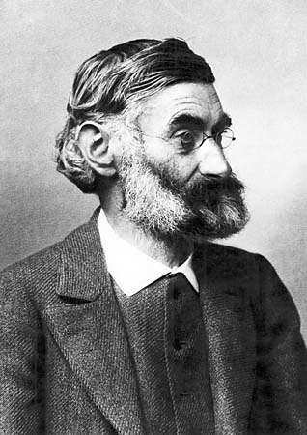
Ernst Abbe
1866 Research director at Zeiss Optical Works.
1868 Developed apochromatic lenses which further reduce chromatic aberration beyond what an achromat is capable of.
1871 Describes a refractometer for measure index of refraction at various wavelengths.
Abbe sine condition describes requirements to reduce aberrations.

Slide 27
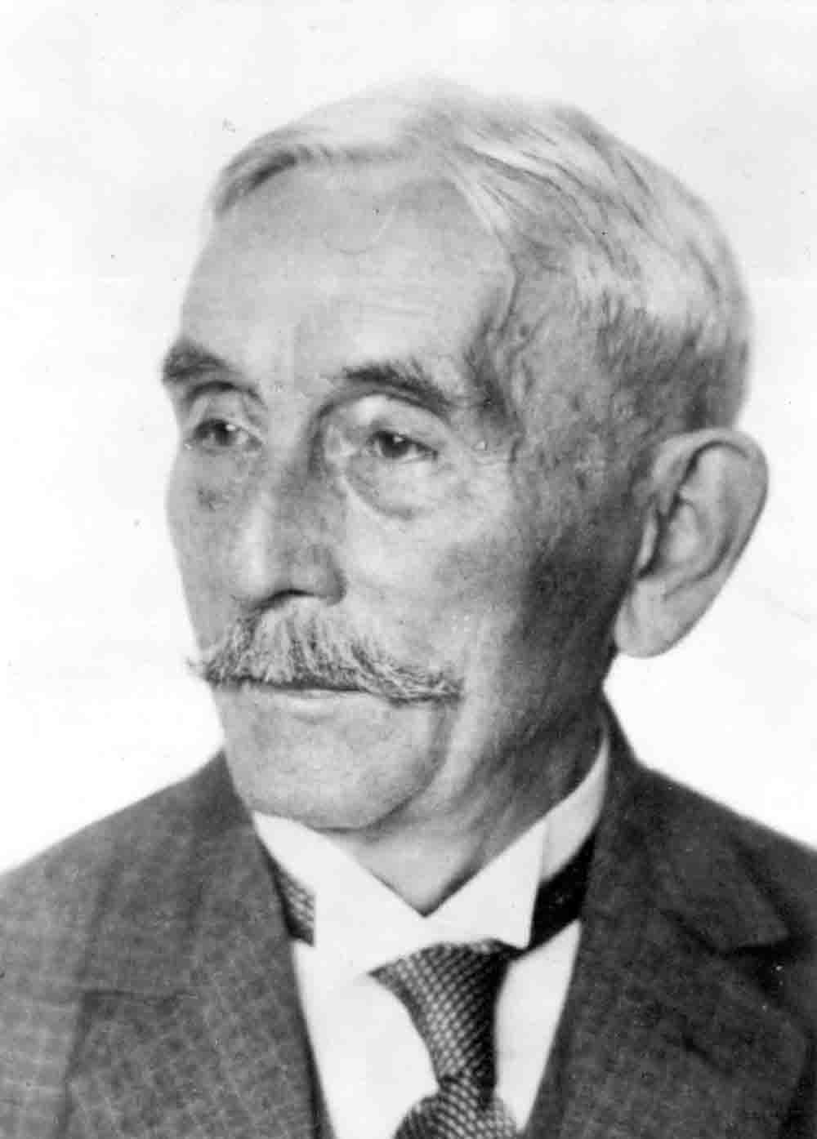
Otto Schott 1884
In conjunction with Carl Zeiss and Ernst Abbe founded what is now Schott glass.
Developed new and novel forms of glass.

Slide 28
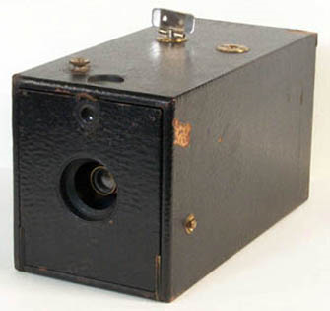
George Eastman ~1888
Licensed patents from Peter and David Houston covering various aspects of using rolls of film in a camera.
Started Eastman Kodak company which popularized photography.
Original box camera came pre-loaded with film and the customer returned camera for Kodak to make prints and reload.

Slide 29
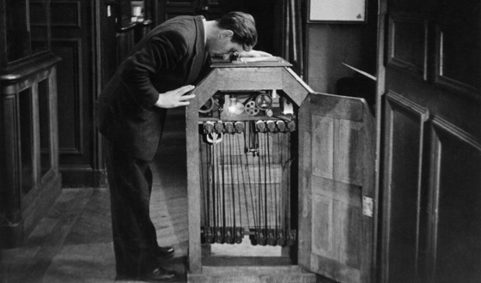
Thomas Edison 1891
Developed the Kinetoscope which enable one person at a time to view motion pictures.

Slide 30
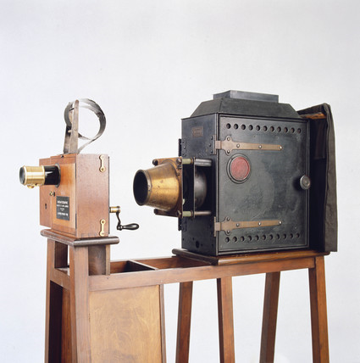
Louis Lumiere 1895
First portable motion picture camera, film processing and projection system.

Slide 31
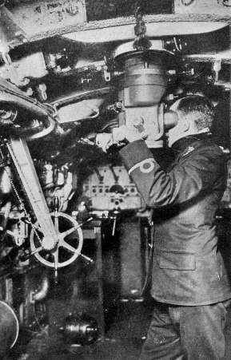
Simon Lake 1902
Developed collapsible submarine periscope.
Earlier submarines had fixed periscopes.
Basic concept goes back to at least 1430s.

Slide 32
George Hale 1908
Developed 60” telescope on Mount Wilson (California).
First light 1908.
Biggest telescope in the world at the time.

Slide 33
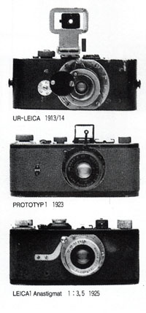
Oskar Barnack ~1912
Worked for Leica
Developed portable camera with rolls of film based on Kodak’s 35 mm wide film.
24 x 36 mm images “35 mm format”
Roll of film as long as he could stretch his arms.
Enlarger & Dark room required.

Slide 34
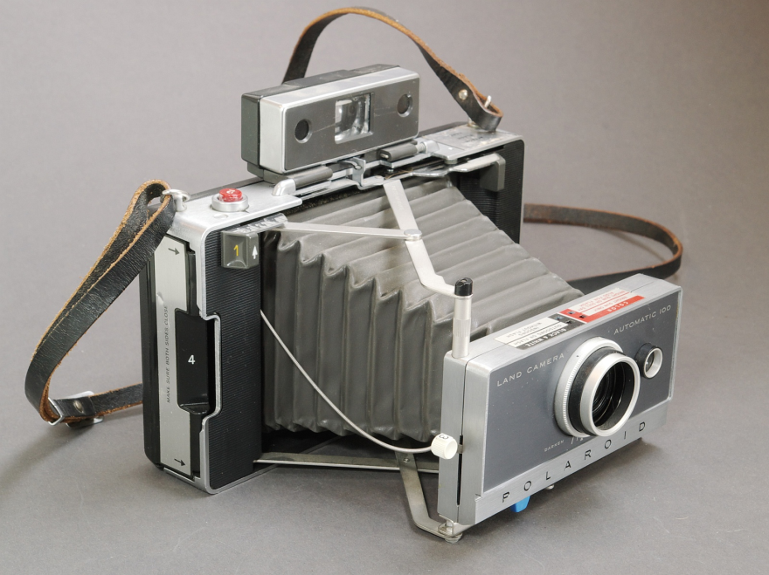
Edwin Land 1947
Established what would become Polaroid corporation in 1932.
Fabricated sheet polarizers for a variety of applications.
Developed the Land Camera and associated film in 1947 which introduced instant photography giving fully developed print in 60 seconds.

Slide 35
Boyle & Smith 1969
Demonstrated a charged-couple device where charge could be shifted along the surface of a semiconductor to storage capacitors.
Fairchild semiconductor developed the technology into commercial devices.
Kodak developed a digital camera in 1975 based on the Fairchild sensor. (0.01 Mpix).

Slide 36
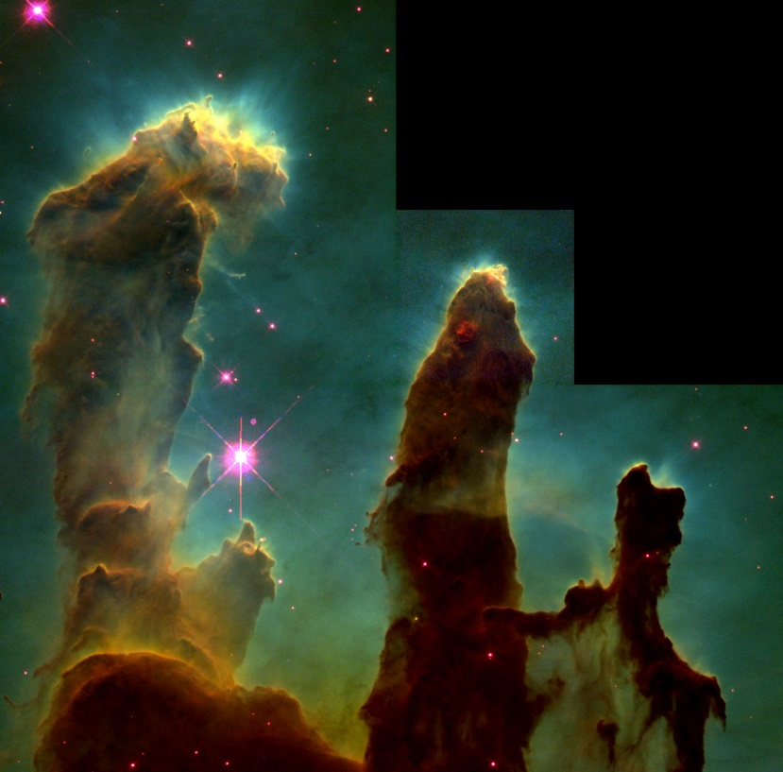
Hubble Telescope
First launched in 1990.
Primary mirror was made incorrectly and had spherical aberration.
Repair mission performed in 1993.
Corrected system now provides some of the most iconic astro-photographs ever captured.

