Slide 1
Computational Photography
OPTI 600C
High Dynamic Range Imaging
Jim Schwiegerling
2014
Note: many stolen slides here.

Slide 2
High Dynamic Range Imaging
Cameras have a limited range of luminance values that they can record.
Displays and prints have a limited range of luminance values they can provide.
Scenes often greatly exceed these ranges, so techniques for capturing and displaying them need to be further developed.
Eye does this naturally.

Slide 3
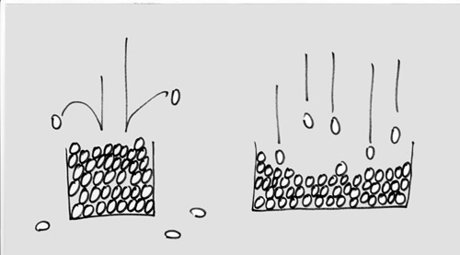
Light in the Bucket
http://www.circleofconfusion.ie/articles/a-brief-look-at-dynamic-range/
Larger pixels will hold more photons. These photons
also need to be accurately counted and noise can
introduce errors.

Slide 4
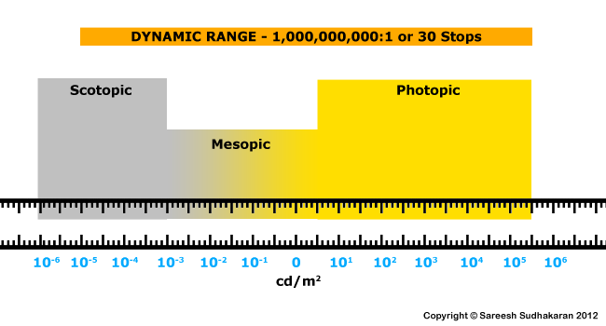
Dynamic Range
JPEG
File conversion affects levels.
JPEG reduces non-linearly
to 256 levels
RAW
12bits = 4096
8bits = 256

Slide 5
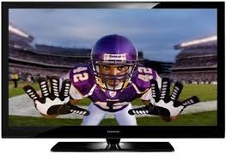
Display Limits
120 cd/m²
0.03 cd/m²

Slide 6
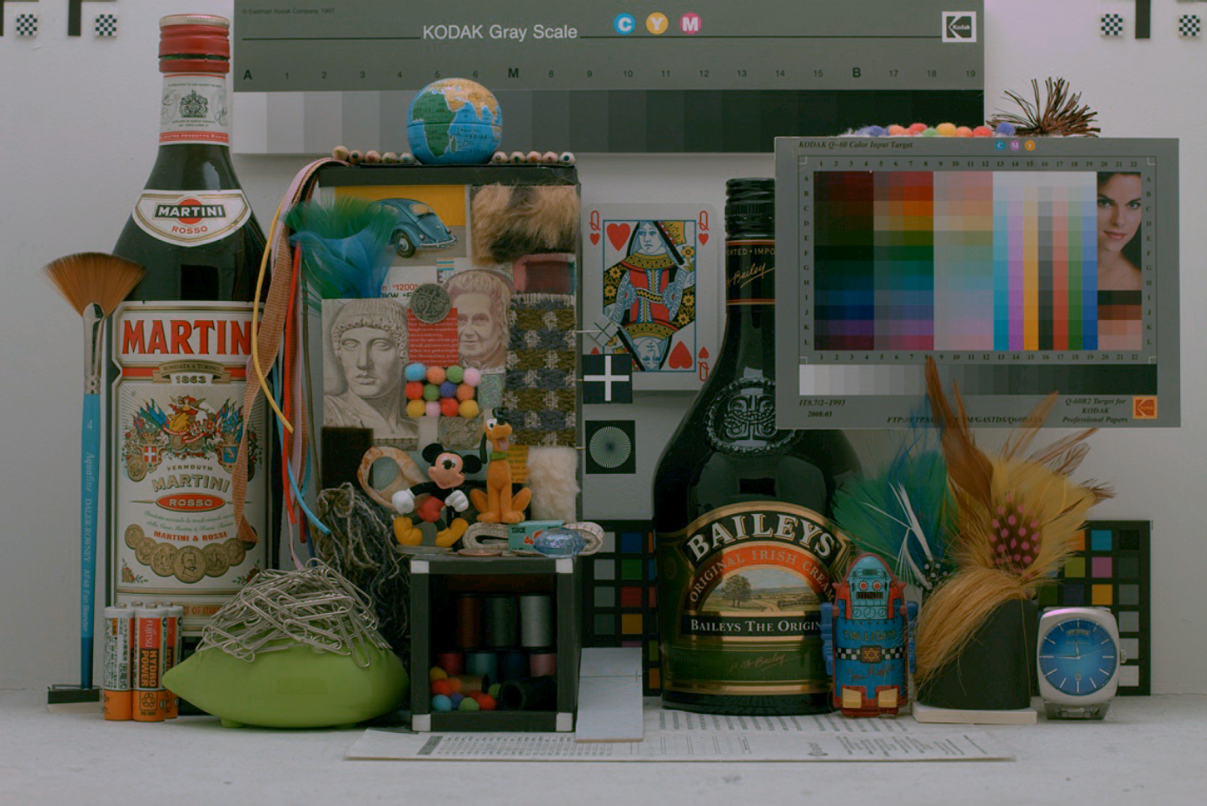
Display Limits
Each channel get 256 possible luminance levels

Slide 7
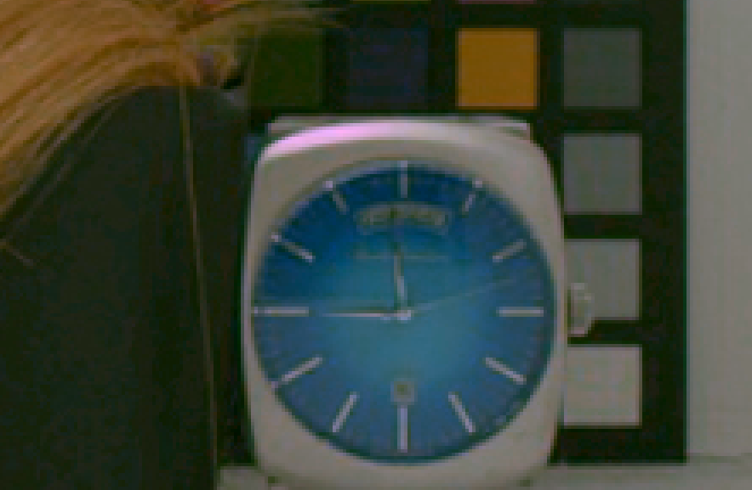
Display Limits
Reflection has high pixel
values compared to rest of
scene.

Slide 8
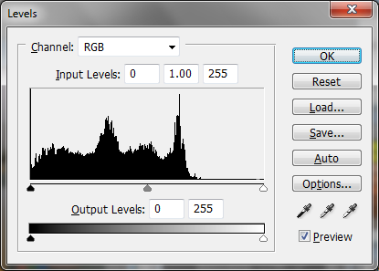
Display Limits

Slide 9
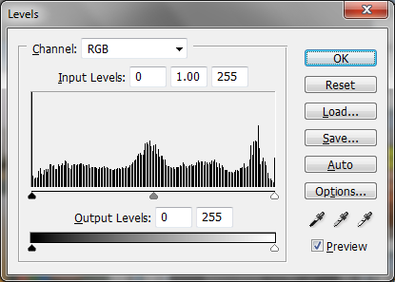
Display Limits

Slide 10
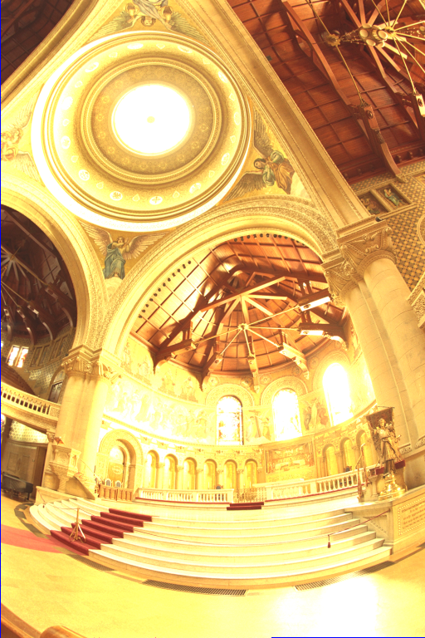
Multiple Exposure Photography
5 Orders of magnitude

Slide 11
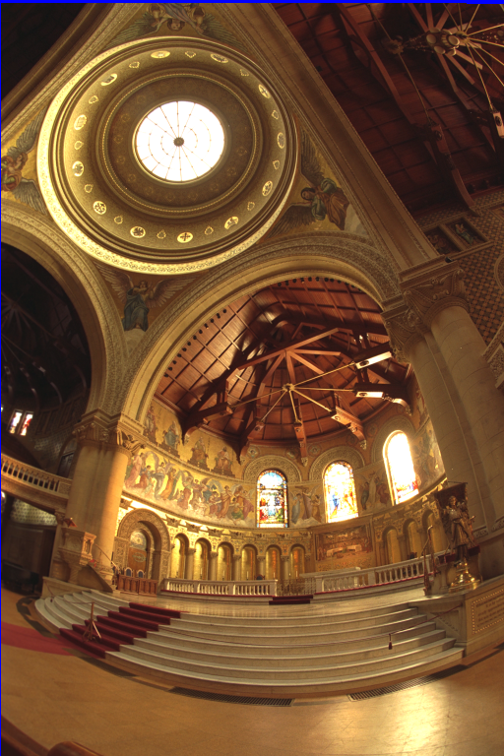
Multiple Exposure Photography
5 Orders of magnitude

Slide 12
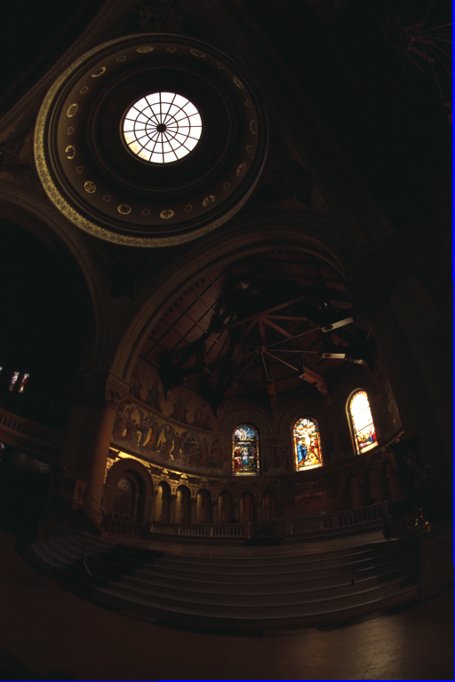
Multiple Exposure Photography
5 Orders of magnitude

Slide 13
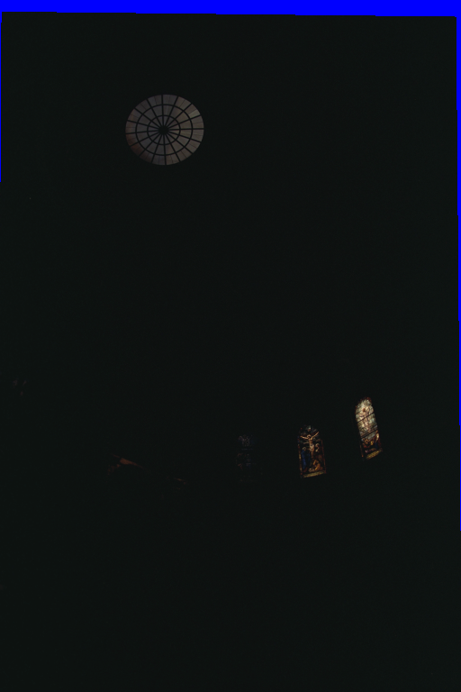
Multiple Exposure Photography
5 Orders of magnitude

Slide 14
Varying Exposure
Shutter speed ranges from ~30 sec to 1/4000th sec which is six orders of magnitude.
Aperture ~F/1.4 to F/22 (2.5 orders of magnitude) Changes depth of focus.
ISO 100 to 3200 (2.5 orders of magnitude) noise becomes issue with higher ISO.
Neutral density filters. good range of possibilities, but need to touch camera to attach.

Slide 15
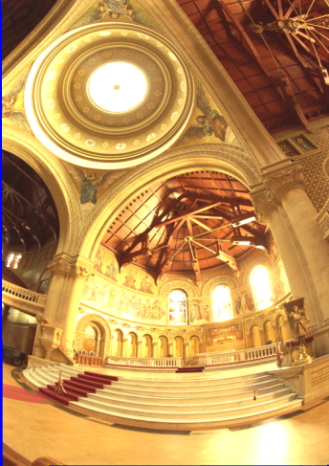
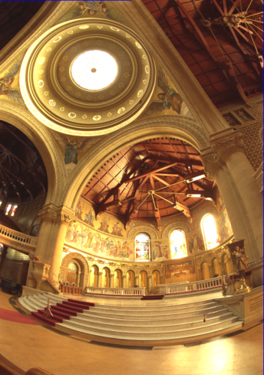

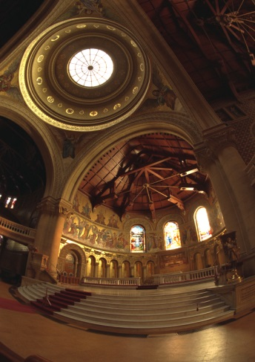
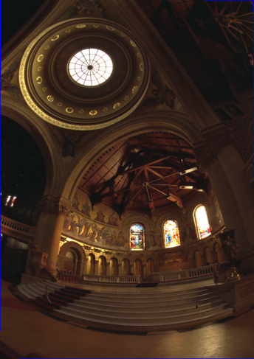
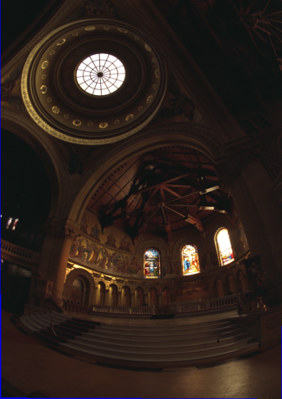

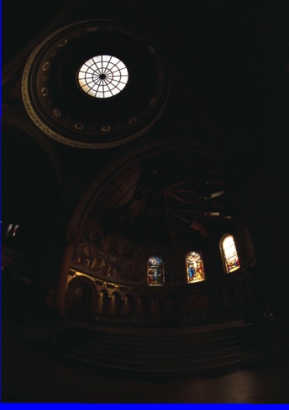
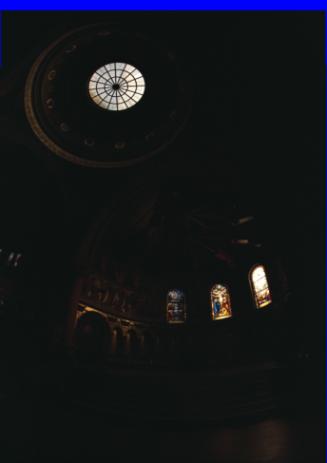
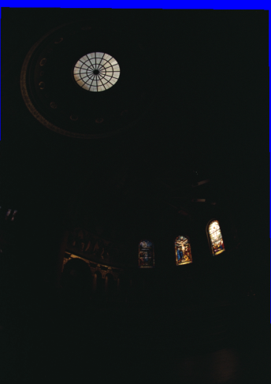
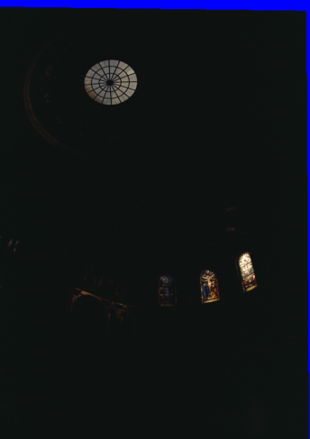
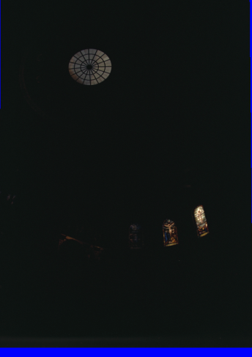
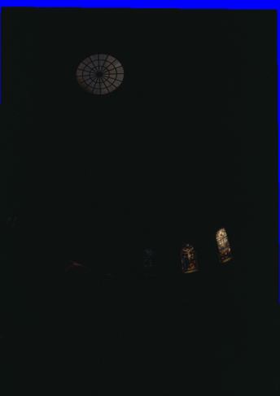
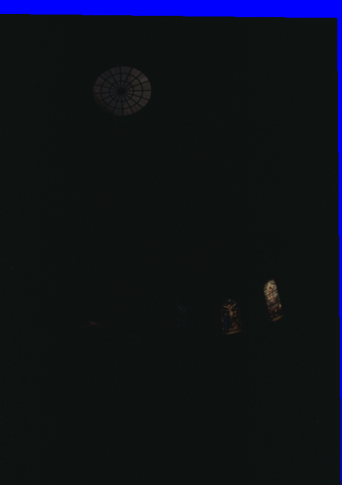
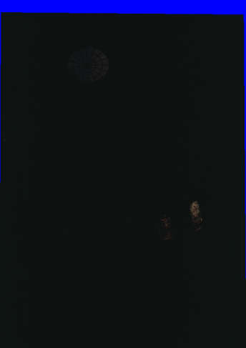

Slide 16
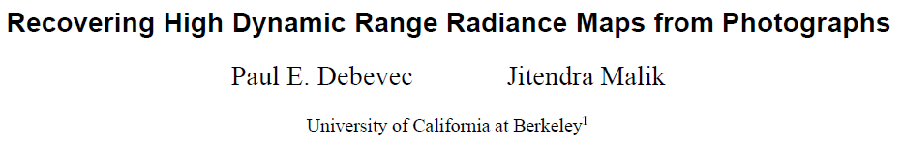
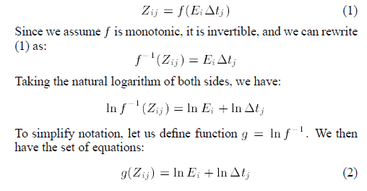
Pixel Value
(Known)
Conversion
Function
Irradiance
on pixel
Exposure Time
(Known)

Slide 17
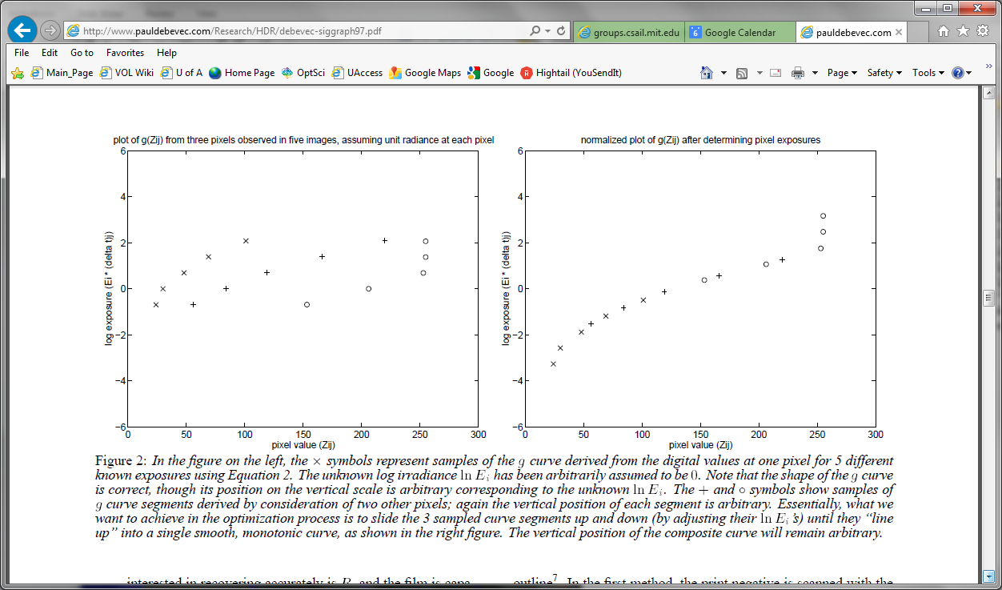
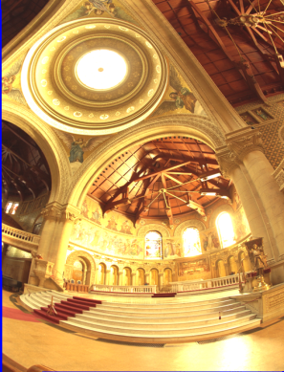


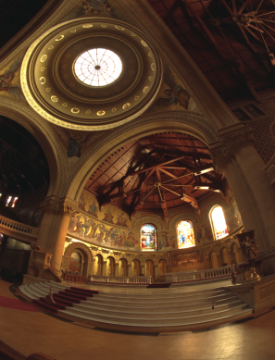

Goal is to figure out Ei to with a scale factor give pixel values,
exposure time and assuming g( ) is smooth and monotonic.
Assume same Ei for each pixel
initially and see how g( ) varies
over multiple images.

Slide 18
Goal is to figure out Ei to with a scale factor give pixel values,
exposure time and assuming g( ) is smooth and monotonic.

Slide 19
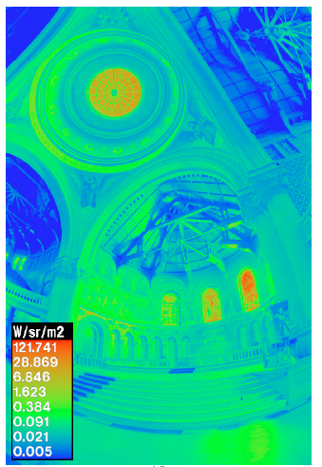
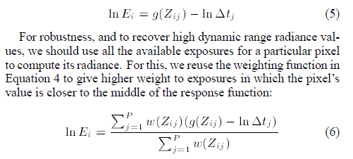
Radiance Map

Slide 20
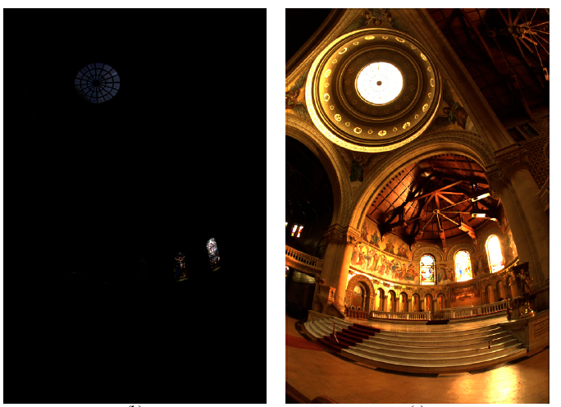
Linear Display

Slide 21
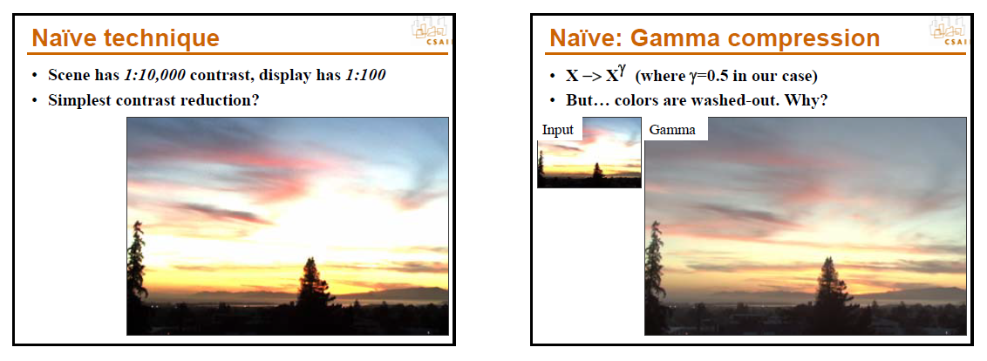
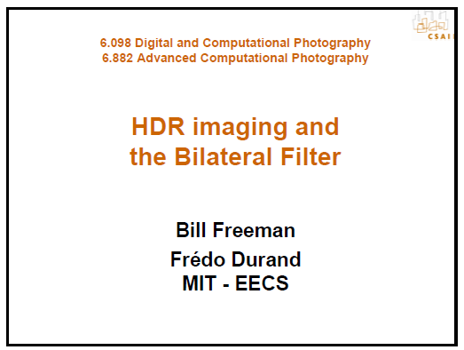
Gamma
From

Slide 22
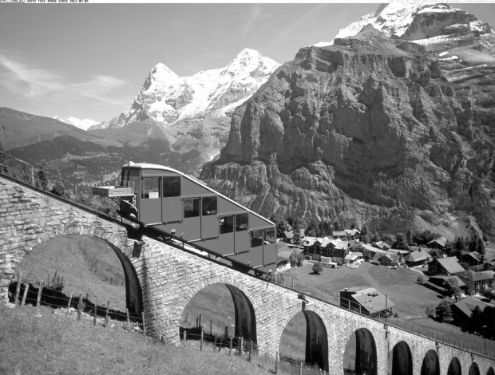
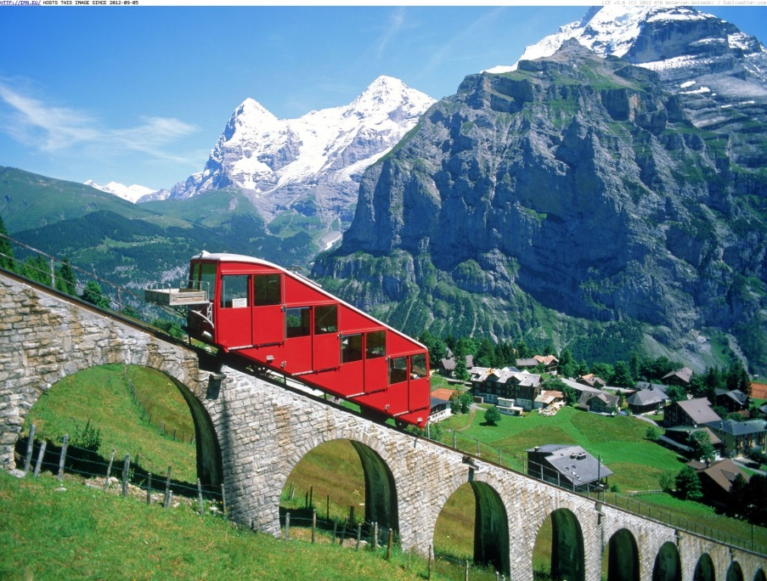
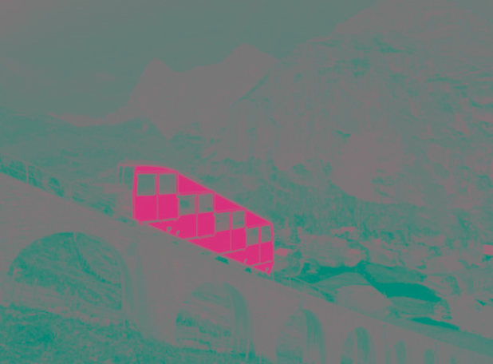
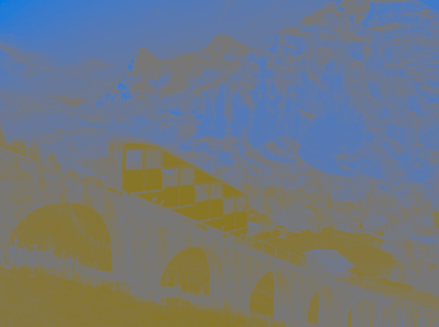
Luminance and Color Channels

Slide 23
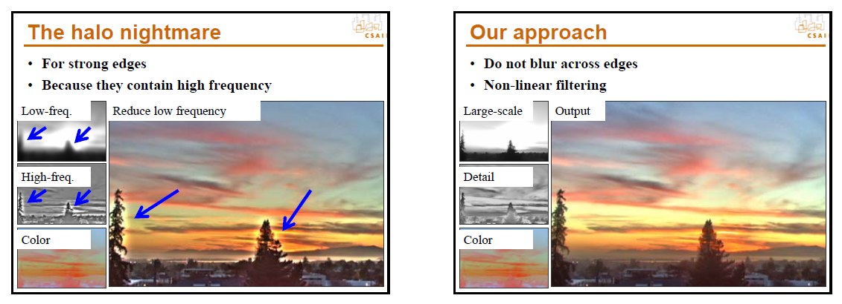
Tone Mapping
From

Slide 24
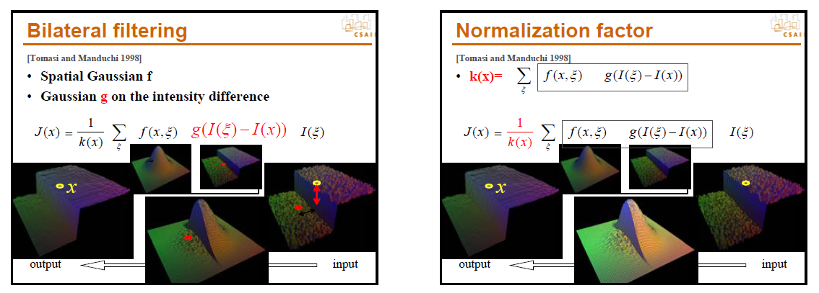
Bilateral Filter
From

Slide 25
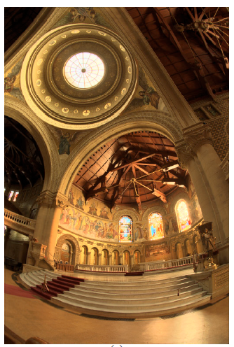
Tone Mapping

