Slide 1
Computational Photography OPTI 600C
Jim Schwiegerling
2014

Slide 2
Computational Photography
Many definitions, many concepts have been performed for years, but just not called computational photography.
Conventional photography captures a 2D projection of a scene and has limited flexibility in adjusting its display (exposure, contrast, color balance).
Computational photography incorporates “current” technologies in lighting, optics, sensors and post-processing to create images beyond what conventional photography can provide.
Digital images make this process easier.

Slide 3
Class Outline
Software for manipulating data such as Matlab (e.g. Octave free alternative).
Images will be provided for various assignments, but if you have access to a DSLR a better variety of images will be available to play with.
Class grade will be based on homework assignments. I am mainly interested in you trying the techniques even if the results aren’t great.
Be creative!

Slide 4
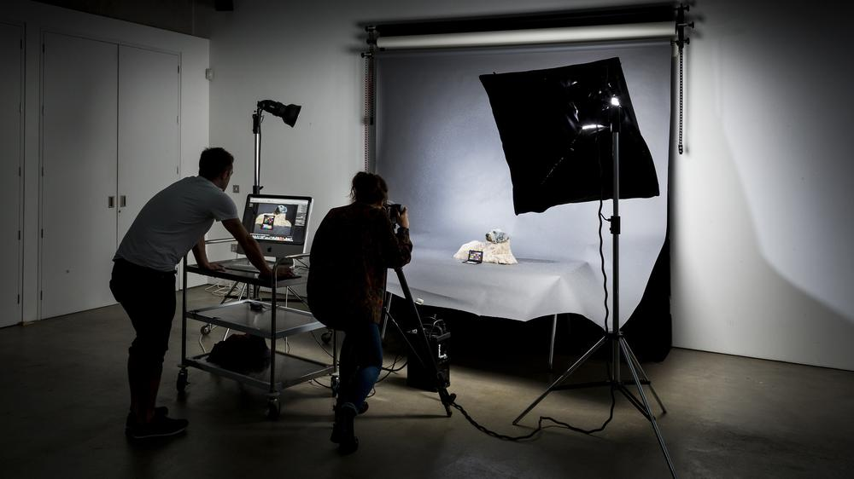
Traditional Photography
http://www.rca.ac.uk/media/images/RCA_10-13_1017.width-1000.jpg

Slide 5
Traditional Photography
Illumination – Sun, lamps, flash, ambient, self-luminous
Subject – spectral reflectance, polarization, 3D
Optics – focal length, aperture setting
Sensor – glass plates, film, CMOS, CCD, 2D
Post-Processing – dodge and burn, Photoshop, image processing.

Slide 6
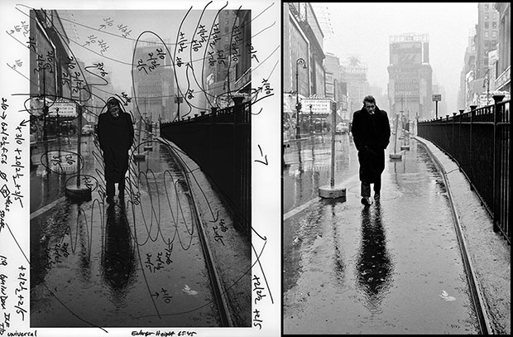
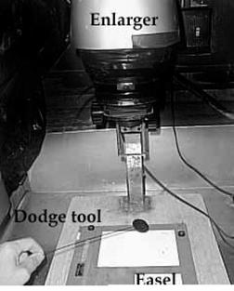
Dodge & Burn
http://petapixel.com/assets/uploads/2013/09/dean.jpg

Slide 7
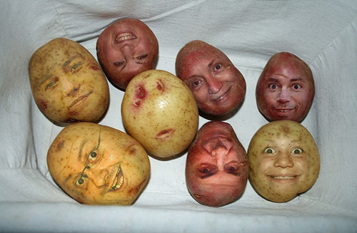
PhotoShop
http://img.xcitefun.net/users/2010/01/143983,xcitefun-photoshopped-images-1.jpg

Slide 8
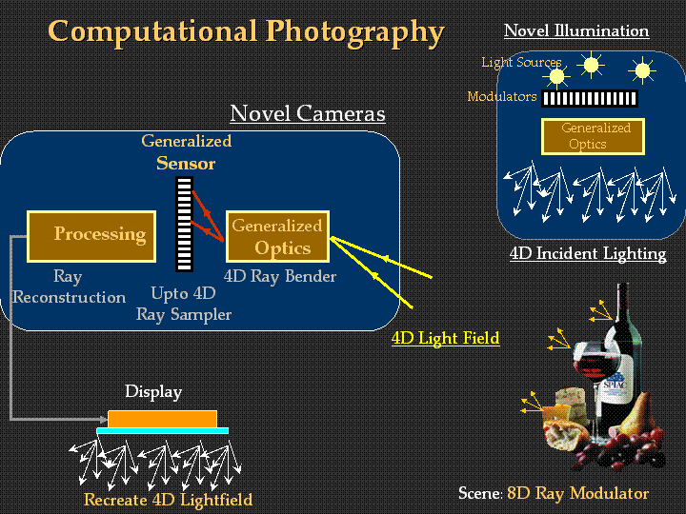
Computational Photography
http://web.media.mit.edu/~raskar/photo/Slides/00IntroRamesh.gif

Slide 9
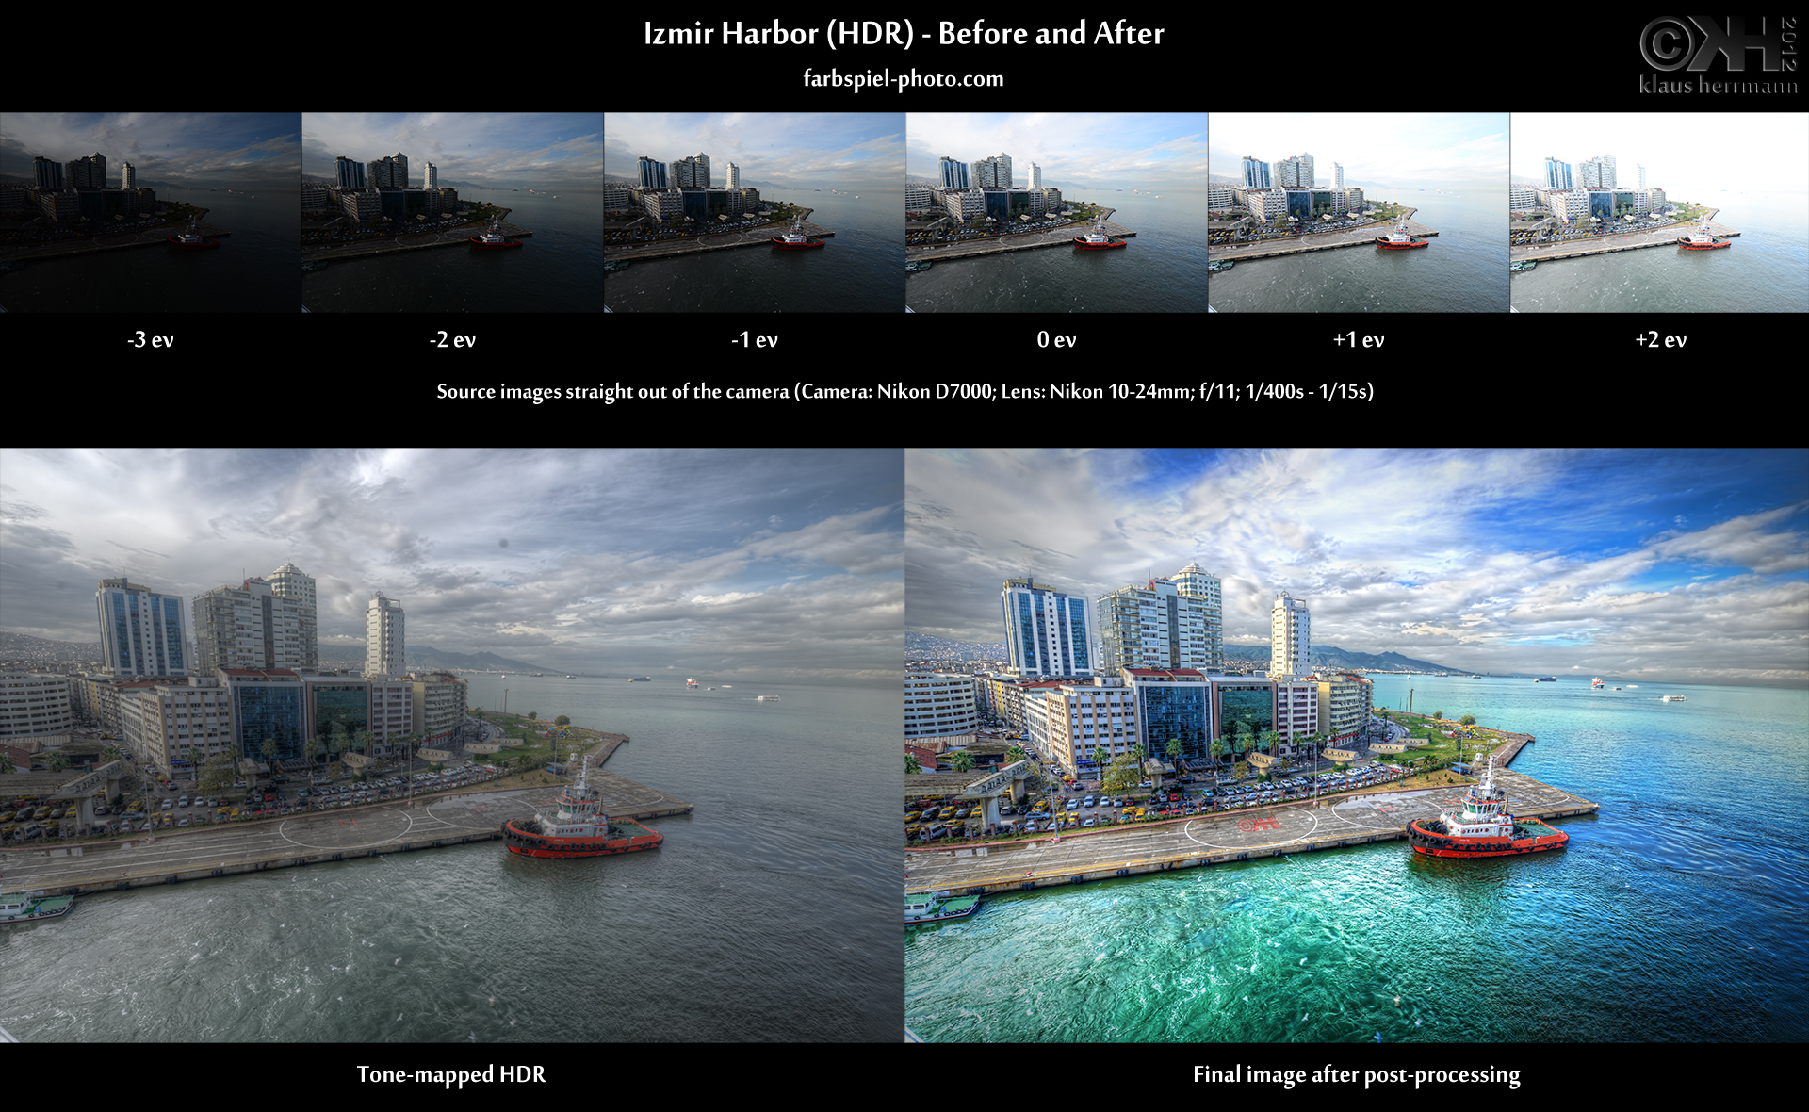
High Dynamic Range

Slide 10
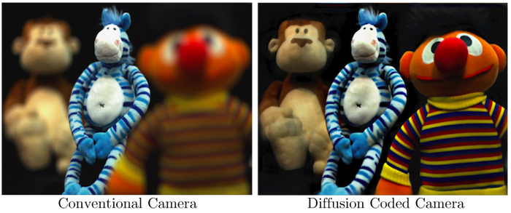
Extended Depth of Focus

Slide 11
Links
http://www.utah3d.net/utah-travel/southern-utah/cedar-breaks.html
https://pictures.lytro.com/

Slide 12
Prokudin-Gorskii Collection
Prokudin-Gorskii made a photographic survey of the Russian empire between 1905 and 1915.
Used special camera to expose three images through red, green and blue filters on long strip of glass.
Images can be combined to create single color image.
Available at www.loc.gov/pictures/collection/prok/

Slide 13
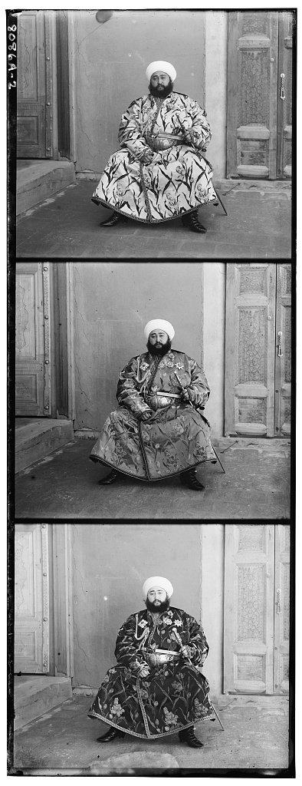
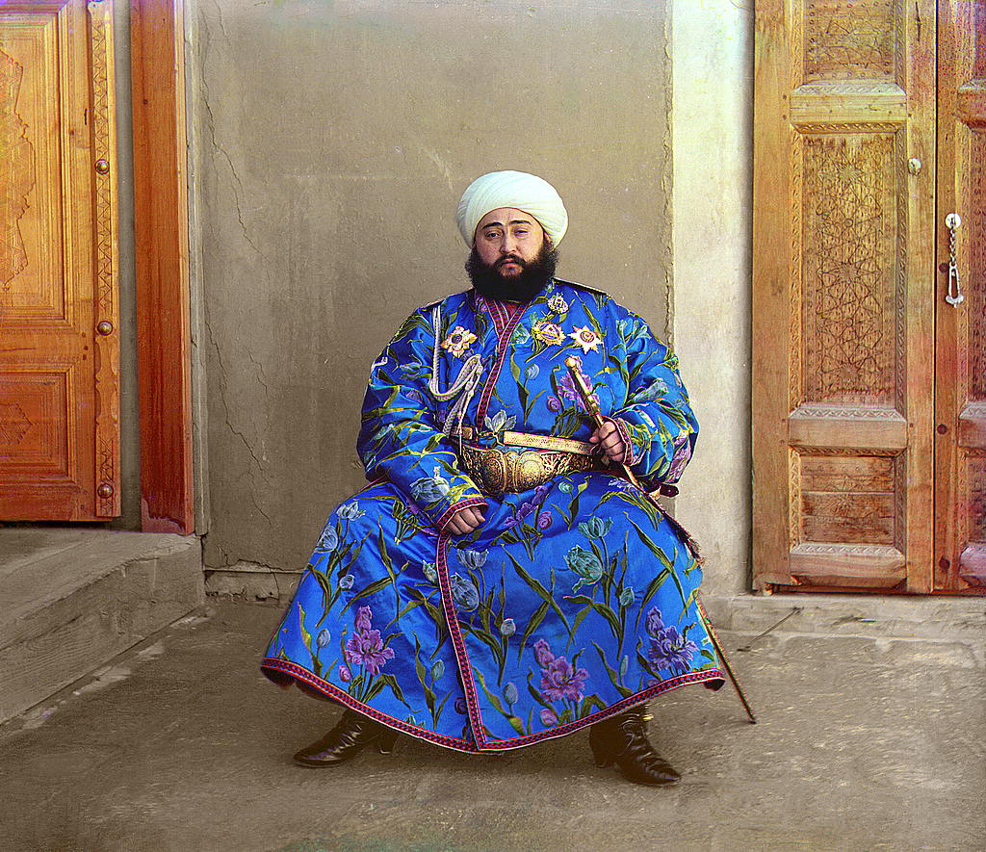
Prokudin-Gorskii Collection

Slide 14
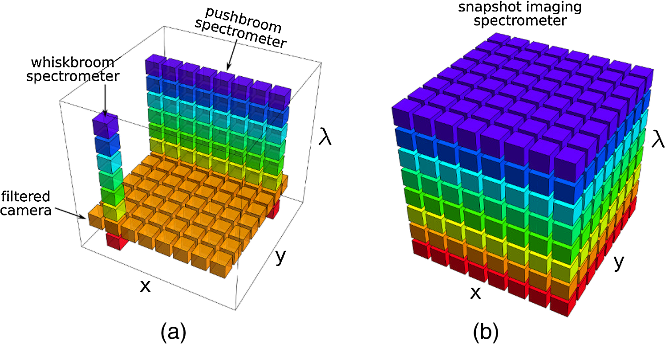
Multispectral Imaging

Slide 15
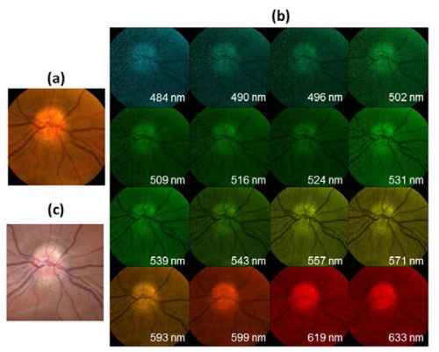
Multispectral Images

Slide 16
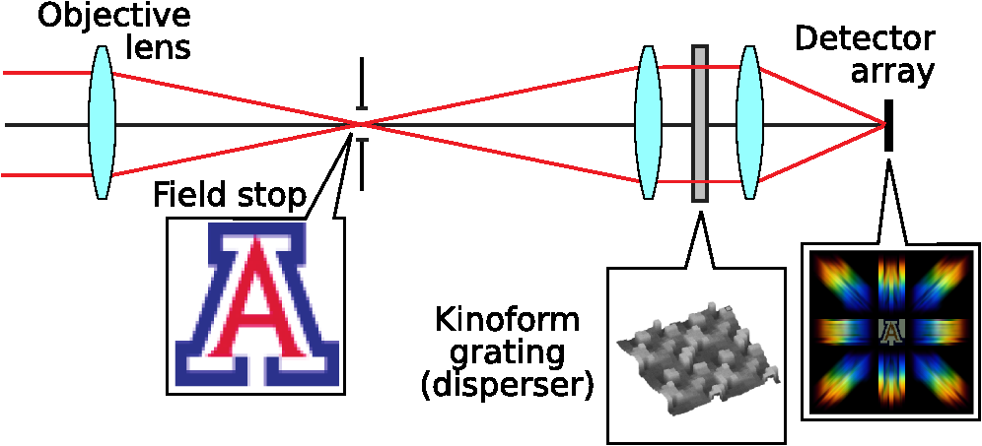
Computed Tomographic Imaging Spectrometer (CTIS)

Slide 17
Color and Color Vision
The perceived color of an object depends on
four factors:
Spectrum of the illumination source
Spectral Reflectance of the object
Spectral response of the photoreceptors
(including bleaching)
4. Interactions between photoreceptors

Slide 18
Light Sources
Spectral
Output
Spectral
Output
Spectral
Output
nm
nm
nm
400
700
400
700
400
700
White
Monochromatic
Colored

Slide 19
Pigments
Spectral
Reflectance
Spectral
Reflectance
Spectral
Reflectance
nm
nm
nm
400
700
400
700
400
700
Red
Green
Blue

Slide 20
Subtractive Colors
Pigments (e.g. paints and inks) absorb different portions of the spectrum
Spectral
Output
Spectral
Output
Spectral
Output
Multiply the spectrum of the light source by the spectral reflectivity
of the object to find
the distribution entering the eye.
nm
nm
nm
400
700
400
700
400
700
nm
nm
nm
400
700
400
700
400
700

Slide 21
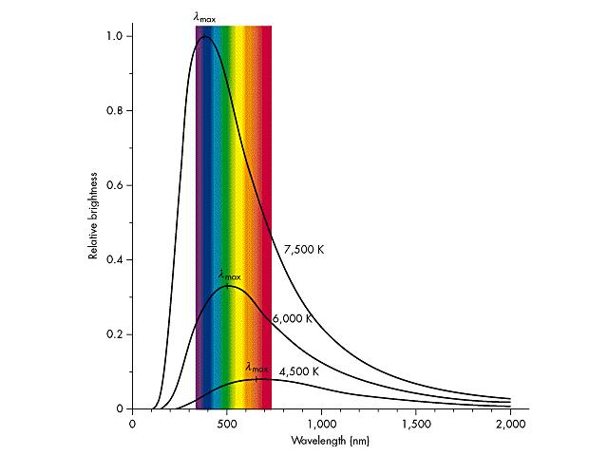
Blackbody Radiation
For lower temperatures,
blackbodies appear red.
As they heat up, the
shift through the spectrum
towards blue.
Our sun looks like a
6500K blackbody.
Incandescent lights are poor
efficiency blackbodies
radiators.

Slide 22
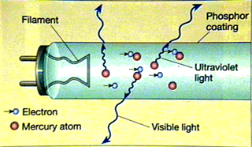
Gas-Discharge & Fluorescent Lamps
A low pressure gas or vapor is
encased in a glass tube. Electrical
connections are made at the ends of
the tube. Electrical discharge excites
the atoms and they emit in a series
of spectral lines. We can use
individual lines for illumination
(e.g. sodium vapor) or ultraviolet
lines to stimulate phosphors.

Slide 23
CIE Standard Illuminants
Illuminant A - Tungsten lamp looking like a blackbody of 2856 K
Illuminant B - (discontinued) Noon sunlight.
Illuminant C - (discontinued) Noon sunlight.
Illuminant D55 - (Occasionally used) 5500 K blackbody
Illuminant D65 - 6500 K blackbody, looks like average sunlight and
replaces Illuminants B and C.
Illuminant D75 - (Occasionally used) 7500 K blackbody

Slide 24
Illuminants A and D₆₅

Slide 25
Additive Colors
Self-luminous Sources (e.g. lamps and CRT phosphors) emit different
spectrums which combine to give a single apparent source.
Spectral
Output
Spectral
Output
Spectral
Output
Add the spectrums of the different light sources to get the spectrum of the apparent source
entering the eye.
nm
nm
nm
400
700
400
700
400
700

Slide 26
Color Models
Attempt to put all visible colors in a ordered system.
Mathematics based, art based and perceptually based systems.

Slide 27
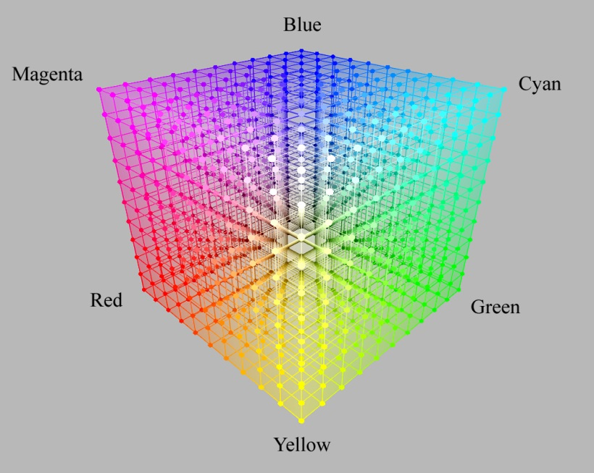
RGB Color Model
A red, green and blue primary are mixed in different proportions
to give a color
(1,0,0) is red
(0,1,0) is green
(0,0,1) is blue
24 bit color on computer monitors devote 8 bits (256 values) to each
primary color (i.e. red can take on values (0…255) / 255)
(1,1,1) is white
(0,0,0) is black

Slide 28
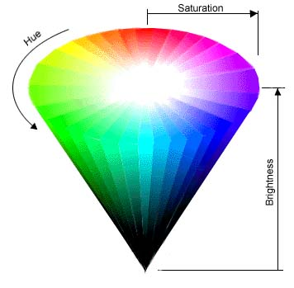
HSB (HSV) Color Model
Hue – color is represented by angle
Saturation – amount of white represented
by radial position
Brightness (Value) – intensity is represented
by the vertical dimension

Slide 29
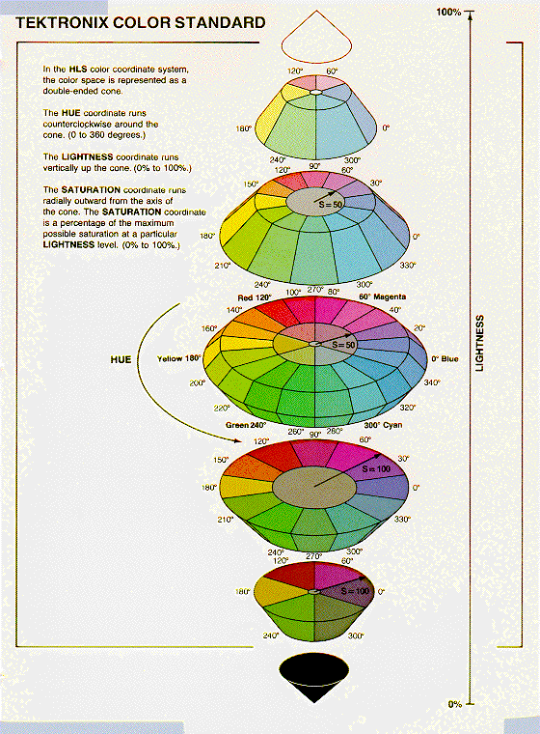
HLS Color Model
Hue – color is represented by angle
Lightness – intensity is represented
by the vertical dimension
Saturation – amount of white represented
by radial position

Slide 30
Commission internationale de l'Eclairage, CIE
90 year old commission on color
Recognized as the standards body for illumination & color.
Has defined standard illuminants and human response curves.

Slide 31
Luminosity Functions
The spectral responses of the eye are called the luminosity functions. The
The V(λ) curve (photpic response) is for cone vision and the V’(λ) curve
(scoptopic response) is for rod vision. V(λ) was adopted as a standard by
the CIE in 1924. There are some errors for λ<500 nm, that remain. The
V’(λ) curve was adopted in 1951 and assumes an observer younger than
30 years old.
V(λ)
V’(λ)

Slide 32
Human Color Models
Observer adjusts the Luminances of R, G and B
lights until they match C_{λ}
R
G
B
R = 700.0 nm
G = 546.1 nm
B = 435.8 nm
C_{λ} = r’(λ)R + g’(λ)G + b’(λ)B
C_{λ}

Slide 33
1931 CIE Color Matching Functions

Slide 34
Color Matching Functions
What does a negative value of the Color
Matching Function mean? Bring one light to the other side of the field. Observer now adjusts, for example, the Luminances of G and B lights until they match C_{λ} + R
G
B
R = 700.0 nm
G = 546.1 nm
B = 435.8 nm
R
C_{λ} + r’(λ)R = g’(λ)G + b’(λ)B
C_{λ}

Slide 35
1931 CIE Color Matching Functions
The CIE defined three
theoretical primaries
x’, y’ and z’ such that
the color matching
functions are everywhere
positive and the “green”
matching function is the
same as the photopic
response of the eye.

Slide 36
Conversion x’y’z’ to r’g’b’
The x’, y’, z’ are more convenient from a book-keeping standpoint
and the relative luminance is easy to determine since it is related to y’.
The consequence of this conversion is that the spectral distribution of
the corresponding primaries now have negative values. This means
they are a purely theoretical source and can not be made.

Slide 37
Tristimulus Values X, Y, Z
The tristimulus values are coordinates
in a three dimensional color space. They
are obtained by projecting the spectral
distribution of the object of interest P(λ)
onto the color matching functions.

Slide 38
Chromaticity Coordinates x, y, z
The chromaticity coordinates
are used to normalize out the
brightness of the object. This way,
the color and the brightness can be
spearated. The coordinate z is not
independent of x and y, so this is
a two dimensional space.

Slide 39
Chromaticity Coordinates
Light Source
Spectral
Distribution
x
Object Spectral
Reflectance or
Transmittance
Spectral Distribution
of Light entering the
eye.
=
Project onto
x’, y’, z’
Normalize
Calculate
Chromaticity
Coordinates
Calculate Tristimulus
Values X, Y, Z
Plot (x, y)

Slide 40
Example - Spectrally Pure Colors
Suppose P(λ) = δ(λ-λ_{o})
Plotting x vs. y for spectrally pure colors gives the boundary of
color vision

Slide 41
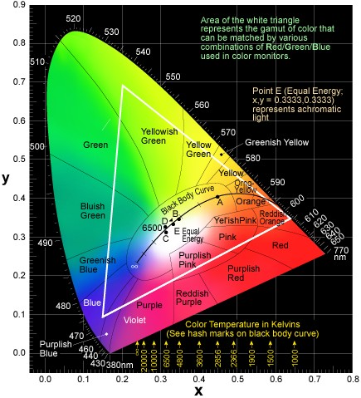
CIE Chromaticity Chart

Slide 42
Example - White Light
Suppose P(λ) = 1

Slide 43
CIE Chromaticity Chart

Slide 44
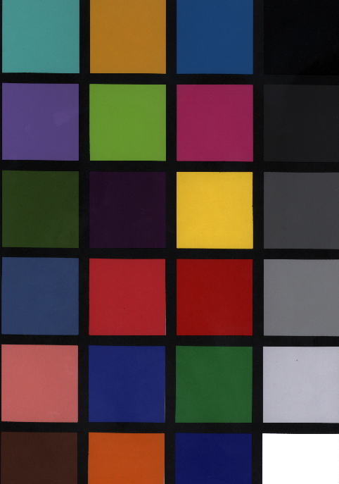
Example - MacBeth Color Checker
Blue Sky

Slide 45
Example - Blue Sky Patch
The Macbeth color
checker assumes that
Illuminant C is used
for illumination.
Multiply the spectral
distribution of Illuminant
C by the spectral
reflectance of the color
patch to get the light
entering the eye.

Slide 46
Example Blue Sky Patch

Slide 47
Example - MacBeth Color Checker
Dark Skin

Slide 48
Example - Dark Skin Patch
Dark skin is much darker
than the blue sky. The
chromaticity coordinates,
however, remove the
luminance factor and only
look at color.

Slide 49
Example Dark Skin

Slide 50
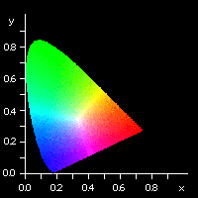
CIE Chromaticity Diagram
Think of this as a distorted
version of the HSB color model.
W = White Point (0.33,0.33)
D = Dominant Wavelength (hue)
D
C
A
B
W
C = Complimentary Color

Slide 51
MacAdam Ellipses
Just noticeable differences for
two similar colors is nonlinear on
the CIE diagram. Would like a
color space that these ellipses
become circles. (ellipses are 3x
larger than actuality)

Slide 52
1976 CIELAB
Plastic, Textile & Paint
L* is related to the lightness and
is nonlinear to account for the
nonlinear response of the visual
system to luminance. The a’s and
b’s distort the CIE diagram to
make the MacAdam ellipses more
round.
X_{n}, Y_{n} and Z_{n} are for white

Slide 53
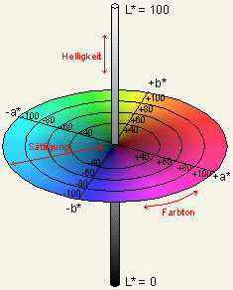
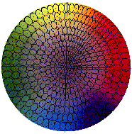
1976 CIELAB
Polar Coordinates
Color Difference

Slide 54
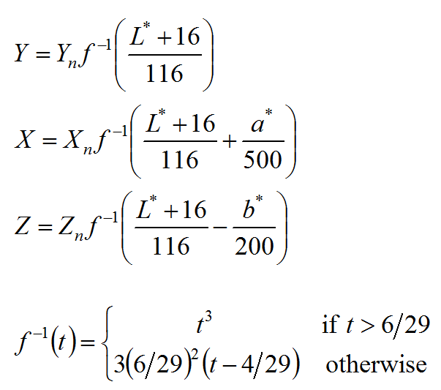
CIELAB to XYZ
Polar to Cartesian
CIELAB to XYZ

Slide 55
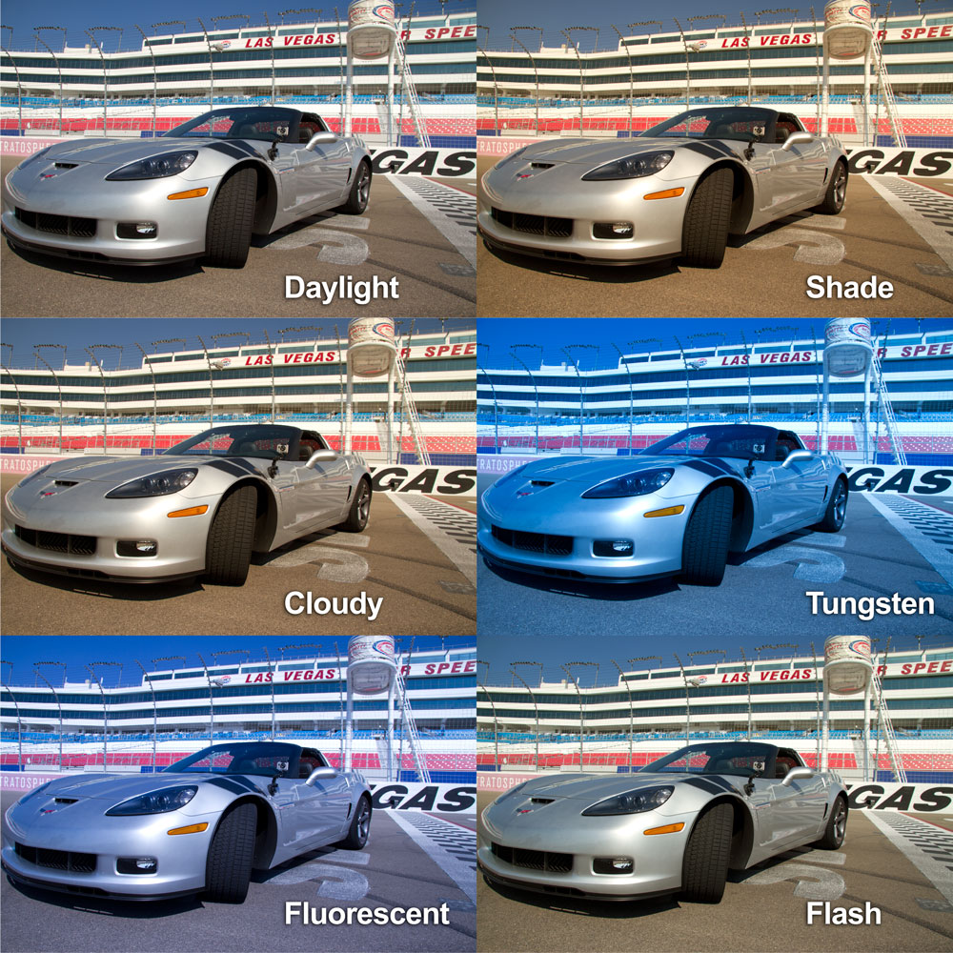
Camera White Balance
Photofocus.com

Slide 56
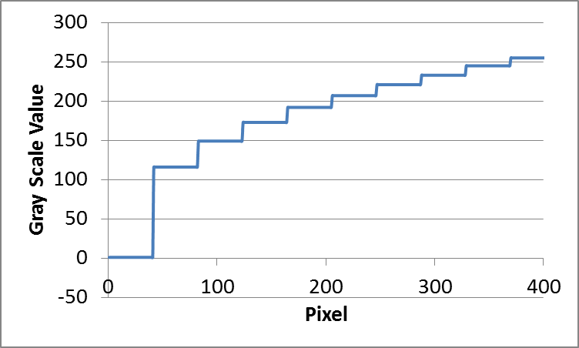
Gamma Correction

Slide 57
sRGB Color Space

Slide 58
sRGB to XYZ Conversion

Slide 59
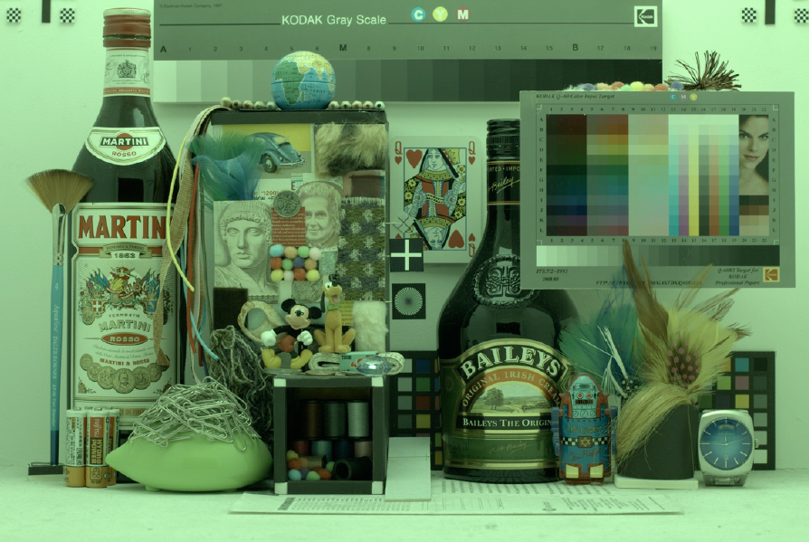
Original Image

Slide 60
White Balanced

Slide 61
Calibrated to sRGB

