Slide 1
Distortion
Jim Schwiegerling PhD
College of Optical Sciences
University of Arizona
Tucson, Arizona

Slide 2
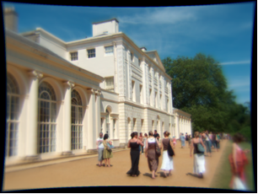
Pincushion Distortion

Slide 3
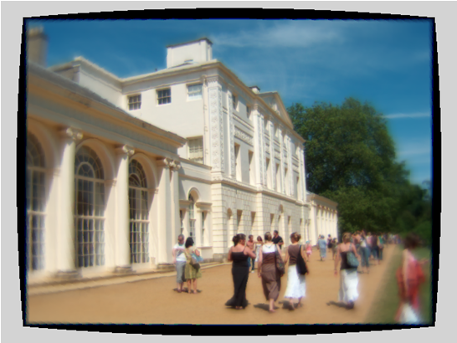
Distortion Correction

Slide 4
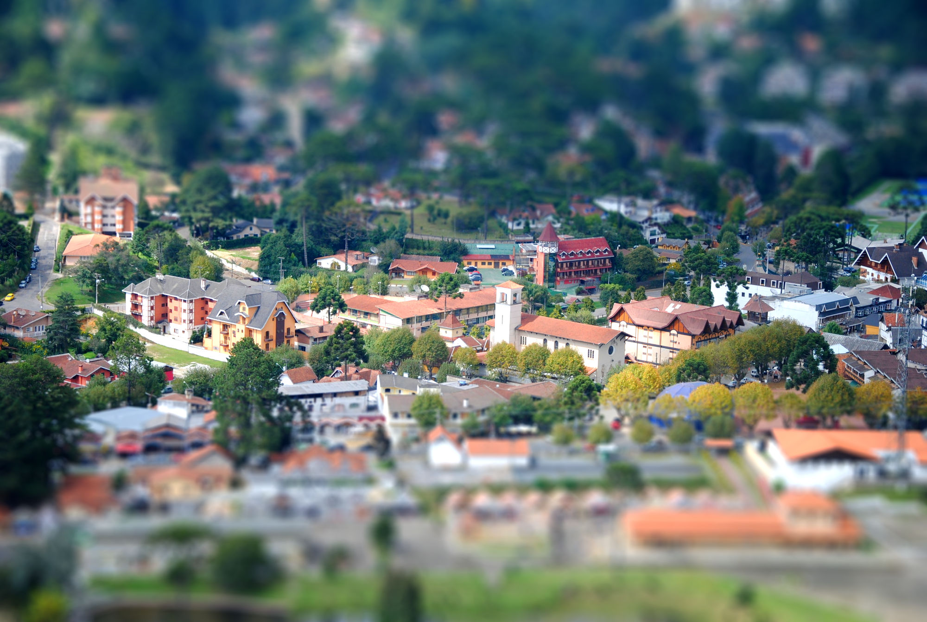
Depth of Field

Slide 5
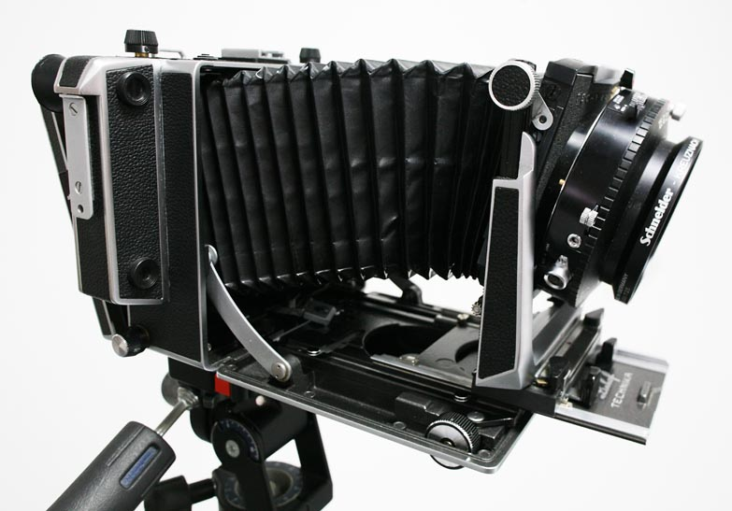
Tilt/Shift System

Slide 6
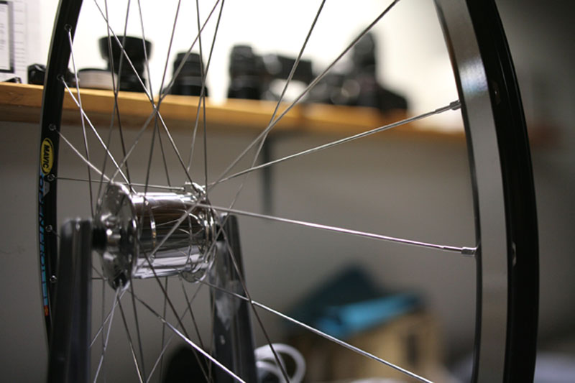
Scheimpflug Imaging
http://users.gsinet.net/pjwhite/tilt-shift.htm

Slide 7
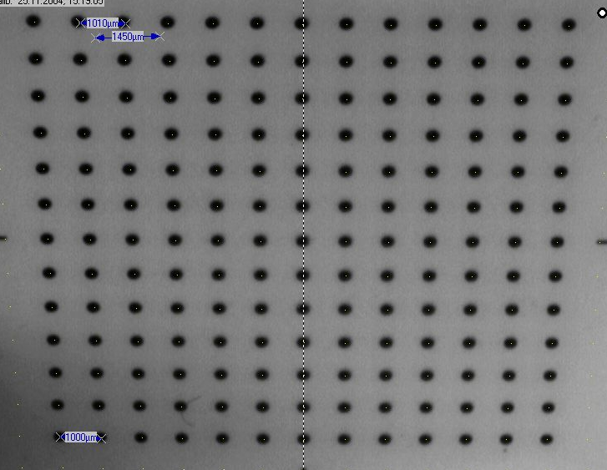
Keystone Distortion

Slide 8
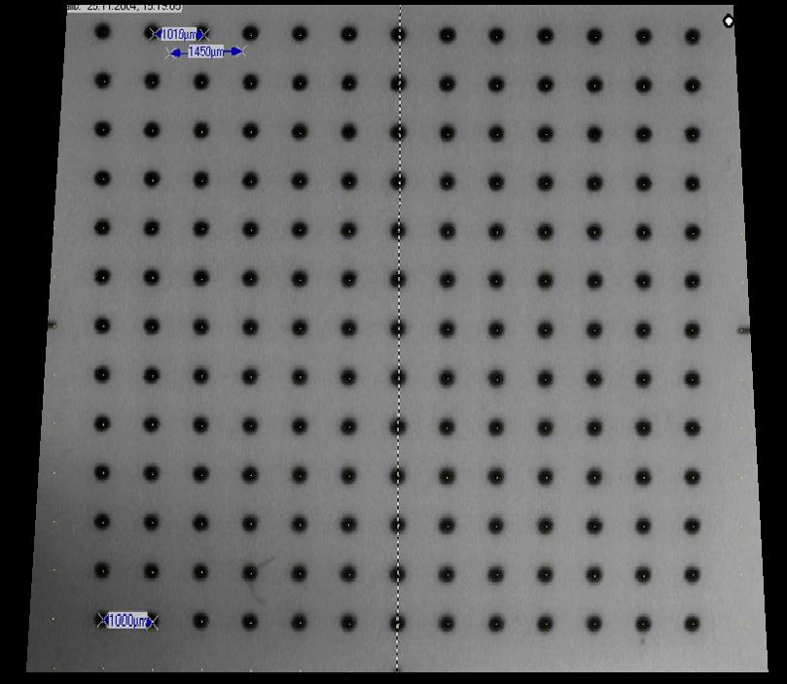
Keystone Correction

Slide 9
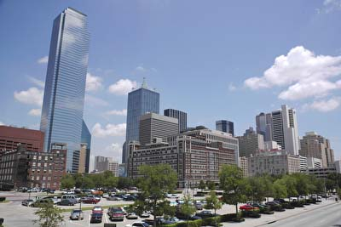
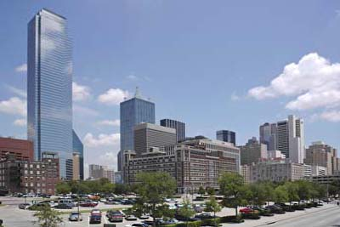
Keystone Correction
www.lonestardigital.com/perspective_correction.htm

Slide 10
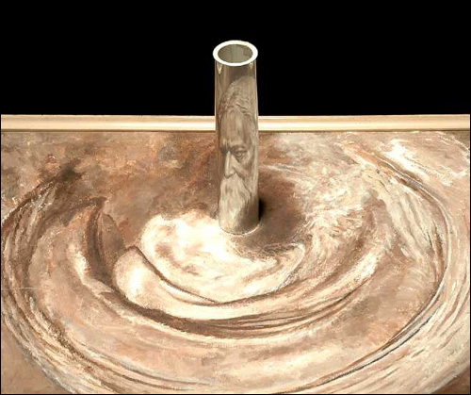
Anamorphoscope

Slide 11
Ray Intersections

