Slide 1
Panoramic Images
Jim Schwiegerling PhD
College of Optical Sciences
University of Arizona
Tucson, Arizona

Slide 2
Panoramic Images
Panoramic Images seek to give an extremely wide field of
View (typically in the horizontal direction).

Slide 3
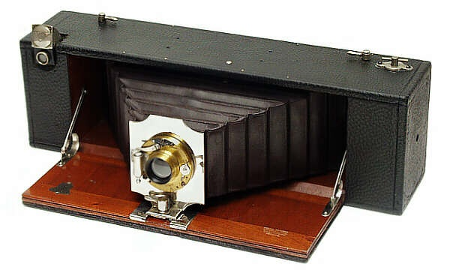
Straight Panoramic Camera
Bell’s straight working panoramic camera uses a wide
angle lens to capture the image.

Slide 4
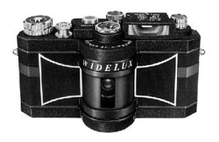
Swiveling Lens
Lens scans during exposure.
Thin slit is swept across
image plane to expose film.
http://www.berk-edu.com/HYB_subsite/pano.html

Slide 5
Image Stitching
Kari Pulli, Nokia

Slide 6
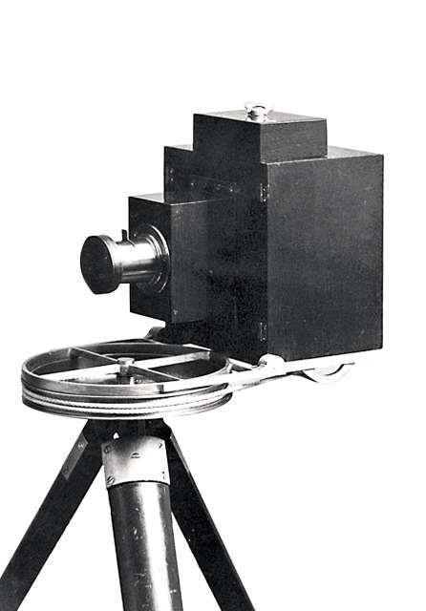
Full Rotation
Can do full 360°, but
need to be careful about
pivot point.
http://betterphotography.in

Slide 7
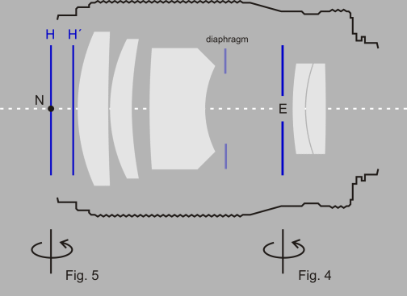
Camera Rotation
http://toothwalker.org/optics/cop.html

Slide 8
Camera Rotation
http://toothwalker.org/optics/cop.html

Slide 9
Camera Rotation
http://toothwalker.org/optics/cop.html

Slide 10
Projection onto Plane
Kari Pulli, Nokia

Slide 11
Perspective Transform
Kari Pulli, Nokia

Slide 12
Perspective Transform
Kari Pulli, Nokia

Slide 13
Perspective Transform
Kari Pulli, Nokia

Slide 14
Cylinder Transform
Kari Pulli, Nokia

Slide 15
Cylinder Transform
Kari Pulli, Nokia

Slide 16
Raw Images

Slide 17
Pure Translational Alignment
Top of arch aligned

Slide 18
Pure Translational Alignment
Misalignment
Top of arch aligned

Slide 19
Pure Translational Alignment
Misalignment
Different Exposures
Top of arch aligned

Slide 20
Patch Matching

Slide 21
Patch Matching

Slide 22
Patch Matching

Slide 23
Patch Matching

Slide 24
Harris Corners
Kari Pulli, Nokia

Slide 25
Harris Corners
Kari Pulli, Nokia

Slide 26
Harris Detector

Slide 27
X and Y Derivatives

Slide 28
Derivatives

Slide 29
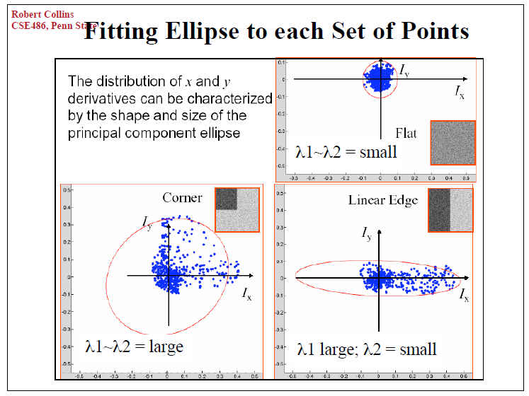
Eigenvalues

Slide 30
Eigenvalues

Slide 31
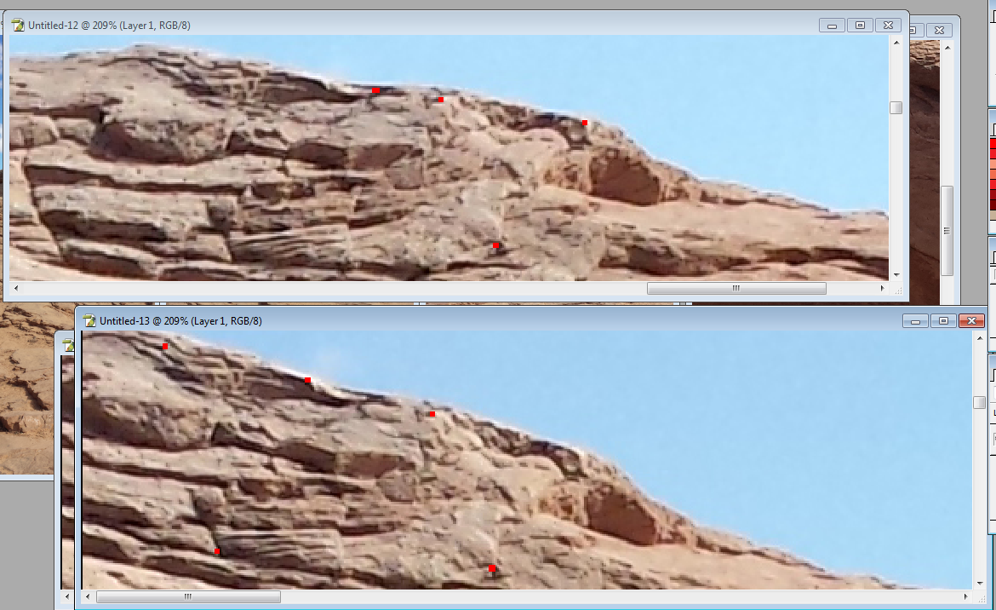
Corresponding Points

Slide 32
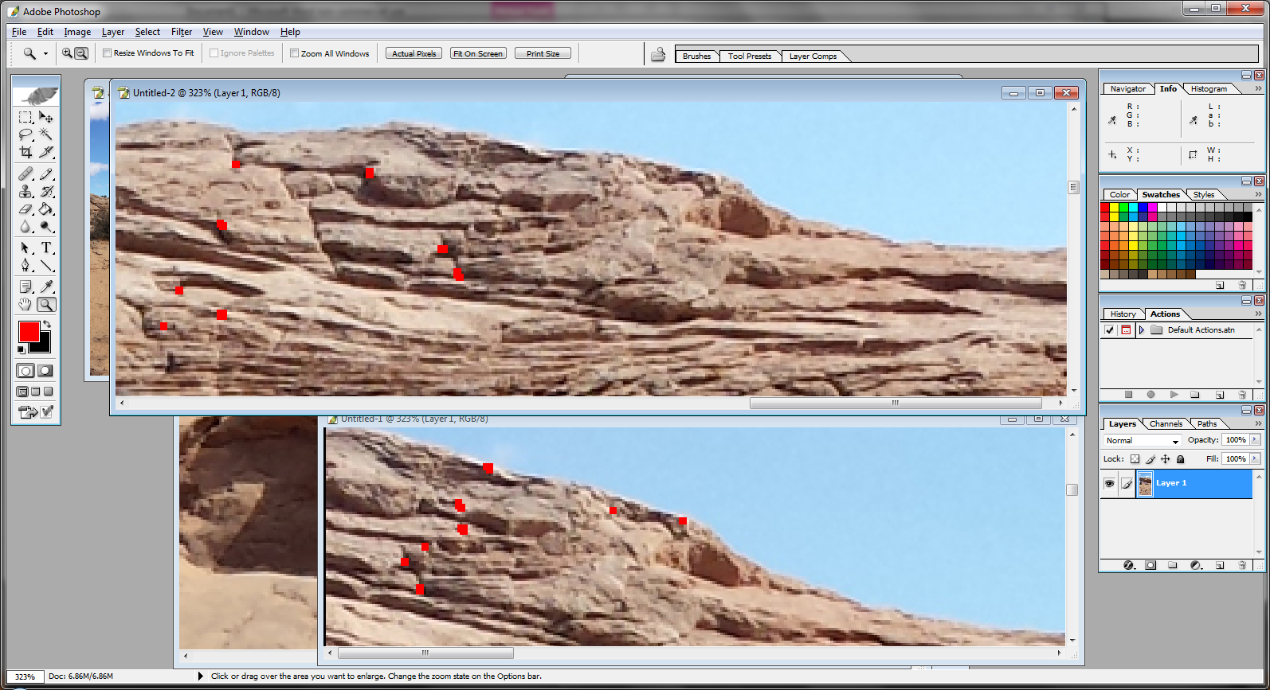
Template Matching

Slide 33
Perspective Transform

Slide 34
Perspective Transform

Slide 35
Translation vs. Perspective
Translation
Perspective

Slide 36
Translation vs. Perspective
Translation
Perspective

Slide 37
Cylindrical Projection

Slide 38
Cylindrical vs. Perspective
Cylindrical
Perspective

Slide 39
Cylindrical vs. Perspective
Cylindrical
Perspective

Slide 40
Cylindrical vs. Perspective
Cylindrical
Perspective

