Slide 1
Calculation of image position, size and orientation using first order properties
OPTI.521 Tutorial
Yuhao Wang

Slide 2
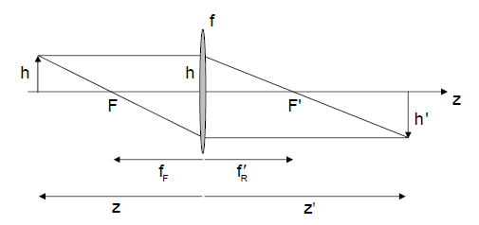
First order properties
Imaging with a thin lens

Slide 3
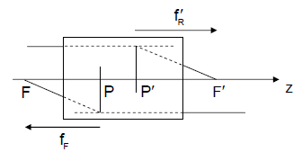
Cardinal points and planes

Slide 4
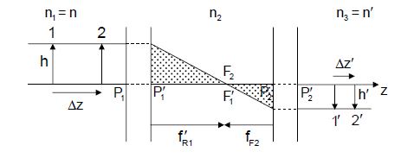
Afocal system

Slide 5
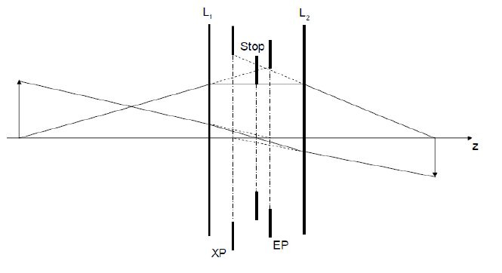
Paraxial Raytracing

Slide 6
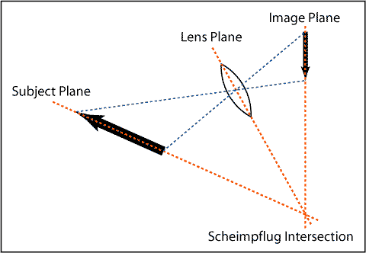
Scheimpflug principle

Slide 7
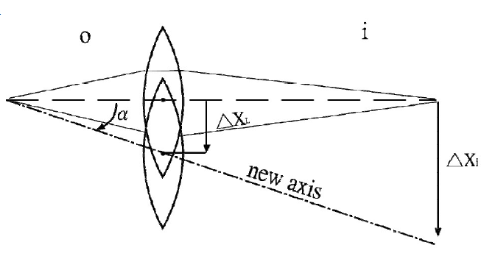
Lens motion
Lateral motion

Slide 8
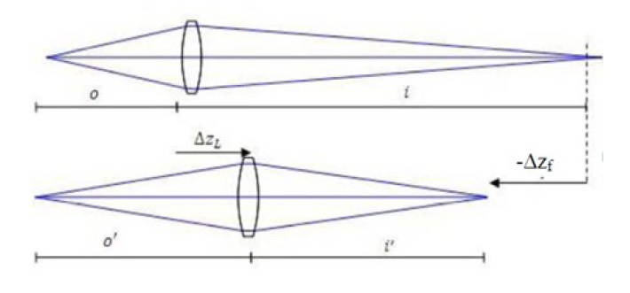
Longitudinal motion

Slide 9
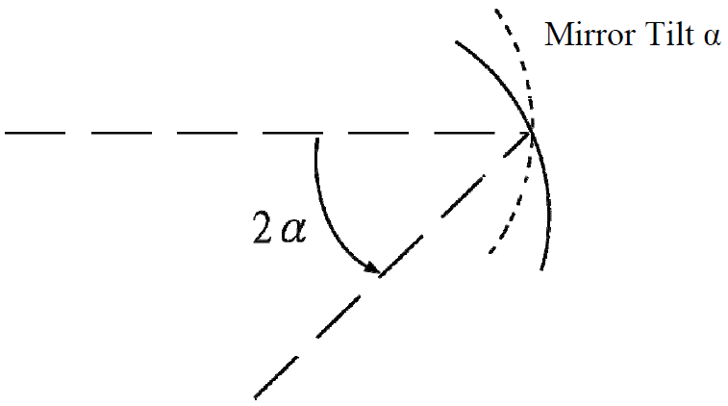
Tilt of optical element
For lens, no significant effect if tilt the lens about its center
For mirror, the image will tilt 2α if you tilt the mirror by α
Lens is sensitive to decenter, mirror is sensitive to tilt.

Slide 10
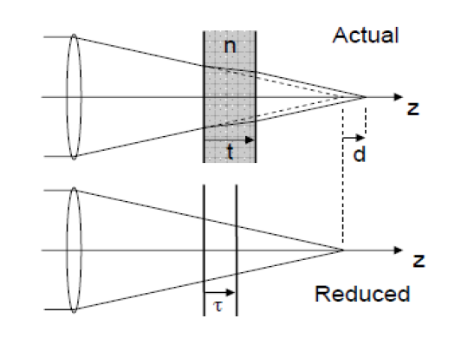
Plane Parallel Plate (PPP)

Slide 11
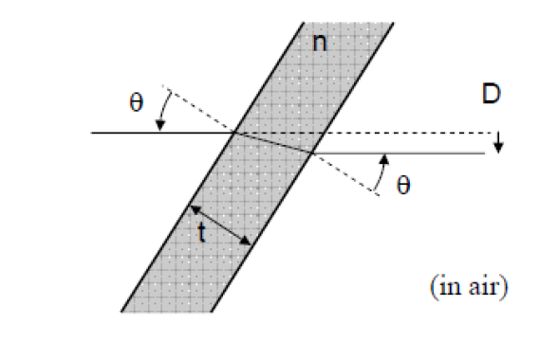

Slide 12
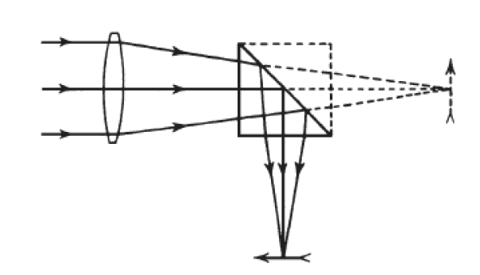
Prisms
Prisms fold the optical path, correct the image parity, and deviate light
Prism systems can be considered systems of plane mirrors.

Slide 13
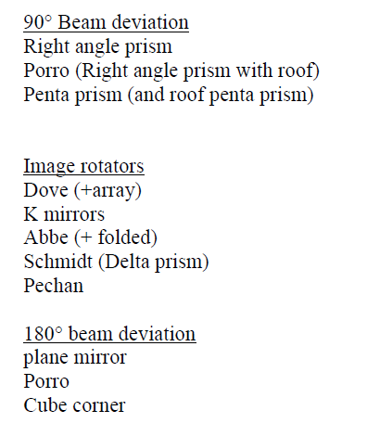
Common prisms classification

Slide 14
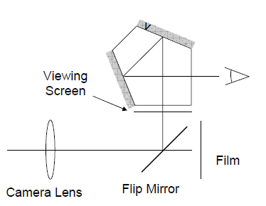
Applications
Reflex prism (3 R) – a pentaprism with an added roof mirror.
Used in single lens reflex (SLR) camera viewfinders to provide an erect image of the proper parity.

Slide 15
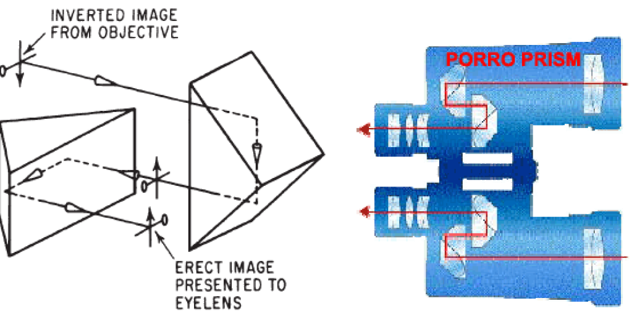
Porror prisms

Slide 16
Conclusion
This tutorial discussed the methods to calculation image location, size and orientation using first order properties. Gaussian properties and paraxial raytrace are used. Especially, image orientation and parities are discussed in multiple prism systems. Also, some miscellaneous topics like Scheimpflug principle, lens motion and effects of plane parallel plate are also discussed.

Slide 17
Reference
[1] John E. Greivenkamp “Field Guide to Geometrical Optics” SPIE
[2] Prof. Jim Burge, class notes and lectures of “Introductory opto-mechanical engineering”, Fall 2010
[3] Prof. John Greivenkamp, class notes and lectures of “Optical Design and Instrumentation I”, Fall 2009
[4] Wikipedia, webpage http://en.wikipedia.org/wiki/Scheimpflug_principle

