Slide 1
Rapid Prototyping Technologies
Wei-Ren Ng
Department of Electrical and Computer Engineering, University of Arizona

Slide 2
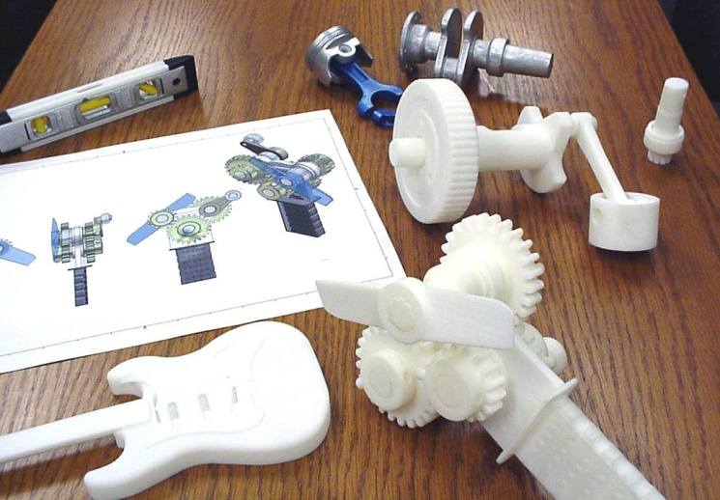
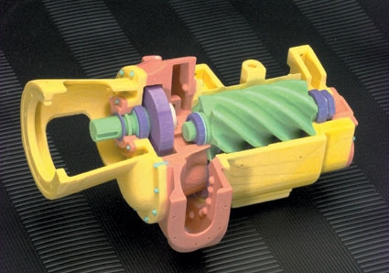
Introduction
Rapid prototyping (RP) is a new manufacturing technique.
  allows for fast fabrication of computer models designed with three-dimension (3D) computer aided design (CAD) software.
RP is used in a wide variety of industries, from shoe to car manufacturers.
Allows for fast realizations of ideas into functioning prototypes, shortening the design time
  Lead towards successful final products

Slide 3
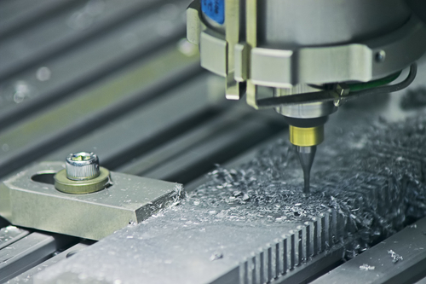
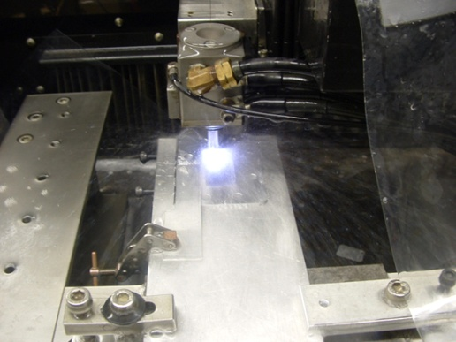
Introduction
Two general types:
  Additive
  Subtractive,
Subtractive type RP or
traditional tooling manufacturing
  a technique in which material is
  removed from a solid piece of
  material until the desired design remains.
  Examples:
    computer numerical control (CNC)
    electric discharge machining (EDM).
Additive type RP is the opposite of subtractive type RP.
  Instead of removing material, material is added layer upon layer to build up the desired design
  Examples:
    fused deposition modeling (FDM)
    selective Laser Sintering (SLS)

Slide 4
Design process

Slide 5
Design Steps
Process:
  Design CAD model
  Export as STL
  2D slices
  printing
Different types of RP technologies, all of them require the 3D CAD model’s Stereolithography file for fabrication.

Slide 6
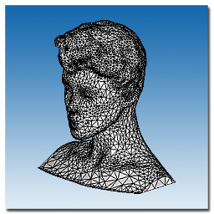
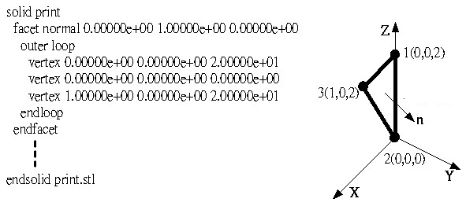
Stereolithography (STL) File Format
Stereolithography or Standard Tessellation Language (STL)
file format.
  only describes the surface geometry of a 3D CAD model.
  No information on the color, texture or material.
  The surface geometry is described with triangular facets.
    Each triangle facets uses a set of Cartesian coordinates to describe its three vertices and the surface normal vector using a right-hand rule for ordering.

Slide 7
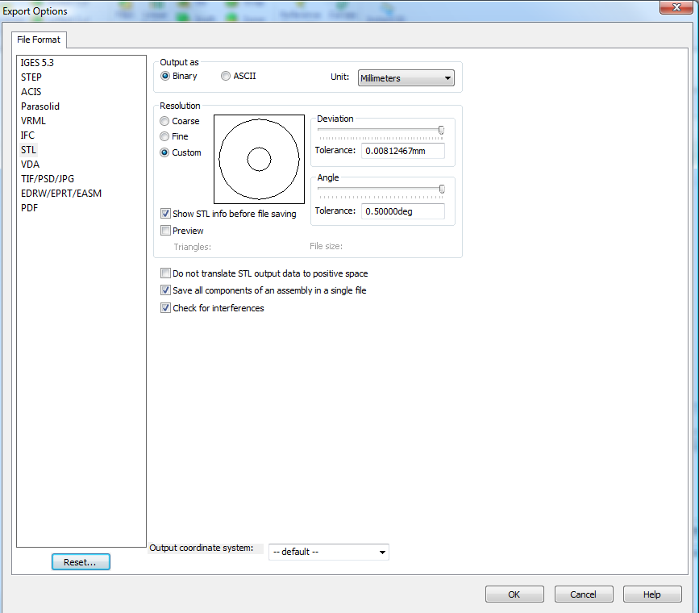
Exporting STL from Solidworks
File →Save as →Change ‘Save as type’ to .STL
Select ‘Options’ for more advance export options.
Can select to export the STL as Binary or ASCII file format in millimeter, centimeter, meter, inches or feet depending on the unit used in the CAD model.

Slide 8
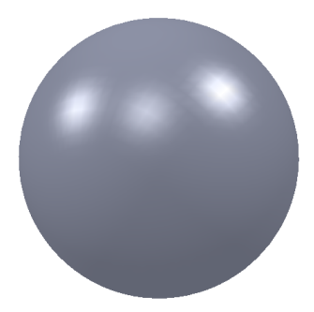
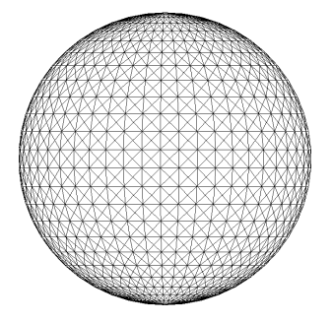
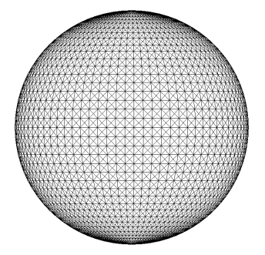
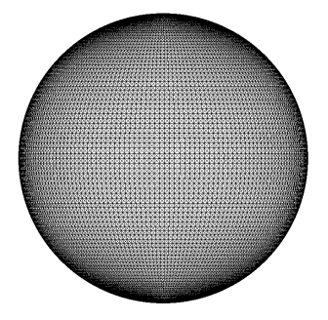
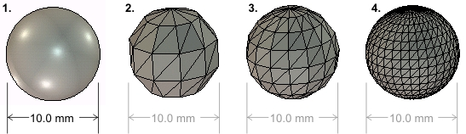
STL File Format Tolerancing
Example of different STL tolerance

Slide 9
Additive rapid prototyping systems

Slide 10
Additive Rapid Prototyping Systems
The different types of additive RP technologies can be categorized into three types:
  Liquid based (SLA and Inkjet based Printing)
  Solid based (FDM)
  Powder based (SLS)
Common components:
  Print tray
  Embedded computer for control systems
  Curing process – UV or laser
  Client computer – convert STL to 2D print slices

Slide 11
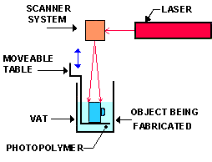
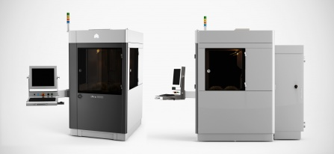
Liquid based Additive Rapid Prototyping
StereoLithography Apparatus (SLA)

Slide 12
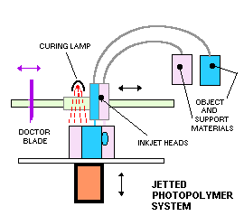
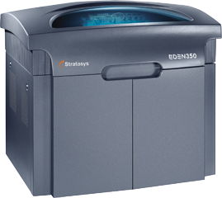
Liquid based Additive Rapid Prototyping
INKJET BASED

Slide 13
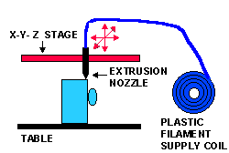
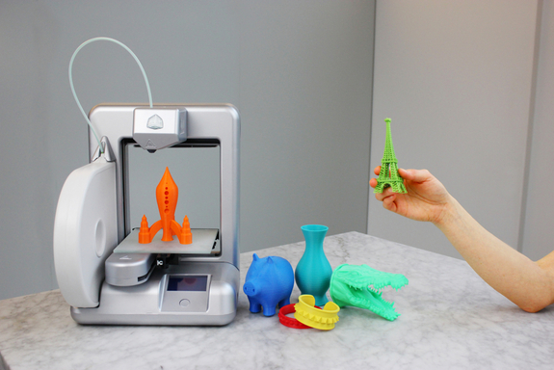
Solid based Additive Rapid Prototyping
Fused Deposition Modeling FDM

Slide 14
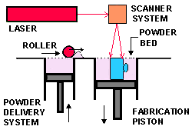
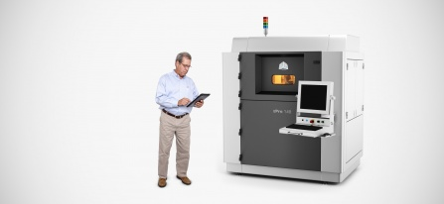
Powder based Additive Rapid Prototyping
  Selective Laser Sintering (SLS)

Slide 15
Comparison
 | Stereolithography Aparatus (SLA) | Inkjet Based | Fused Deposition Modeling (FDM) | Selective Laser Sintering (SLS)
Build tray size (inches) | 20 x 20 x 24 | 12 x 6 x 9 | 24 x 20 x 24 | 27.5 x 15 x 23
System price range | $75K-800K | $46K-80K | $10K-300K | $200K-1M+
Speed | Average | Poor | Poor | Average to good
Accuracy | Very good | Good to very good | Fair | Good
Surface Finish | Very good | Good to very good | Fair | Good to very good
Strengths | Large part size Accuracy | Accuracy Finish | Price Materials | Accuracy Materials
Weaknesses | Post processing Messy liquids | Speed Limited materials Part size | Speed Part size | Size and weight System price Surface finish
Available build material | Acrylics (fair selection) Clear and rigid ABS-like Polypropylene-like (PP) Flexible or elastomeric Water-resistant | Polyester-based plastic Investment casting wax | ABS Polycarbonate (PC) Polyphenylsulfone Elastomer | Nylon, including flame-retardant, glass-, aluminum-, carbon-filled and others providing increased strength and other properties Polystyrene (PS) Elastomeric Steel and stainless steel alloys Bronze alloy Cobalt-chrome alloy Titanium

Slide 16
Optomechanical applications

Slide 17
Optomechanical Applications
3D CAD design considerations:
  RP fabrication tolerances – fitting and alignment
  Optical fine adjustment ability
  Stiffness of material to support heavy optical devices
  Fasteners
  Spacing
  Adhesion

Slide 18
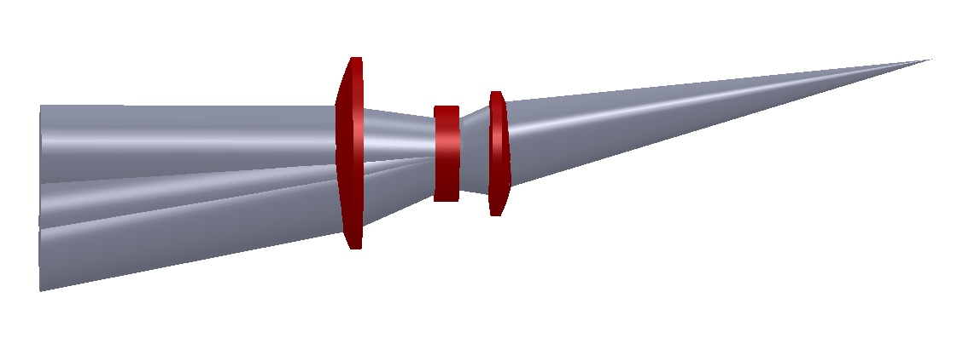
Optomechanical examples
Zemax exported .STP file in Solidworks
Design integrated optomechanical parts around optics

Slide 19
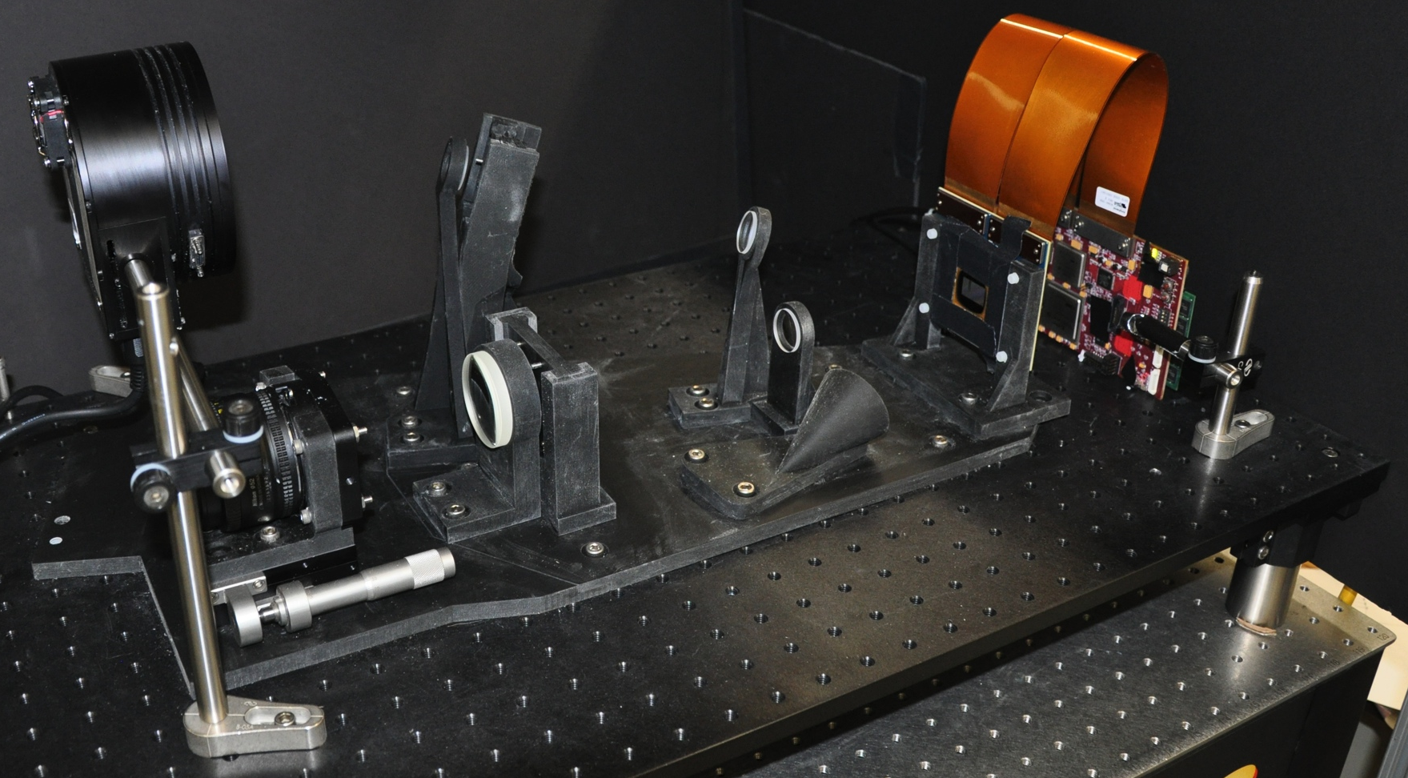
Optomechanical examples
Spectral image classifier

Slide 20
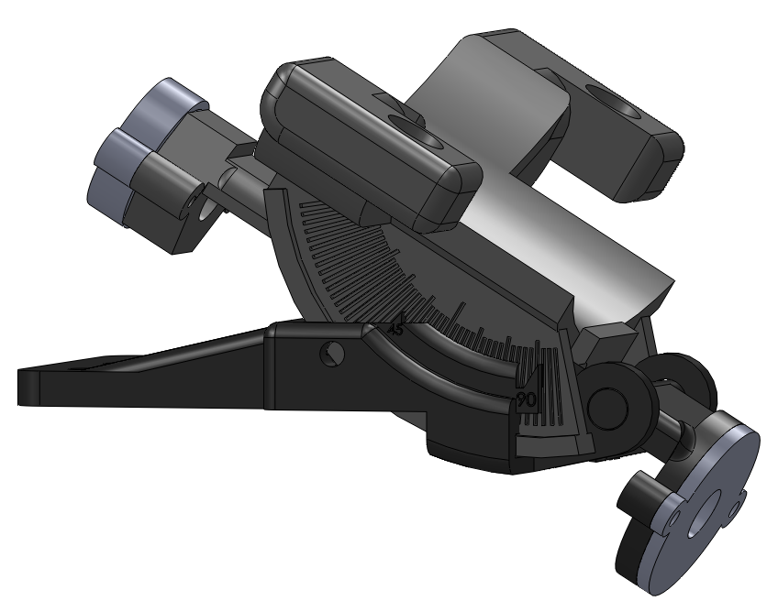
Optomechanical examples
Adjustable camera mount

Slide 21
Conclusion
Advantages:
  Fast and inexpensive method of prototyping design ideas
  Allows for an integrated optomechanical design
  Multiple design iterations to finalize design
  Physical validation of design
Disadvantages:
  Resolution not as fine as traditional machining (millimeter to sub-millimeter resolution)
  Surface flatness is rough (dependant of material and type of RP)

