Slide 1
Tracking integration in concentrating photovoltaic using laterally moving optics
Hongzhang Ma
Dec. 12. 2013

Slide 2
Contents
1. Tracking-integrated concentrating photovoltaics
1.1 Concentrating photovoltaics (CPV)
1.2 Tracking-integrated CPV
2. Analysis of the Tracking-integrated CPV
2.1 One relative movement between the optics and the receiver
2.2 Two moving optics arrays and a solar cell array
3. Mounting issue and other existing tracking module
4. Conclusion

Slide 3
1.1 Concentrating photovoltaics
Concentrating photovoltaic (CPV) systems employs optics to concentrate direct sunlight onto solar cells.
lower cost
high conversion efficiency

Slide 4
Classification of the CPV systems
Concentration ratio: The ratio of input and output aperture areas
classification | Concentration ratio (point) | Solar cell | Tracker
Highconcentrating photovoltaics (HCPV) | 400× | multi-junction solar cells | accurate dual-axis tracking
Medium-concentrating photovoltaics (MCPV) | 10×~ 20× | silicon solar cells (Or others) | single- or dual-axis trackers
Low-concentrating photovoltaics (LCPV) | 2× ~ 4× | conventional silicon solar panels | maybe installed on a tracker, maybe NOT

Slide 5
Two examples of HCPV
Reflective
Refractive
Common features:
concentrating optics + deployed solar cells are packaged as a concentrating photovoltaics module.
installed on an external solar tracker.
Possible to remove the external tracker?

Slide 6
1.2 Tracking-integrated CPV
a) conventional (stationary) CPV module with its acceptance angle α
b) a tracking-integrated CPV module with the aperture angle α_{A} of the optical system and the acceptance angle α for a particular direction
Possible to keep the high efficiency as well as reduce the overall cost?

Slide 7
Acceptance angle α and Aperture angle α_{A}
For conventional CPV modules, the acceptance angle α of the deployed optics is a single measure that determines the demands and tolerances that apply to the used external solar tracker.
For a tracking-integrated CPV module, two parameters are necessary for a full description, the aperture angle α_{A} of the optical system and the acceptance angle α of the deployed optics. The aperture angle of the optical system defines the angular range that can be covered by the integrated-tracking and therefore determines the demands for an additional external solar tracker, if needed. The acceptance angle determines the angular tolerances for each particular direction within the aperture angle of the optical system.

Slide 8
2. Analysis about the Tracking-integrated CPV
One laterally moving optics array and a solar cell array
Two laterally moving optics arrays and a solar cell array
(To reduce the complexity of the integrated tracking as well as the thickness of the overall CPV module the optics are restricted to lateral movement only)

Slide 9
2.1 One laterally moving optics array and a solar cell array
Simultaneous Multiple Surface design method in two dimensions (SMS2D) is used to design the optics.
SMS surfaces are piecewise curves made of several portions of Cartesian ovals that map initial ray sets to final ray sets.

Slide 10
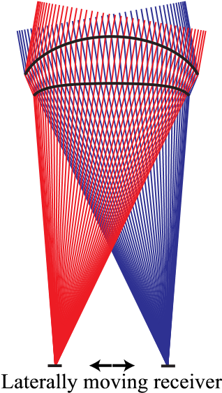
Example of a calculated meniscus lens for two parallel ray sets and design angles θ=±10◦.
(SMS2D)
Within the aperture of the lens, the module obtains a 100× point concentration. But it is not sufficient to make use of high-efficiency solar cells. How?

Slide 11
2.2 Two laterally moving optics arrays and a solar cell array
To properly evaluate the benefit from an additional moving lens array, the number of two curved optical surfaces should remain constant.
Extended SMS2D algorithm used to design laterally moving optics.

Slide 12
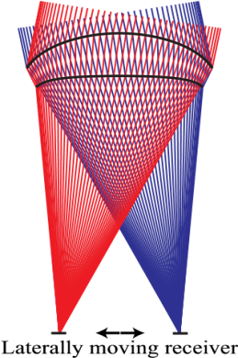
Offset x
2
nd
Optical axis
1
st
Optical axis
receiver plane
(SMS2D)
Schematic drawing of a basic optical system consisting of two laterally moving lenses and a receiver plane. (Extended SMS2D)
2
nd
lens position p
Working distance W
The final results are approximately 20× line concentration and 500× point concentration over the entire angular range.
Is this the best way?

Slide 13
P
1
P
3
Extended SMS2D
F
3
F
1
Extended SMS2D design procedure to include motion by the alternate addition of surface segments on the top and bottom surfaces of two plano-convex lenses. The calculation starts through the center of the bottom surface which determines the optical path length (a). It then proceeds through mirroring (b) to the edges (c) of the lenses. Finally, all chains add up to the final lenses that map the incident rays to the receiver point R (d).
F
0
Q
2
P
0
R
(
b
)
R

Slide 14
Possible Mounting of CPV modules
3. Mounting issue and other existing tracking module
Polar aligned single axis tracker
Towards the South, tilt angle equal to the latitude, rotational axis equals the earth’s axis of rotation.
Horizontally aligned single axis tracker
Polar aligned stationary CPV module mounting
Horizontally aligned stationary CPV module mounting

Slide 15
Existing tracking module
1. Micro-tracking CPV module - 300x concentration ratio

Slide 16
2. Spherical gradient-index lens 1000× concentration ratio
Existing tracking module

Slide 17
4. Conclusion
1. General concept of tracking-integrated CPV and its potential of a lower overall cost.
2. Detailed benefit-cost analysis will be necessary.

Slide 18
THANK YOU!

