Slide 1
Investigating Adhesives for Attaching Mirrors to Aluminium Plates
OPTI 523L Individual Project
by
Melanie Saayman

Slide 2
Adhesives
Available:
Loctite 326
Summers Optical Milbond
3M 2216 B/A gray
Ordered:
NuSil LS-6140
Dow Corning 732, Q3-6093 & 93-500 (samples requested)
TBD:
GE Silicones RTV566
PR-1440 Class A (PRC-DeSoto)

Slide 3
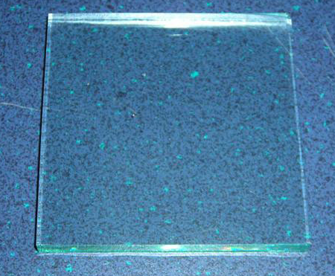
Glass Samples
70 x 70 x 5.5 mm
Status: Available
TBD: Prepare surfaces for adhesion by grounding

Slide 4
Aluminium Samples
50 x 50 x 12.5 mm
Status: Available
TBD:
Surface preparation: Sand surfaces using sandpaper

Slide 5
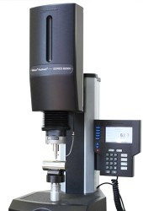
Instron*
Status:
Expected to be available in +- 2 weeks
Expect to start taking measurements during the week of April 19th
*Wilson Instruments 2000 Series Rockwell Hardness Tester

Slide 6
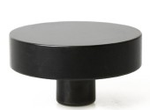
Accessories
2.5 inch Flat Anvil: Keeps the sample 90 degrees perpendicular to the indenter.

Slide 7
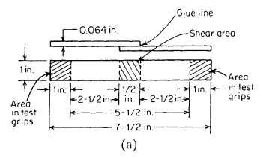
Lap Shear Tests - Background
Standard lap shear specimen design [1]:
Modified lap shear specimen designs to maintain axial loading [1]:

Slide 8
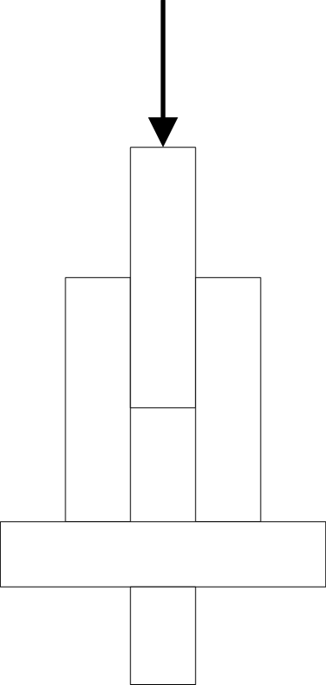
Proposed Lap Shear Test

Slide 9
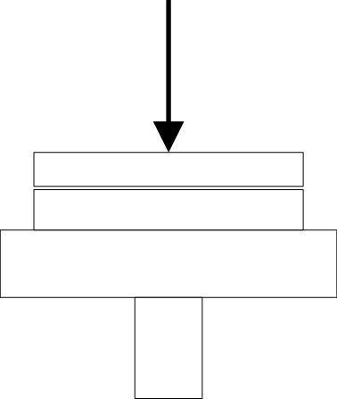
Test Under Compression

Slide 10
Variables
Choice of Adhesive
Bond area
Bond thickness

Slide 11
References
[1] Petrie E. M., Handbook of Adhesives and Sealants pp. 149 -151

