Slide 1
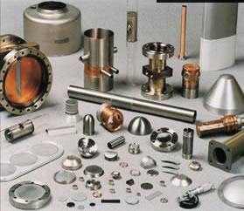
Beryllium: Properties and Applications
Laura Coyle
Introduction to Opto-Mechanical Engineering
December 6th, 2010

Slide 2
Outline
Why use Beryllium?
Important Properties
Manufacturing Process
Applications

Slide 3
Why Beryllium?
STIFF, yet LIGHTWEIGHT
DIMENSIONALLY STABLE OVER A WIDE RANGE OF TEMPERATURES

Slide 4
Important Properties
Density | 1.85 g/cm³ | LOW
Young’s Modulus | 276-303 GPa | HIGH
Yield Strength | 207 MPa (O-30) 241-296 MPa (I-200)
Thermal Conductivity | 220 W/m K | HIGH
Coefficient of Thermal Expansion | 11.5 ppm/°C
Poisson’s Ratio | 0.08
Hardness | 80-100 (Rockwell)
Melting Point | 1287 °C | HIGH
Notes:
Young Modulus - Al – 70 Gpa; Steel 200
Copper – 115

Slide 5
More Properties
Resistant to corrosion
High specific stiffness (E/density ~ 160)
Compare to Aluminum (26), Titanium (25)
Similar to Silicon Carbide (140)
High X-ray transparency
Not magnetic
Toxic to humans

Slide 6
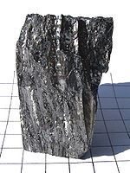
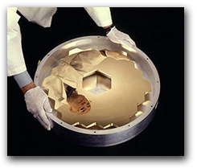
??

Slide 7
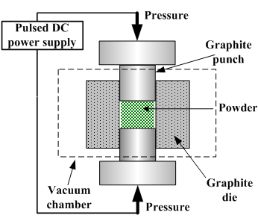
Traditional Die Pressing
Load powder into a mold
Compress using a punch (uniaxial)
Issues:
Non-uniform compaction
Geometrical limitations
Cannot achieve 100% theoretical density
Notes:
Friction between walls of mold and powder
Typical geometry is a cylinder – others possible
Can’t do right angles, undercuts, threads

Slide 8
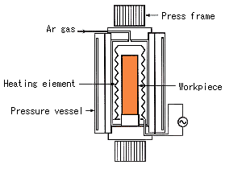
Hot Isostatic Pressing
Load powder into a copper mold
Enclose in steel can
Outgas (remove particles that can interfere with bonding)
Compress powder hydrostatically using hot gas
Leach in nitric acid to dissolve mold
Remove mirror
Notes:
Bonding on an atomic level
Mandrels can be used to make complex shapes – ribs, mounting interfaces
Gasses: nitrogen, oxygen, water vapor
Need high purity powder
Press: 2000 degrees C, 1-2000 atm

Slide 9
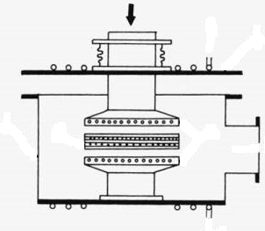
Vacuum Hot Pressing
Power in mold is compressed from two opposing directions at 1000°C
Compare to HIP
HIP can have up to 50% higher microyield strength
Lower cost
Less lead time
Larger blanks – often used to bond HIP’ed pieces together
Notes:
Increase microyield strength – cam make thinner ribs without sacrificing rigidity
Thinner sections reduce stress from thermal effects

Slide 10
Powder
HIP is used so make the blank as isotropic as possible
Powder geometry can help:
Can better predict shape of final blank made with spherical powder– less machining required
Spherical powder increases blank isotropy – can use die pressing, vacuum hot pressing
Notes:
Diameters ~ 100 um

Slide 11
Polishing
Blanks are cast with near-net shape; usually little machining is required
Polishing can typically achieve surface roughessness of 20 angstroms, and surface flatness of λ/20 peak-valley
Beryllium oxide forms on surface
No coating needed in IR
Coating for visible/UV is often gold, silver, aluminum
Notes:
Can improve finish in smaller mirrors
BeO harder than many glass coatings
Visible coatings

Slide 12
Cost
Depends on size, complexity, surface finish
Beryllium is an expensive material – powder type can change cost by 50%
Can mix with aluminum to reduce cost
Better to use HIP than machine from scratch
Tolerances on surface can be the driving factor
20 angstroms RMS is fairly standard
10 angstroms RMS is possible with increased cost
Coatings add to cost as well
Quote from AXSYS for 25 mm bare optic
Beryllium (30 angstroms RMS) - $1334
Aluminum (50 angstroms RMS) - $646

Slide 13
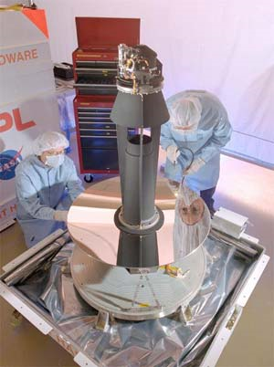
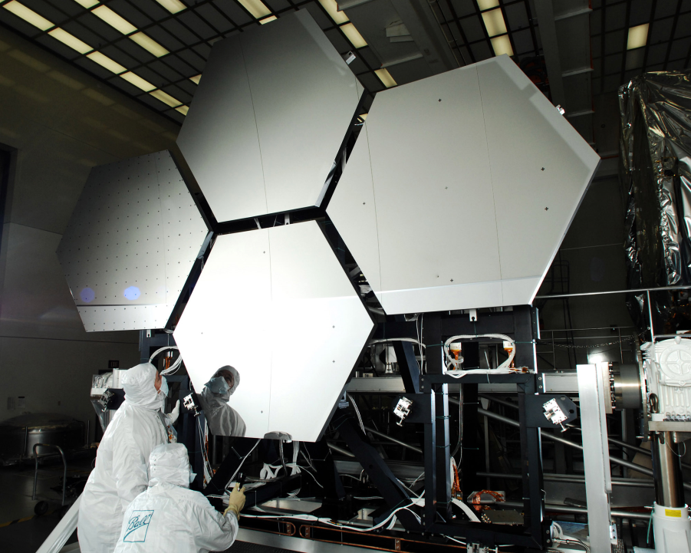
Application: Cryo Telescopes
Good dimensional stability at low temperatures
Lightweight
Used in Spitzer Space Telescope, James Webb Space Telescope

Slide 14
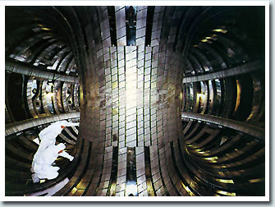
Application: Supercolliders
Beryllium is used to make the beam pipes in all 4 experiments for the Large Hadron Collider
Dimensionally stable at low temperatures, high vacuum
Non-magnetic – does not interfere with magnets used to steer/focus particle beams
Transparent to high energy particles – does not become radioactive

Slide 15
References
“Beryllium Products.” Brush Wellman, Inc. <http://www.berylliumproducts.com/>
Delatte, Michelle, L., “Ultralight weight Beryllium mirror development,” Proc. SPIE, Vol. 1753 (1993).
Marder, James, “Creation of aspheric beryllium optical surfaces directly in the hot isostatic pressing consolidation process,” Proc. SPIE Vol. 1485 (1991).
Parsonage, Thomas. “JWST Beryllium Telescope: Material and Substrate Fabrication,” Proc. SPIE, Vol. 5494, 39 (2004).
Vudler, V., Richard, P., “Beryllium Mirrors: Refinements Enable New Applications,” The Photonics Design and Applications Handbook (2002) <http://www.hardric.com>
Yoder, Paul R., Opto-Mechanical Systems Design, 3rd edition. SPIE Press: Washington, D.C. (2006). pp. 118-121.

