Slide 1
Athermal lens mount design
A tutorial on the use of ZEMAX and Solidworks in athermal lens mount design
By James Champagne
OPTI 521 – Optomechanical Engineering
Fall 2010

Slide 2
Overview
Goal is to design a lens mount to compensate defocus caused by temperature changes
Space Environment (Assume ΔT = 60 C)
Remote Sensing Infrared Optical System
ZEMAX
Solidworks

Slide 3
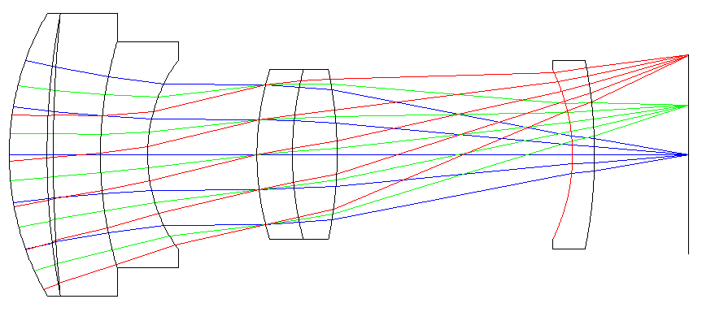
Optical Design
75 mm F/3 Double Gauss
3-5 μm Wavelengths
20 Degree Full Field of View

Slide 4
Glass Types
AMTIR1 (Amorphous)
Dn/dT = 72 ppm/C α = 12 ppm/C n = 2.515
IRG100 (Chalcogenide)
Dn/dT = 103 ppm/C α = 15 ppm/C n = 2.621
CaF2
Dn/dT = -10.4 ppm/C α = 18.4 ppm/C n = 1.410
MgF2
Dn/dT = 0.88 ppm/C α = 9.4 ppm/C n = 1.349
BaF2
Dn/dT = -16 ppm/C α = 18.4 ppm/C n = 1.457

Slide 5
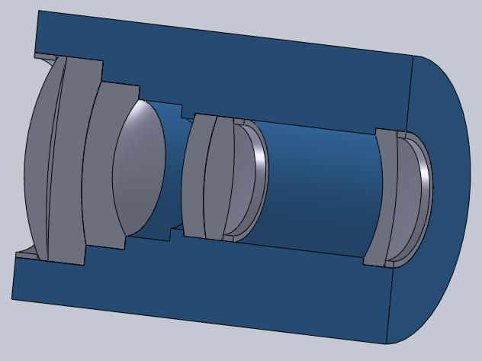
Lens Barrel Design in Solidworks
Al 2024 Lens Barrel

Slide 6
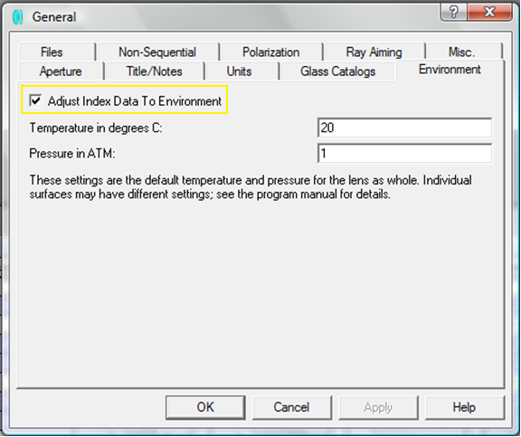
ZEMAX Thermal Analysis
General Tab Adjustment

Slide 7
ZEMAX Thermal Analysis
Lens Data Editor at 20 C and 1 atm (units:inches)

Slide 8
ZEMAX Thermal Analysis
Scroll to right side of Lens Data Editor
Enter CTE data of lens mount in airspaces
Al 2024 α = 22.9 ppm/C

Slide 9
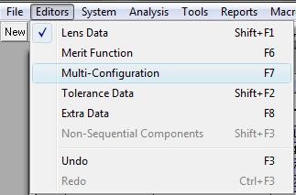
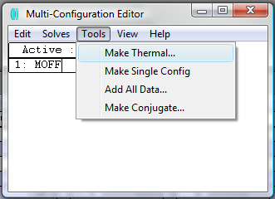
ZEMAX Thermal Analysis
Open Multi-Configuration Editor
Make Thermal under Tools

Slide 10
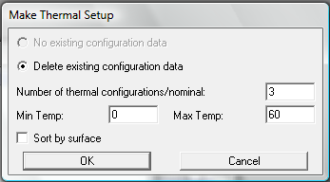
ZEMAX Thermal Analysis
Choose number of configurations
Temperature range from 0 C to 60 C

Slide 11
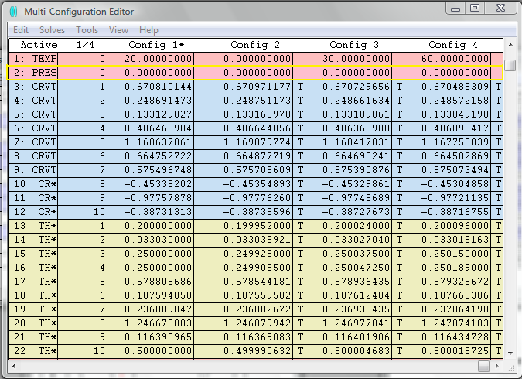
ZEMAX Thermal Analysis
Change pressure to 0 for space environment

Slide 12
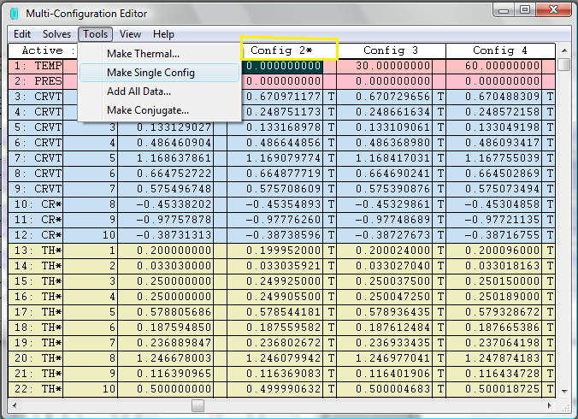
ZEMAX Thermal Analysis
Choose Config 2 and Make Single Config under Tools

Slide 13
ZEMAX Thermal Analysis
Lens Data Editor at 0 C and 0 atm pressure
Optimize BFL for minimum RMS spot radius
New BFL = 0.4995 inches

Slide 14
ZEMAX Thermal Analysis
Repeat and choose Config 4 for 60 C and 0 atm pressure
Lens Data Editor now at 60 C and 0 atm pressure
Optimize BFL for minimum RMS spot radius
New BFL = 0.4959 inches

Slide 15
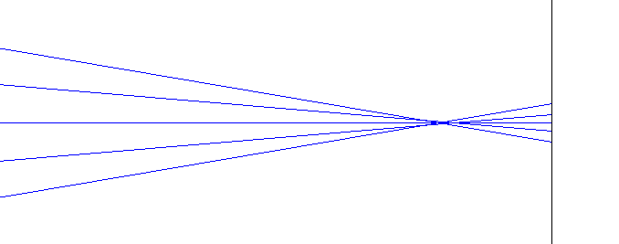
Defocus
The change in BFL between 0 C and 60 C is:
0.0036 inches = 91 μm
Focus moves towards lens for increase in T

Slide 16
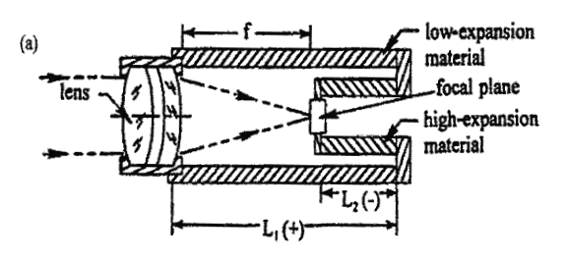
Athermal Lens Mount
Lens/Detector interface mount must move detector plane towards lens for increase in temperature
High-Expansion material – Al 6061
Low-Expansion material – Invar 36

Slide 17
Bi-Metallic Mount Equations

Slide 18
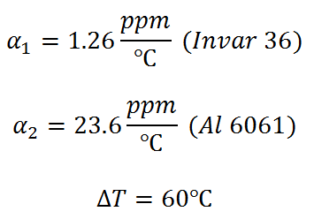
Solving Equations

Slide 19
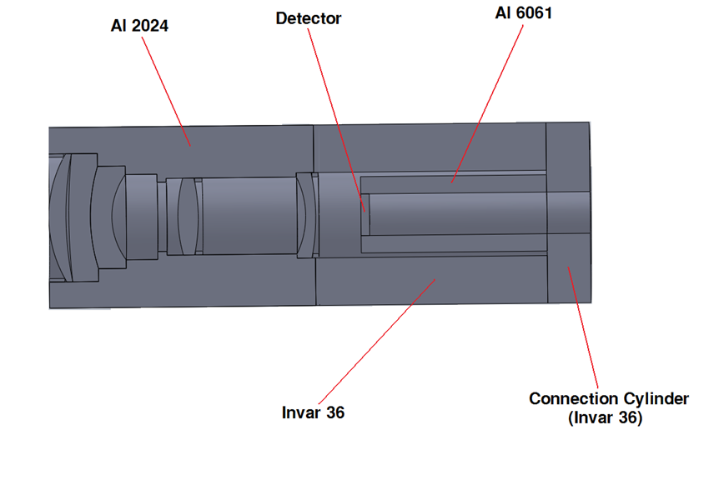
Interface Mount Design in Solidworks

Slide 20
Conclusion
Bi-metallic lens mount to compensate defocus
Infrared optical system in space environment
Warnings
dn/dT and α not constant over large T
Check data input of ZEMAX

Slide 21
References
Friedman, I., “Thermo-optical analysis of two long-focal-length aerial reconnaissance lenses,” Opt. Eng. 20, 1981:161.
Vukobratovich, D, Introduction To Opto-Mechanical Design, Raytheon Systems Co., Tucson, AZ.
Yoder, P.R., Jr., Mounting Optics in Optical Instruments, SPIE Press, Bellingham, WA, 2008.
Zemax Corporations. Zemax Optical Design User’s Manual. Chapter 19: Thermal Analysis (April 2010).
Zemax Knowledge Base. 2010. http://www.zemax.com/kb/categories/Thermal-Analysis/

