Slide 1
Modal Testing
421L/521L (Lab 9)
10/21/2016

Slide 2
Frequency Response
F(s)
G(s)
X(s)
Frequency Response Function
  System characteristics in frequency domain
How to find FRF
  Mathematical modeling based on known parameter
  System identification through experimental
    Apply known input to your system
      Example of known input: impulse (impact hammer), sine sweep (shaker), Pseudo random (Function Generator), operational condition, etc
    Measure the output
      Example of measured output: Accelerometer, Displacement sensors, Strain gage, load cell, LVDT, etc
    Find G(jw) = FFT(x(t))/FFT(f(t)) = x(jw)/f(jw)
      Where G(jw) = FRF, X(t) = output and f(t) = input
Input
System
Output

Slide 3
Signal Processing and Window
Input Ch
Anti-Aliasing Filter
ADC
Analog Signal
Window
FFT
Averaging
Visualization

Slide 4
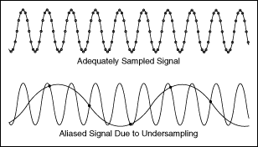
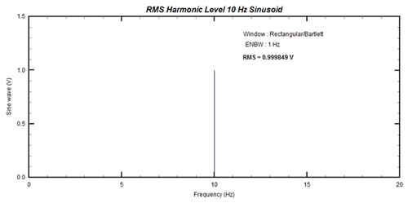
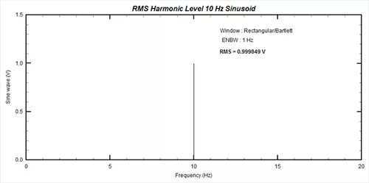
Signal Processing and Window
FFT based signal processing involves ADC.
  Analog to Digital Conversion
  Sampling, Nyquist frequency and frequency folding
  Aliasing (or Anti-aliasing: make 0 if higher than Nyquist freq.)
Frequency folding
fs
Nyquist frequency

Slide 5
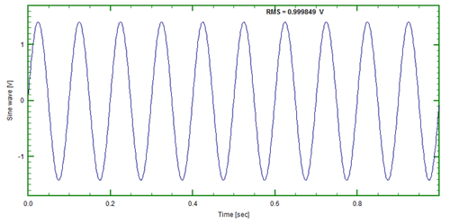
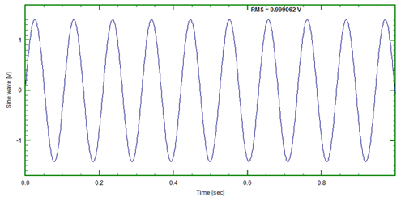
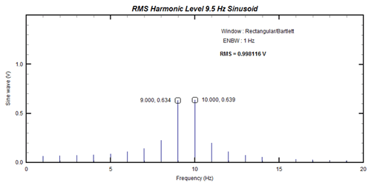
Signal Processing and Window
Finite sampling which does not match exact period creates “leakage”
10Hz sine
9.5Hz sine
Signal
FFT

Slide 6
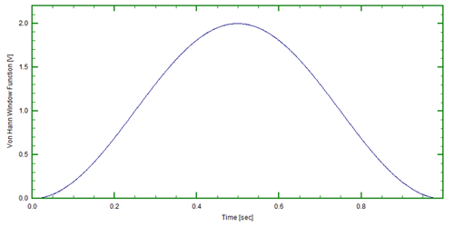
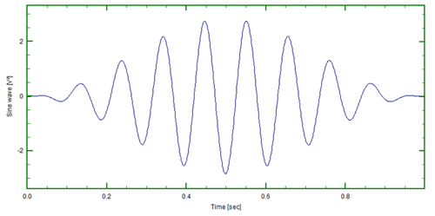
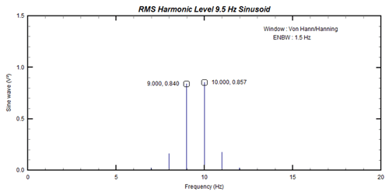
Signal Processing and Window
Window tailors the finite signal such that the start and end matches to 0.
By applying window, spectral leakage could be improved.
There are multiple shapes of Windows

Slide 7
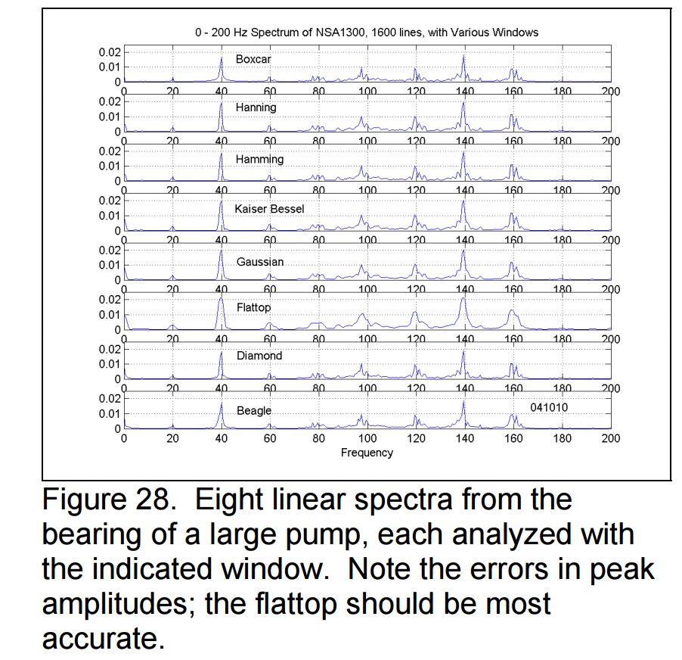
Signal Processing and Window
Proc. of SEM, H. Gaberson, 2002

Slide 8
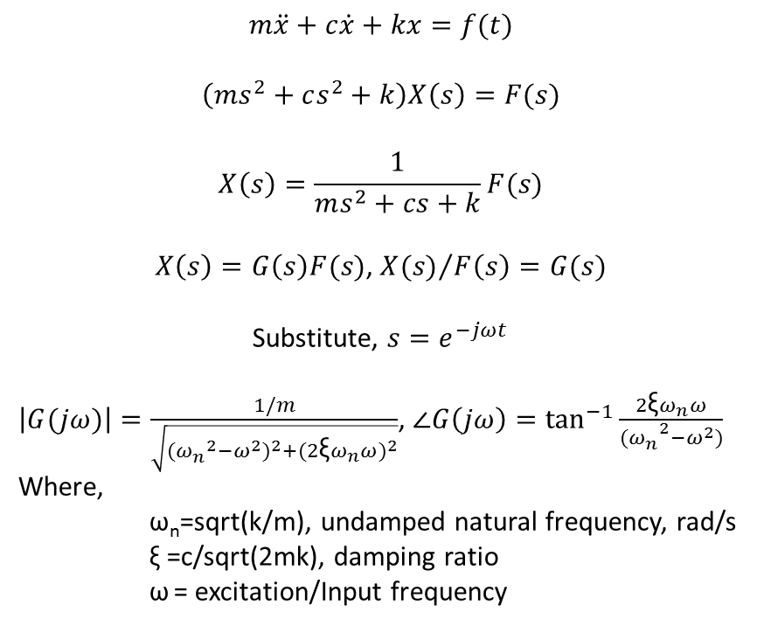
Frequency Response of 1-DOF System
$$m\ddot{x}+c\dot{x}+kx=f(t)$$
$$\left(ms^{2}+cs^{2}+k\right)X\left(s\right)=F(s)$$
$$X\left(s\right)=\frac{1}{ms^{2}+cs+k}F(s)$$
$X\left(s\right)=G\left(s\right)F(s)$, ${X(s)}/{F\left(s\right)}=G(s)$
Substitute, $s=e^{−jωt}$
$\left|G(jω)\right|=\frac{1/m}{\sqrt{{({ω_{n}^{}}^{2}−ω^{2})}^{2}+{(2\text{ξ}ω_{n}ω)}^{2}}}$, $∠G\left(jω\right)=\tan^{−1}{\frac{2\text{ξ}ω_{n}ω}{{{(ω}_{n}^{}}^{2}−ω^{2})}}$
Where,
ω_{n}=sqrt(k/m), undamped natural frequency, rad/s
ξ =c/sqrt(2mk), damping ratio
ω = excitation/Input frequency
k
c
M
x,f
k, stiffness, N/m
m, mass, kg
c, damping coefficient, N/(m/s)

Slide 9
Frequency Response of 1-DOF System

Slide 10
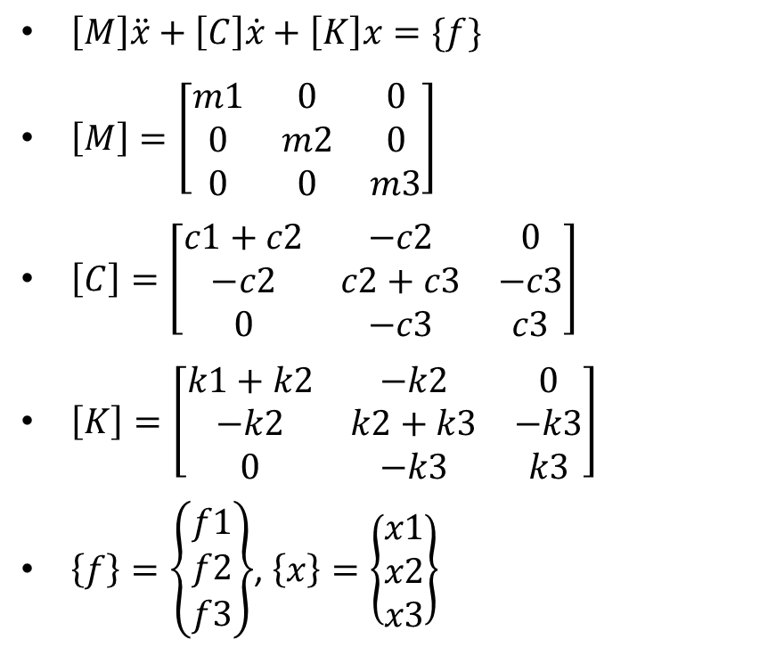
Frequency Response of Multi DOF System
$\left[M\right]\ddot{x}+\left[C\right]\dot{x}+\left[K\right]x=\{f\}$
$\left[M\right]=\left[\begin{matrix}m1 & 0 & 0 \\ 0 & m2 & 0 \\ 0 & 0 & m3\end{matrix}\right]$
$\left[C\right]=\left[\begin{matrix}c1+c2 & −c2 & 0 \\ −c2 & c2+c3 & −c3 \\ 0 & −c3 & c3\end{matrix}\right]$
$\left[K\right]=\left[\begin{matrix}k1+k2 & −k2 & 0 \\ −k2 & k2+k3 & −k3 \\ 0 & −k3 & k3\end{matrix}\right]$
$\left\{f\right\}=\left\{\begin{matrix}f1 \\ f2 \\ f3\end{matrix}\right\}$, $\left\{x\right\}=\left\{\begin{matrix}x1 \\ x2 \\ x3\end{matrix}\right\}$
k1
c1
m1
X1,f1
k2
c2
m2
X2,f2
k3
c3
m3
X3,f3
k, stiffness, N/m
m, mass, kg
c, damping coefficient, N/(m/s)
Mode freq = det. of [K-w²M]=0, mode shape = eigen vector

Slide 11

Frequency Response of Cantilever Beam
Y(x)
E, I, L, ρ
$$ω_{1}={1.875}^{2}\sqrt{\frac{EI}{{ρL}^{4}}}$$
$$ω_{2}={4.694}^{2}\sqrt{\frac{EI}{{ρL}^{4}}}$$
$$ω_{3}={7.855}^{2}\sqrt{\frac{EI}{{ρL}^{4}}}$$
x
See Handout
E: Young’s modulus
I: Moment of inertia
L: length
ρ: mass per unit length

Slide 12
Experiment
Identify mode shape and corresponding frequencies
Mount Accelerometer onto beam
  End for cantilever beam
Mark excitation points
Excite beam by applying ‘impulse’ using impact hammer at the marked points
  Observe input, time response and frequency response
Collect Frequency response (5 sets then average)
Create waterfall chart
Find resonant frequency and corresponding mode shape

Slide 13
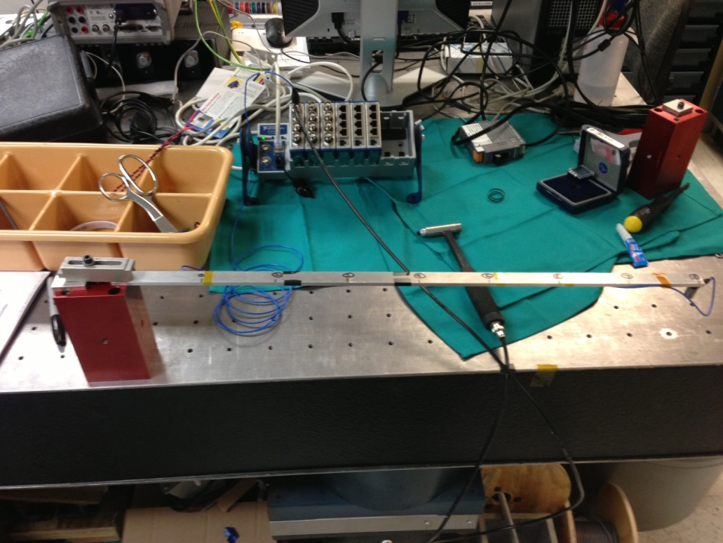
Experimental setup: Cantilever Beam
Aluminum Beam
  Thickness = 4.84mm
  Width = 19.09mm
  Length = 640mm
Accelerometer is mounted at the end of the beam
Mass of accelerometer = 7.83 gram
1
2
3
4
5
6
7
8

Slide 14
Example
3rd mode
2nd mode
1st mode

Slide 15
Example of FRF

Slide 16
Experiment
Install test setup using 4 stainless steel rods and one AL plate as in the direction
Mount 2 tri-axial Accelerometers onto structure
Mark excitation points
Excite Structure by applying ‘impulse’ using impact hammer at the marked points
  Observe input, time response and frequency response
Collect Frequency response (5 sets then average)
Create waterfall chart
Find resonant frequency and corresponding mode shape
Identify mode shape and corresponding frequencies from FEA

Slide 17
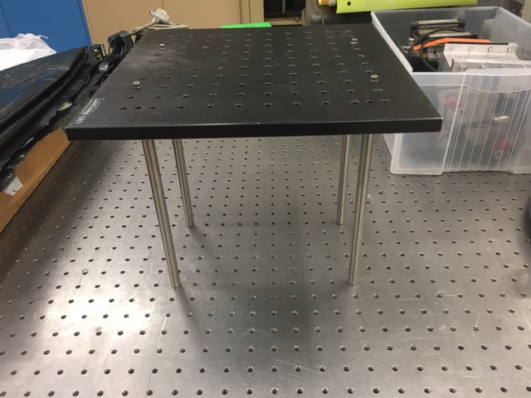
Experimental setup
Stainless Steel rod
  Diameter = 0.5in
  Length = 10in
Aluminum Plate
  Length = 12in
  Width = 12in
  Thickness = 0.5in
2 Tri-axial accelerometer is mounted at the top plate
Accelerometer
AL plate
d2
Stainless
steel rod
d1

Slide 18
Experiment: Configuration #1
Install 12x12in AL plate using 4 stainless steel rods on optical table
Set the spacing between the stainless steel rods,
  *d1 = d2 = 9in
Attach 2 tri-axial accelerometer on the top surface and apply impulse each point marked A, B, C and D
Apply impulse to each marked point.
Log data and find FRF with window
Compare experimental results from A, B, C and D
Analyze static deformation from 3 load cases under unit force at A, B, C and D
Compare analysis results from each load case A, B, C and D
Perform modal analysis and compare the results to the experiment
A
B
D
C

Slide 19
Experiment: Configuration #2
Install 12x12in AL plate using 4 stainless steel rods on optical table
Set the spacing between the stainless steel rods,
  *d1 = 9in
  *d2 = 3in
Attach 2 tri-axial accelerometer on the top surface and apply impulse each point marked A, B, C and D
Apply impulse to each marked point.
Log data and find FRF with window
Compare experimental results from A, B, C and D
Analyze static deformation from 3 load cases under unit force at A, B, C and D
Compare analysis results from each load case A, B, C and D
Perform modal analysis and compare the results to the experiment
A
B
D
C

Slide 20
?
Does your measurement match to your estimation?
  Show your measurement and measured value
How does the geometry affect to the result?
  Translation?
  Rotation?
  Have you observed any higher mode?

Slide 21
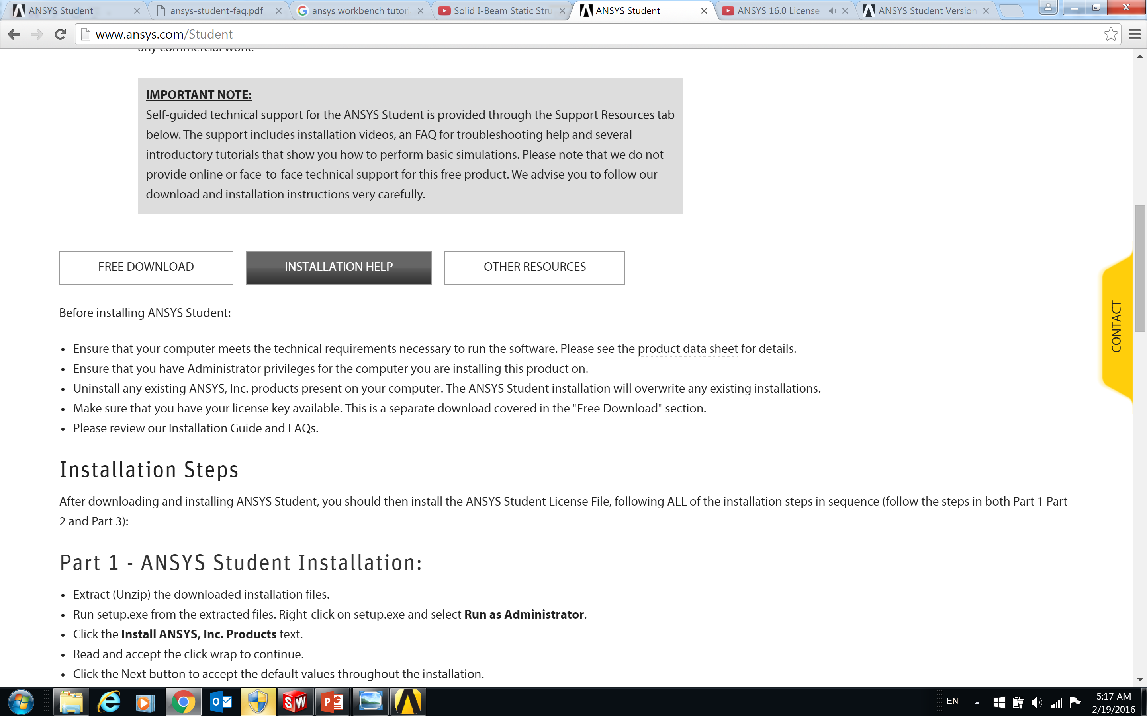
ANSYS
Install ANSYS/student
  http://www.ansys.com/Student
  Free to use for educational purpose

Slide 22
General Steps of FEA
Review your system
Geometric Modeling
  Direct Modeling
  Import 3D(or CAD) model and
Finite Element Modeling
  Define Material Properties and Real Constants
  Define Nodes and Elements
  Apply Boundary Conditions
  Applying Loading Conditions
Solve
  Configure Solver and Solve
Post Processing
  Visualize Result and/or Export Data

Slide 23
Real Hardware Example
HET Wide Field Corrector

Slide 24
Top Level Mechanical Design Requirement
WFC subsystem should be designed for:
35° nominal zenith angle +/- 8.5°
Operational temperature of 10° C +/- 20 ° C
20 Hz minimum fundamental frequency
Meet or exceed the defined mirror positioning requirements including gravity, thermal and initial alignment
Meet or exceed the required mirror adjustment resolution
Serviceability and maintainability

Slide 25
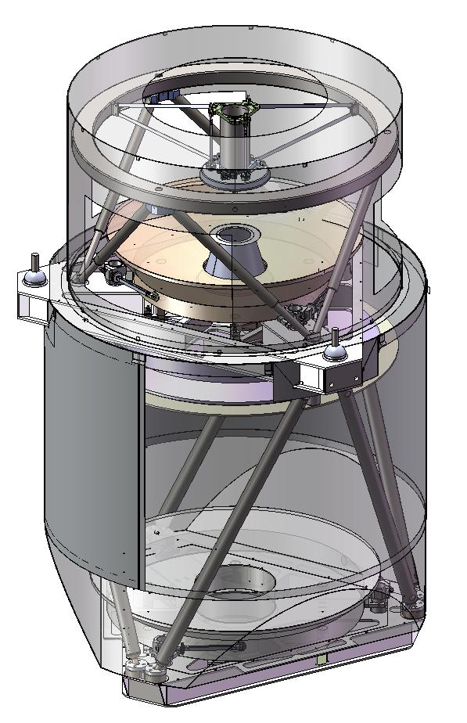
Mechanical Design Overview
System Weights (1802 lbs total)
  950 lbs glass
  550 lbs steel and Invar
  120 lbs aluminum baffles and Cover
  182 lbs lower strongback mounted instruments
System interface to PFIP
  3 point kinematic interface on 1400mm in diameter
  and 195mm from the vertex of M2
Solid mirrors (ClearceramZ-HS by OHARA), undercut for lightweighting
Stainless Steel and Invar truss tubes
M4 support includes truss head ring and pre-tensioned spider vanes that are aligned to the diffraction pattern of the HET primary mirror segments
M2/M5 and M3 supported by steel strongback

Slide 26
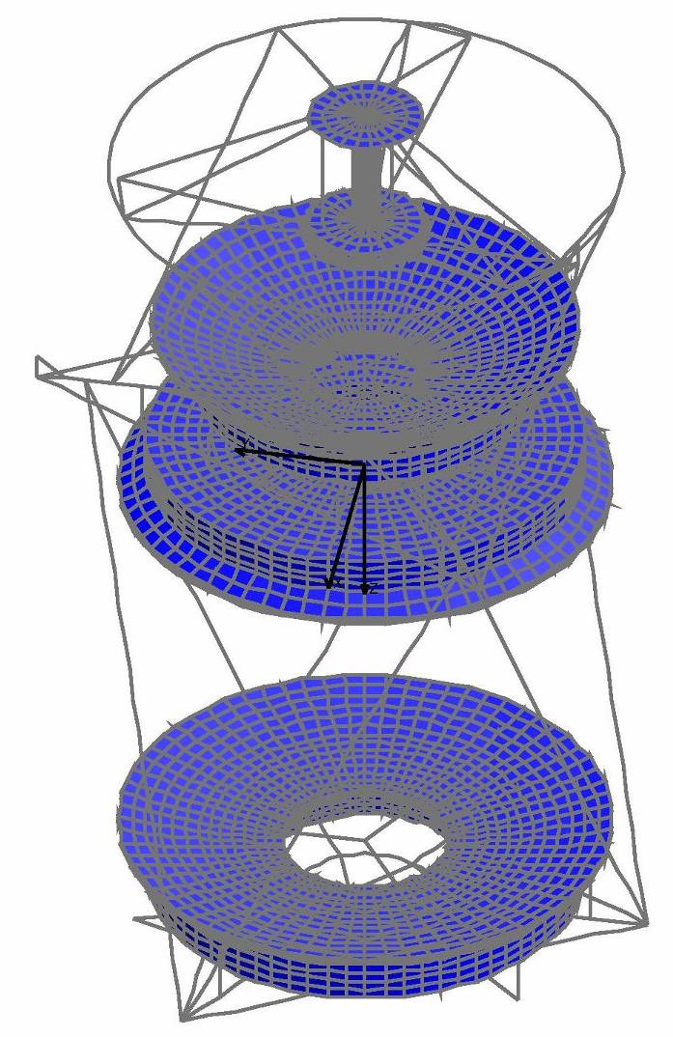
FEA System Model

Slide 27
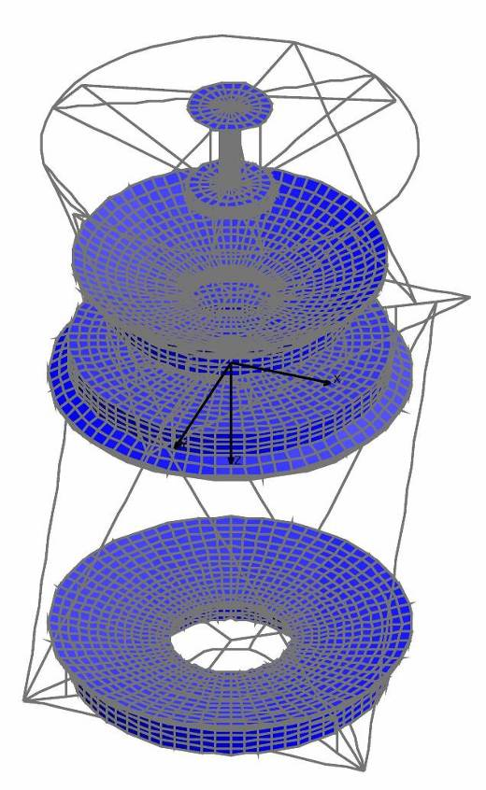
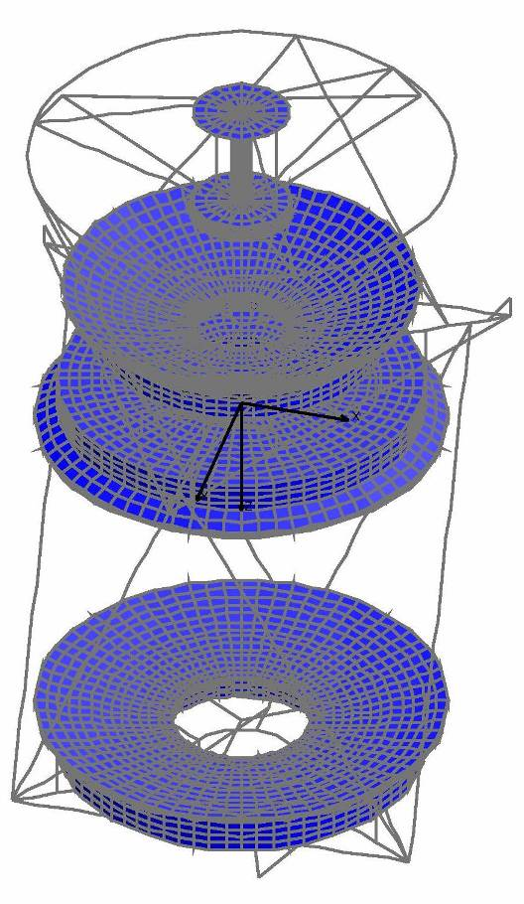
PDR – CDR
FEA Iterations
PDR
CDR
Structural Updates
Updated interface points (optical axis)
Updated both strongbacks to 1018 steel
Updated cross sections
Updated all material properties
Added lumped masses for UT instruments
Updated head ring and added head ring compliance

Slide 28
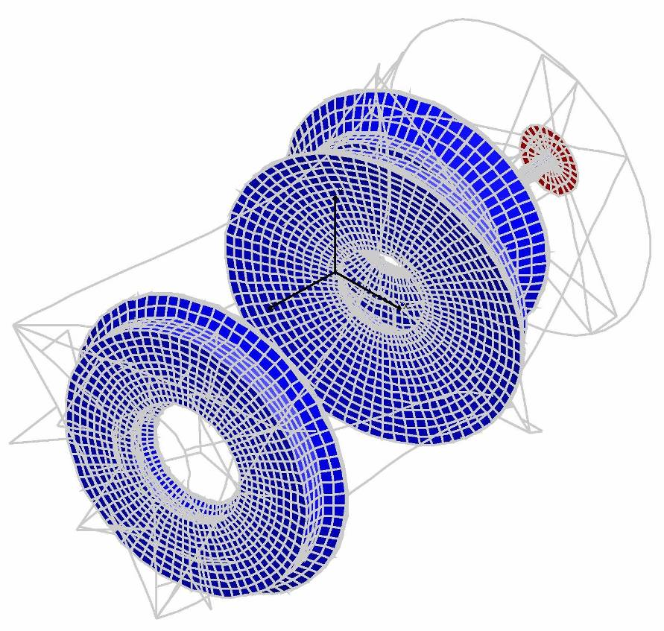
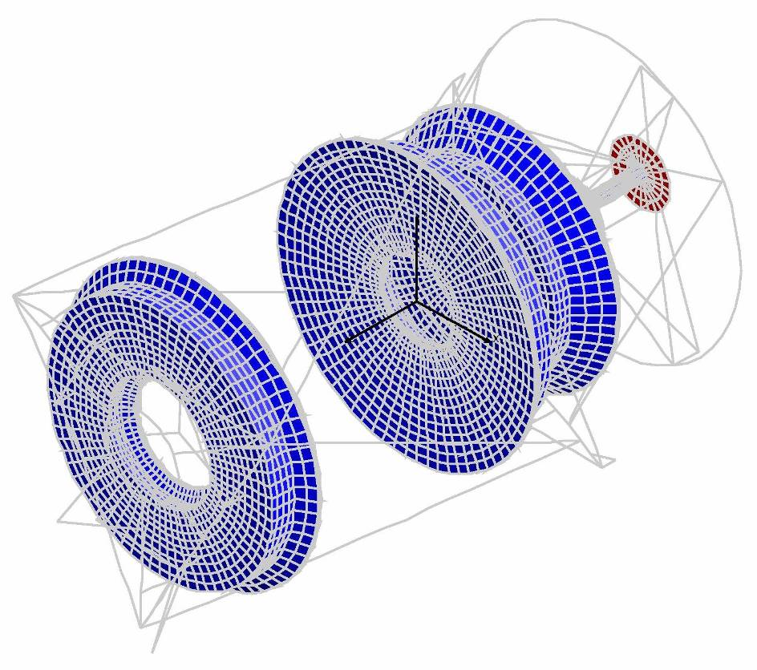
Frequency Response
Fundamental Frequency
25.47 Hz
2nd Frequency
29.53 Hz

Slide 29
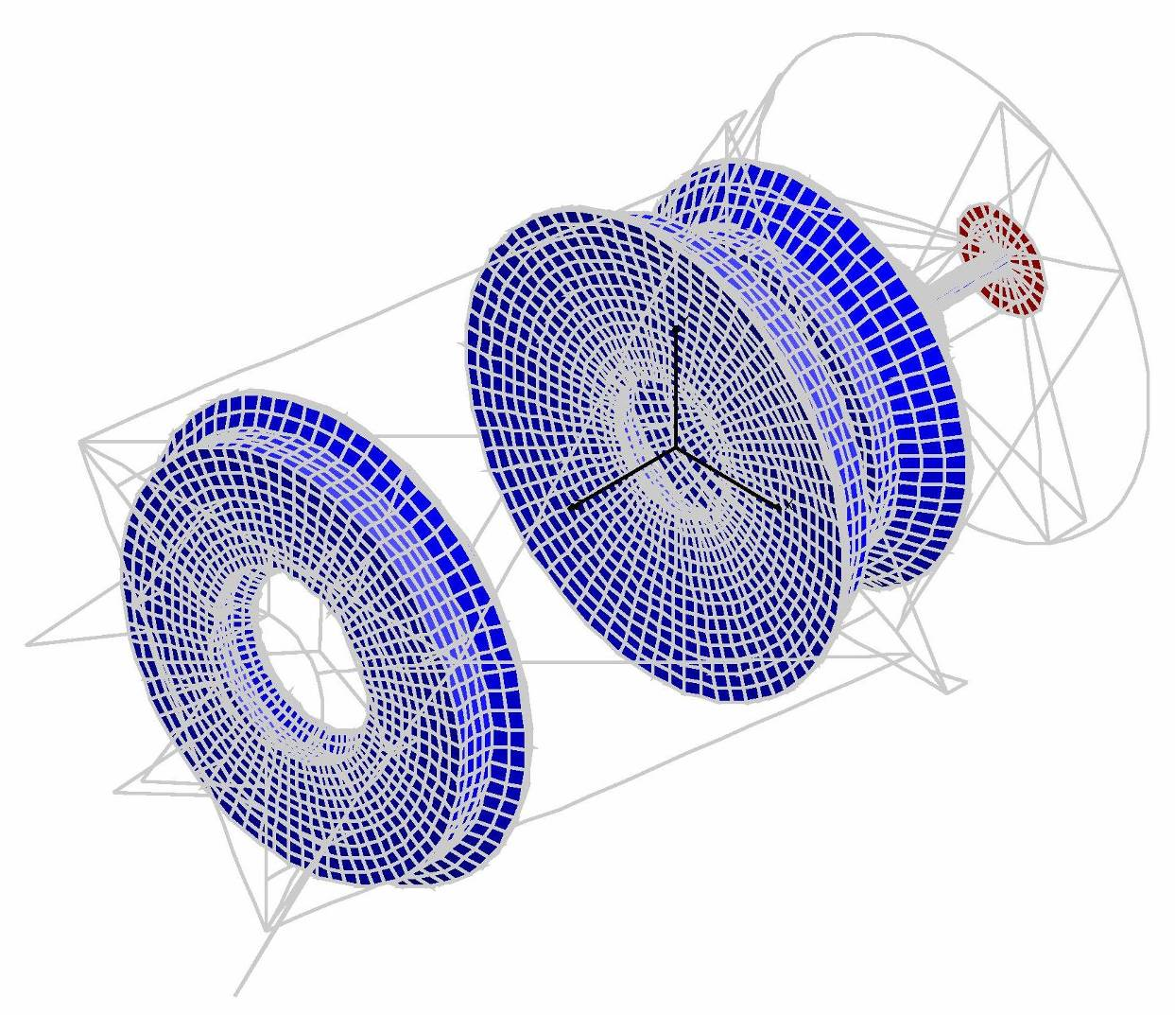
Frequency Response
3rd Frequency = 29.86 Hz
4th Frequency = 30.08 Hz
5th Frequency = 30.69 Hz
6th Frequency = 31.19 Hz
Movement of lower instrument package masses coupled with slight movement of the M2/M5 strongback.
3rd frequency shown

Slide 30
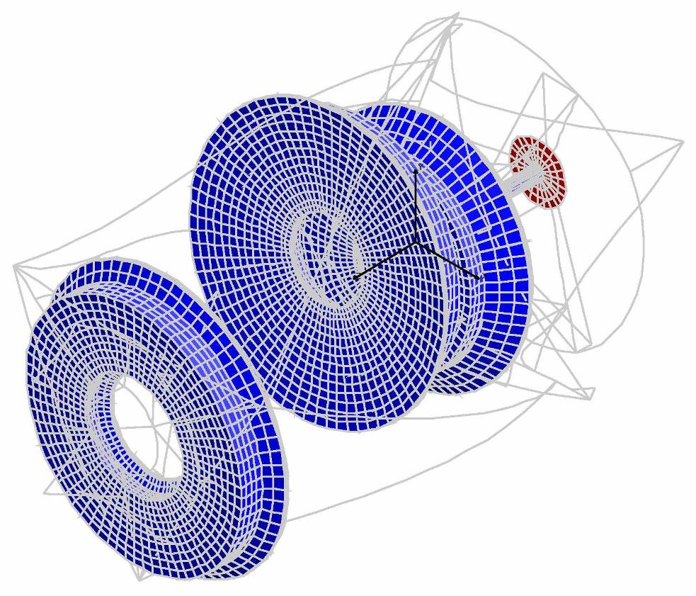
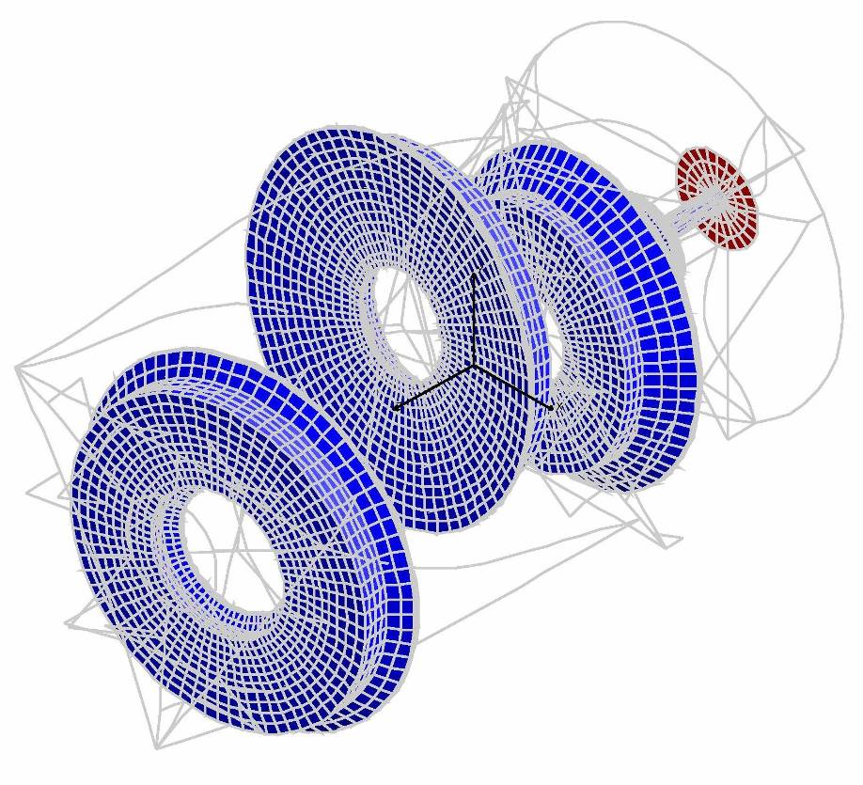
Frequency Response
7th Frequency
38.61 Hz
8th Frequency
43.68 Hz

Slide 31
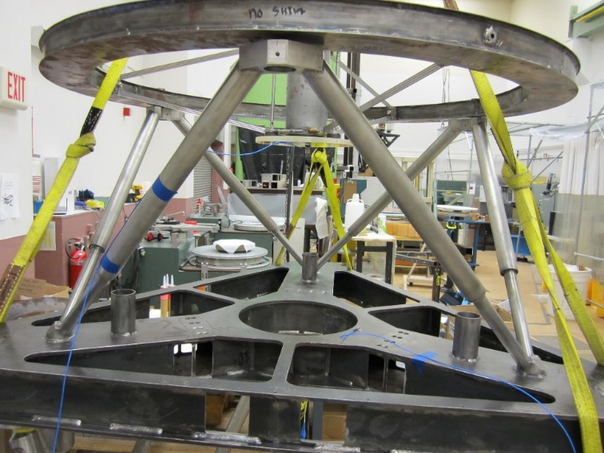
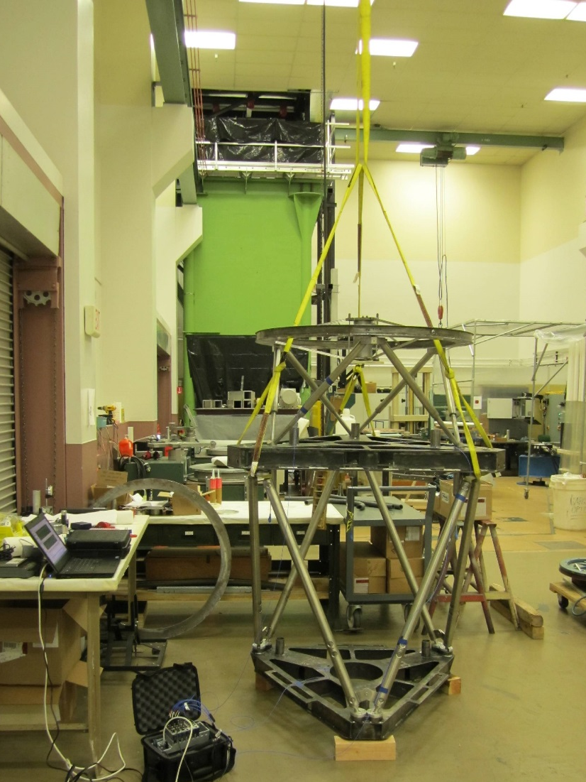
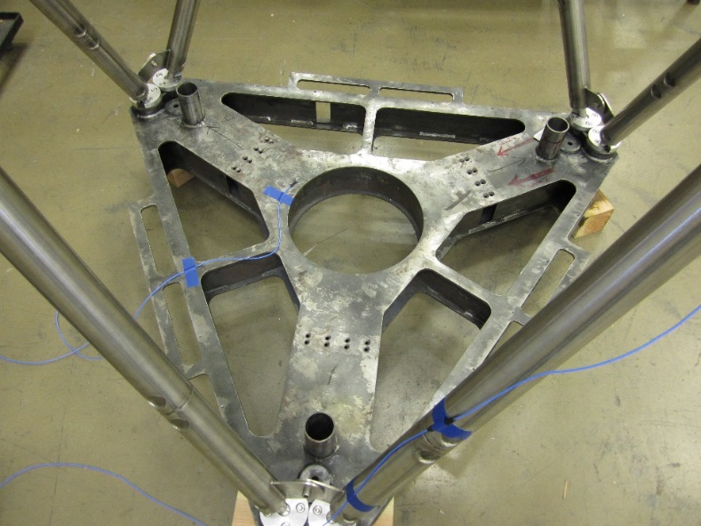
WFC Structure Modal Test
Straps to hang
Accelerometer
DAQ device

Slide 32
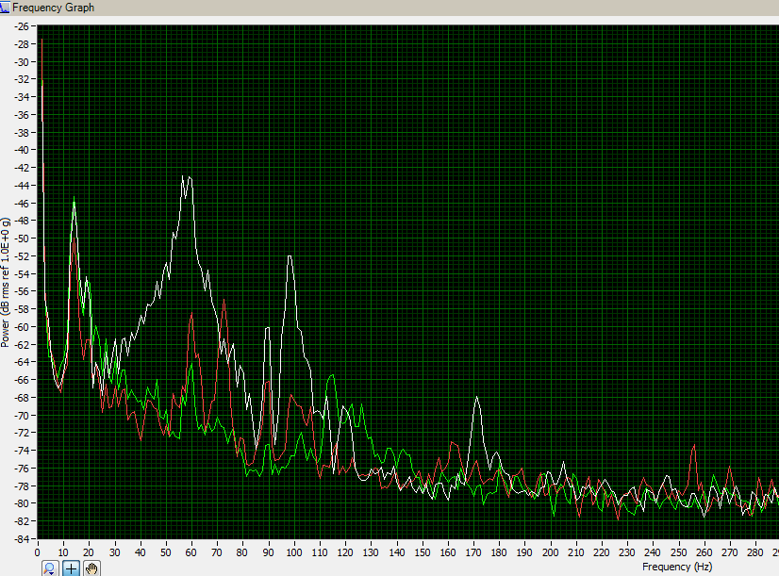
Data Acquisition and Analysis
Dominant mode:
headring movement in z direction
at 43Hz (FEA = 49Hz)

