Slide 1
Estimation of Fundamental Natural Frequency, Damping Ratio and Equivalent Mass
421L/521L (Lab 8)

Slide 2
Single DOF Modeling
accelerometer
E, I, L, ρ
Cantilever
k
c
E, I, L, ρ
Fixed-Fixed
M
E: Young’s modulus
I: Moment of inertia
L: length
ρ: mass per unit length
x
k, stiffness, N/m
m, mass, kg
c, damping coefficient, N/(m/s)
mx”+cx’+kx = f(t)
x(t) = Aexp(-ξω_{n}t)COS(ω_{n}sqrt(1-ξ²)t- ψ)+Bsin(ωt)
Time response = Transient response + Forced response(sinusoidal)
Where,
ω_{n}=sqrt(k/m), undamped natural frequency, rad/s
ξ =c/sqrt(2mk), damping ratio
ω_{d}=ω_{n}sqrt(1-ξ²), damped natural frequency, rad/s

Slide 3
Visualization of responses
Exponential part
Sinusoidal part
Transient
response
Forced response
(Sinusoidal input)
Transient response
+ Forced response

Slide 4
Experiment
Identify the fundamental mode characteristics using logarithmic decrement
Mount Accelerometer onto beam
End for cantilever beam
Center for fixed-fixed beam
Excite beam by applying ‘impulse’ or initial displacement
Observe transient response (No forced response)
Collect time response
Pick two peaks and measure amplitude and period
Find natural frequency, damping ratio
Find equivalent mass from beam equation
Find damping coefficient and stiffness

Slide 5
?
Equivalent mass and natural frequency estimation by Rayleigh method (See the handout)
Cantilever Beam
m_{eq} = 0.2235ρ L
ω_{n}=3.6639sqrt(EI/(ρL⁴)) rad/s
Fixed-Fixed Beam
m_{eq} = 0.3836ρ L
ω_{n}=22.373sqrt(EI/(ρL⁴)) rad/s
Does your measurement match to your estimation?
Show your measurement and measured value
What if you count the mass of the accelerometer?

Slide 6
Experimental setup: Cantilever Beam
Aluminum Beam
Thickness = 4.84mm
Width = 19.09mm
Length = 640mm
Accelerometer is mounted at the end of the beam
Mass of accelerometer = 7.83 gram

Slide 7
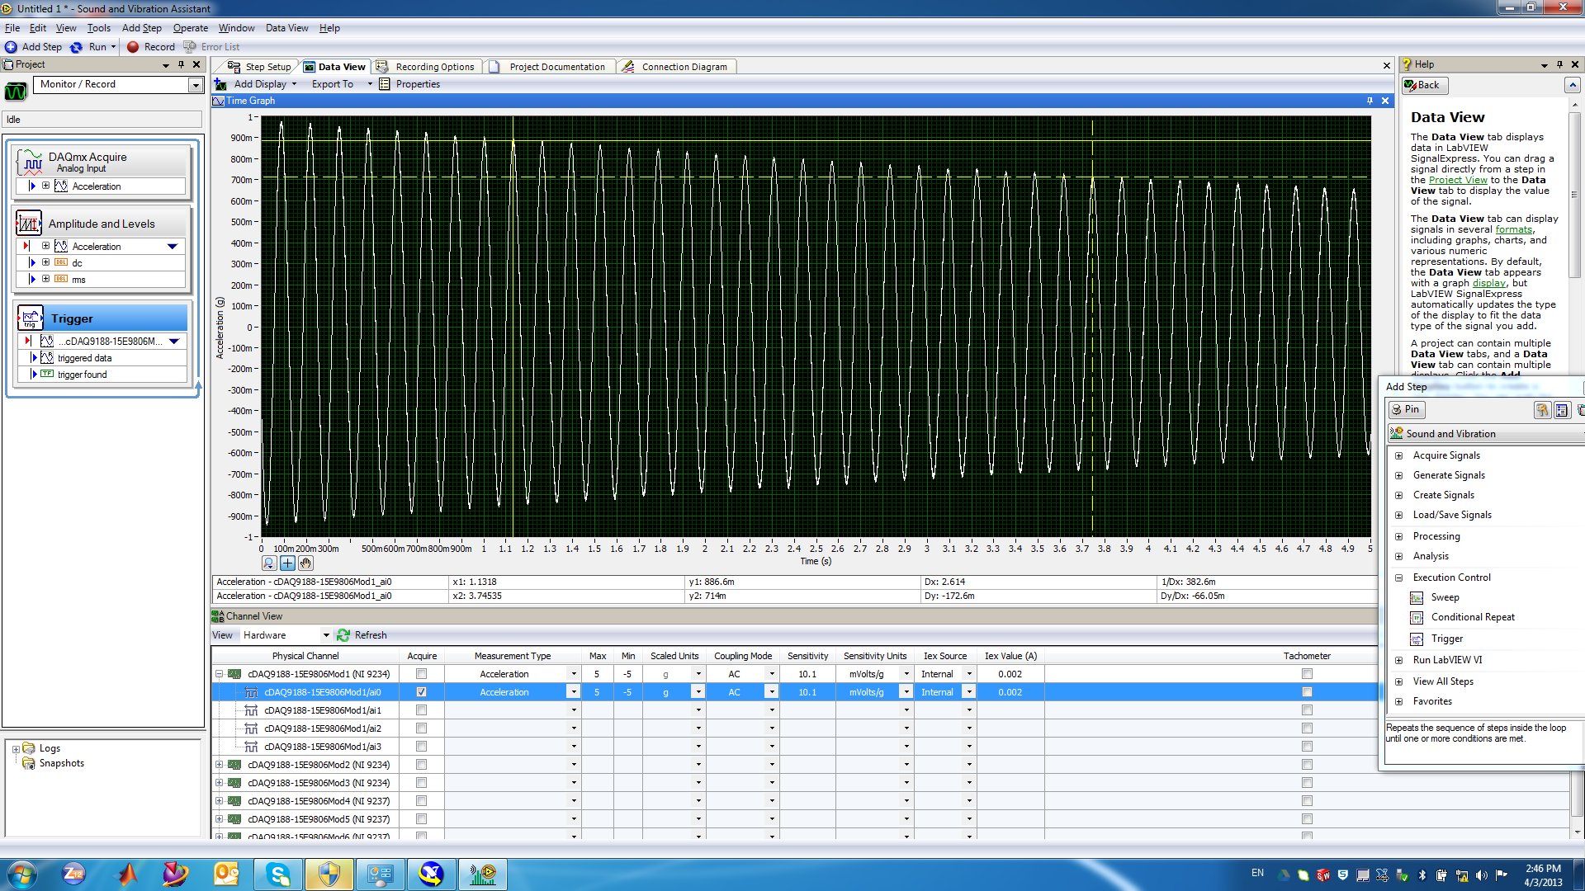
Cantilever Beam
NOTE: X_{1,2} = time in s, y_{1,2} = acceleration in g, (m = ‘mili’)

Slide 8
Work Sheet: Cantilever Beam
# | Item | Unit | Value
A | Time @ peak #1 | s
B | Time @ peak #2 | s
C | Amplitude @ peak #1 | g
D | Amplitude @ peak #2 | g
E | Time between A and B | s
F | Number of periods between A and B
G | Period of oscillation, E/F | s
# | Item | Unit | Value
H | Damped natural frequency, ω_{d} | rad/s
I | Natural frequency, ω_{n} | rad/s
J | zeta
K | Equivalent mass, m_{eq} | kg
L | Stiffness, k | N/m
M | Damping, c | N/(m/s)
N | Natural frequency estimation by Rayleigh method | rad/s

Slide 9
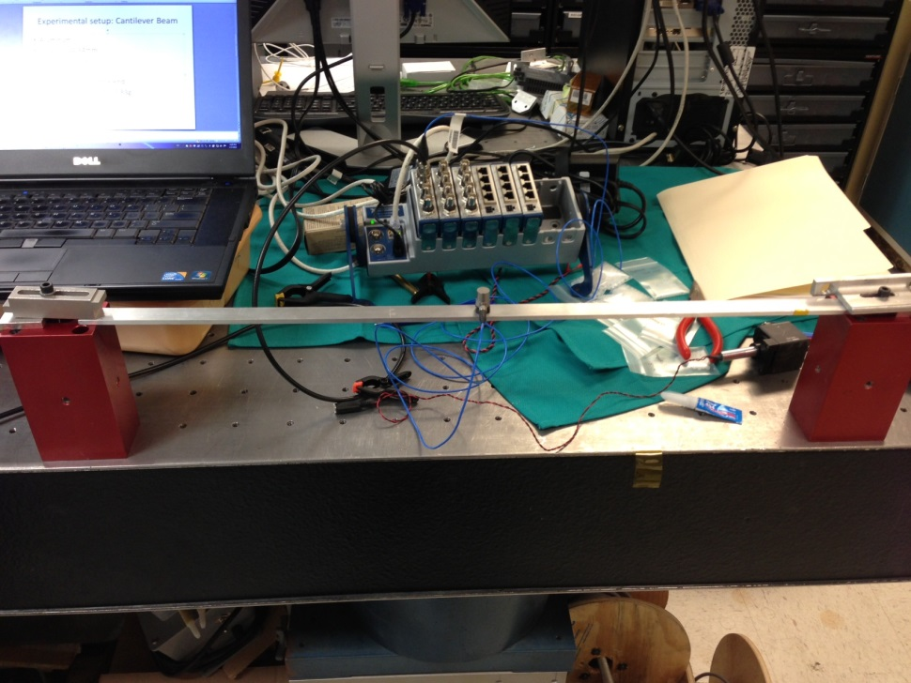
Experimental setup: Fixed-Fixed Beam
Aluminum
Thickness = 4.84 mm
Width = 19.09 mm
Length = 640 mm
Accelerometer is mounted at the center
Mass of accelerometer = 7 .83 gram

Slide 10
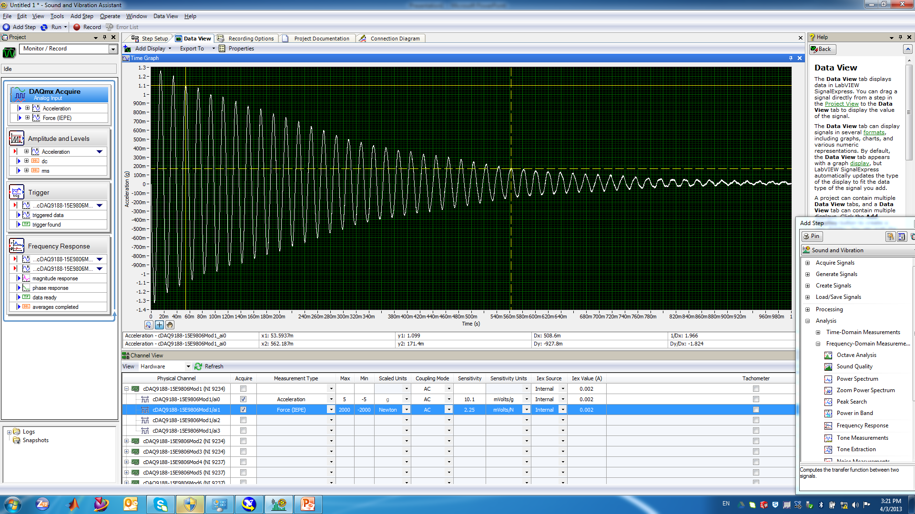
Fixed-Fixed Beam
NOTE: X_{1,2} = time in s, y_{1,2} = acceleration in g, (m = ‘mili’)

Slide 11
Work Sheet: Fixed-Fixed Beam
# | Item | Unit | Value
A | Time @ peak #1 | s
B | Time @ peak #2 | s
C | Amplitude @ peak #1 | g
D | Amplitude @ peak #2 | g
E | Time between A and B | s
F | Number of periods between A and B
G | Period of oscillation, E/F | s
# | Item | Unit | Value
H | Damped natural frequency, ω_{d} | rad/s
I | Natural frequency, ω_{n} | rad/s
J | zeta
K | Equivalent mass, m_{eq} | kg
L | Stiffness, k | N/m
M | Damping, c | N/(m/s)
N | Natural frequency estimation by Rayleigh method | rad/s

Slide 12
Different material?
Repeat the experiment with Steel and any nonmetal material
Compare the result

