Slide 1
Lab 3 - Centering

Slide 2
Centering; or the smart way to align centered optical elements and systems
This lab will make use of concepts used in the previous labs
We will use an air bearing rotary table – it is accurate but delicate
Never rotate the table without at least 50 psi air pressure, check the gauge
The adjustment screws have a limited range; do not force beyond range
We will use dial indicators to help with centering as well as the PSM

Slide 3
Lens Centering Station
PSM
PSM Monitor
Indicator
Airbearing
Rotary table
PSM stage control
Alignment source

Slide 4
Details of air bearing rotary table
Yaw rotation
Displacement Indicator
Z-axis
Flexible Cable Lock
Y-axis
X-axis
Y- adjustment
X- adjustment
Tilt- adjustment
Magnetic Mount
Tip- adjustment
There are two tilt and two centering fine adjustments on the table
Do not force adjustments; they should only be turned a revolution or two
This is delicate equipment; please try to be careful

Slide 5
Rotary table defines an axis
A line or axis is a theoretical concept
A good rotary table is a physical realization of a mechanical axis
Just as the alignment telescope defined an optical axis
The table top defines a plane – 3 degrees of freedom
One is simply height
The periphery defines an end of the axis – 2 degrees
Centering is moving optical surfaces until their axis lies on the mechanical axis defined by the table

Slide 6
Examples
Mirror is decentered
If table rotated 180˚, C of C moves by twice the decenter
Indicator motion will depend on geometry
If object is on axis, image moves in circle 4x the decenter
Mirror is centered when image does not move
Image does not have to be in center of video screen

Slide 7
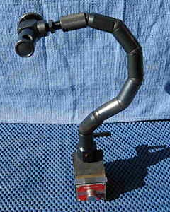
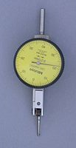
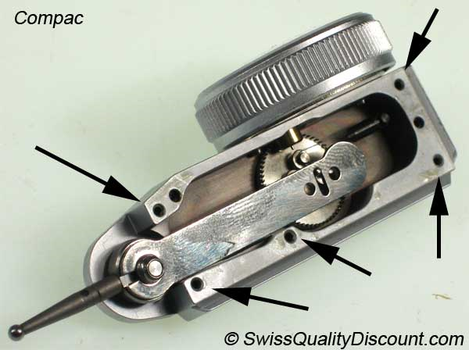
Level the rotary table
Check to see there is air to the table. If so, gently is if it rotates
Attach a tenth indicator to the flexible arm of the magnetic base indicator stand
See that the indicator reads correctly when the tip is pushed upward

Slide 8
Level the rotary table, con’t
Loosen the lock on the flexible arm and move indicator tip to top edge of table
With tip slightly above table lock the flexible arm
Slowly rotate the table and watch the gap between the tip and table
Use a shred of paper to mark the high point
Use the leveling screws to make table top level by eye
Lower indicator tip to just touch table and rotate table slowly. Mark high point
How should the tip be adjusted to be most sensitive?
Continue leveling until table is level to 0.0001” total indicator reading (TIR)
How level is the table now in angle?

Slide 9
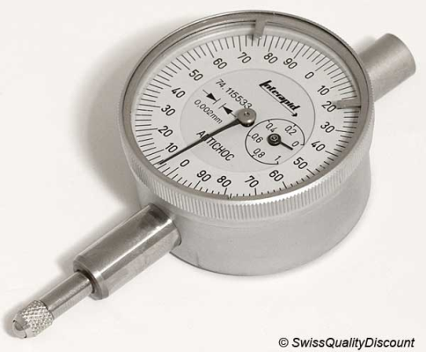
Centering a plane parallel disk
Place a plane parallel disk on the rotary table
Center the disk by eye using the groves
Put a long travel indicator in the indicator stand
Position the indicator tip to point normally to the periphery of the disk
Gently move the indicator toward the disk until you get a reading all around
Mark the disk with a shred of paper and tap disk to center it to 0.001”
How does the roundness of the disk affect your ability to center?
Now measure the upper surface; is the disk parallel?

Slide 10
Centering a lens
Place the three ball fixture on the rotary table
Set the convex surface of a lens on the balls
Adjust a short range indicator to be just below the lower lens surface
Tap the three ball fixture to center the gap between lens and tip
This centers the fixture so the balls
Are equi-distant from the table axis

Slide 11
Centering a lens, con’t 1
Where is the center of curvature of the lens lower surface?
How does the lens lower surface contact the three balls?
How many degrees of freedom does a spherical surface have?
Bring the indicator tip up to the lens lower surface
Center by tapping fixture and finally by adjusting centering screws

Slide 12
Centering a lens, con’t 2
Now bring the indicator above the top surface
Tap the lens (using something plastic) to center the upper surface
What happens to the lower surface?
When centered by eye bring indicator down on surface
Continue to 0.0001” TIR
Where is the center of curvature of the upper surface
Indicate the periphery of the lens. Is the edge concentric with the OA?
What does this say about the coincidence of the optical and mechanical axes?

Slide 13
How well have you done?
Use the alignment telescope to check the centering
Lower the plane mirror over the rotating lens so lens can be seen with the alignment telescope
Does the bullseye pattern move?
Can you do any better by using the fine adjustment knobs?
Use the PSM to pick up the centers of curvature from the two surfaces
Does the spot move?
Can you do any better by using the fine adjustment knobs?

Slide 14
Checking centering of a lens
Method of checking lens centering without a rotary table
Is periphery concentric with the optical axis
Use fixture in picture; controls five degrees of freedom
Three balls are datum A, the two pins datum B, the axis
Rotate lens on balls holding it against pins, indicate upper surface
Isometric View

