Slide 1
Adhesives and fasteners

Slide 2
Notes on adhesives
The “best” when they work correctly; “worst” when they fail
Determine the right adhesive for the job
Prepare adhesive and surface correctly
Use correct bond thickness
Fish line (monofilament) for spacers
Let cure before applying load; be patient!
Watch shelf life, mark date on new adhesive
Store in refrigerator or cool spot
Watch that maker has not “upgraded” adhesive
May no longer work like it used to
Prepare a properly engineered bonding procedure and use it!

Slide 3
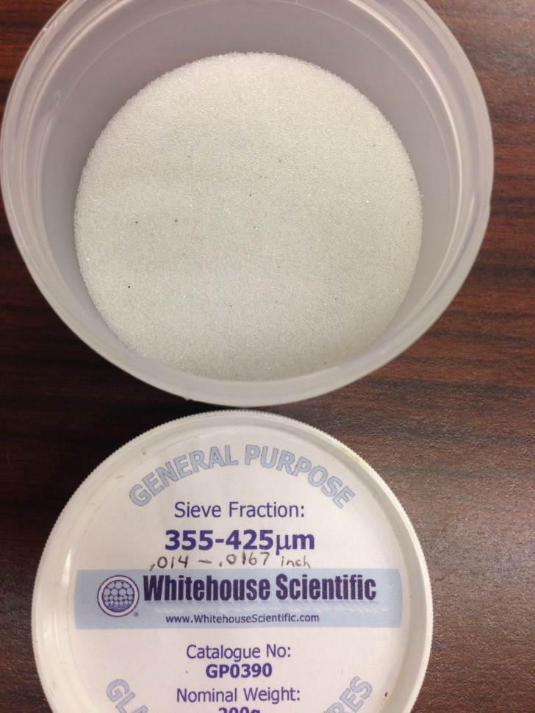
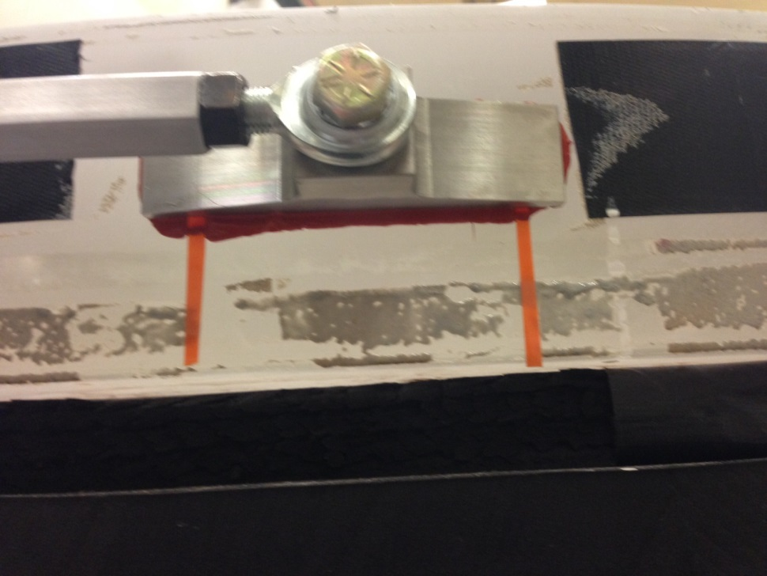
Bond line thickness

Slide 4
Epoxy
Epoxy resin (uncured) is mildly toxic; wear gloves when using
Forms very strong bond, but is hard and somewhat brittle
Strong enough to pull apart glass; exercise caution
Two part adhesive; usually mixed 1:1, but not always
Cure rates/pot life variable with type and quantity of hardener
Fairly viscous but wets surfaces well and will flow
Clamp surfaces until at least partially cured
Debonds with heat but may have to get quite hot
Uncured resin cleans up with acetone

Slide 5
Urethane
Has some give; it is a soft but tough adhesive
Maybe a substitute for RTV; similar properties
Two part adhesive with relatively short pot life
Very sticky; can get everywhere if not careful
Wets surfaces well; will bond plastics that others won’t
Uncured cleans up with acetone

Slide 6
Bond thicknesses
For bonding metal to glass use a soft adhesive
One with give like RTV or urethane
Leave a thick bond line if possible
Can then cut off with thin wire if need to debond
Thick bond will be weak in shear
For low expansion, stable joints use very thin bond line
Adhesives have 10x or more CTE than glass/metals
Hard adhesive & thin bond, something will shear if two halves of bond expand at different rates
Note: epoxy cures exothermically, bond will get hot
Microspheres in cement for thin spacers

Slide 7
Cementing optics like doublets
Use UV curing optical cement
Use 1 drop in concave element
Large lenses a challenge
Set mating surface on cement
Use orbital motion to work cement out to edge
Work slowly to avoid trapping air bubbles
Take apart if bubbles in joint
Center in “V” block or rotary table
Tack with UV light gun for 15-30 seconds
Finish cure with heat or soft UV lamp
Debond in boiling water or oil if water doesn’t work
Be patient, it may take hours

Slide 8
Cementing tips
When potting optical elements in a cell, leave gaps in the cement, even a soft cement. Without gaps there is no place for the cement to expand or contract so the cement will act as though it were hard and distort the optics
Most adhesives shrink on curing. In most cases this is good, but beware, can cause distortion if surfaces not flat

Slide 9
Debonding tricks
Always use eye protection; debonding unpredictable
Use CTE to your advantage; hot or cold so surface pulls away
Use shear by applying mechanical force via wooden clamp
Stress half of joint, then add shock
Usually hard cement will shear
If you plan to have to debond leave channels in the cement
so solvents, etc., can get to the interior of the cement

Slide 10
http://www.tpub.com/content/bridges/TM-5-5420-278-24P/css/TM-5-5420-278-24P_385.htm
Reference for torques for screws. Go to “next” to find tables
http://www.gluguru.com/Adhesives%20Menu.htm
Reference for many types of adhesives

Slide 11
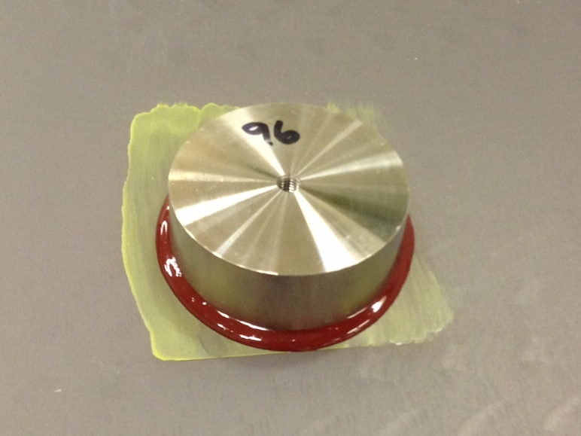
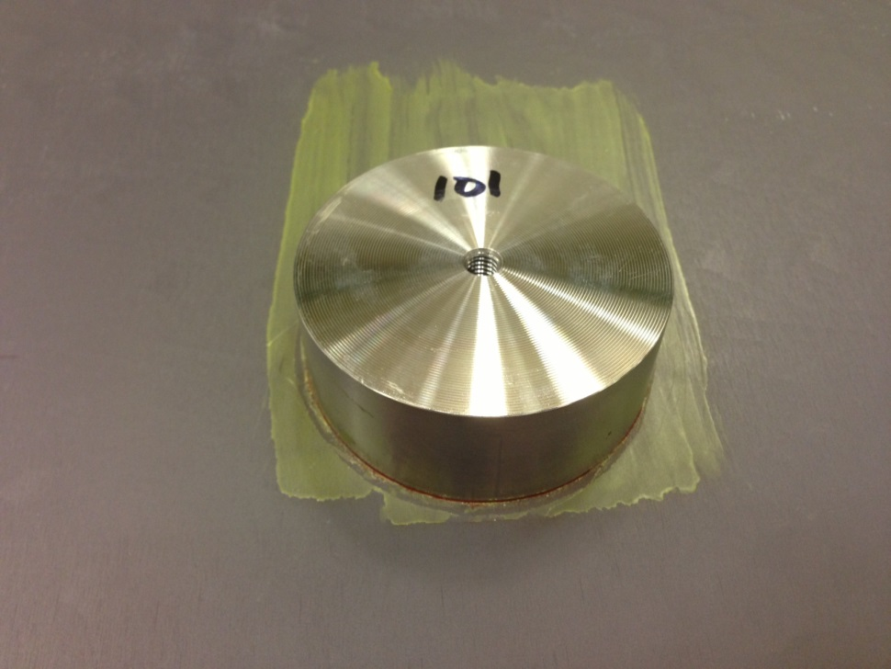
Puck Bonding

Slide 12
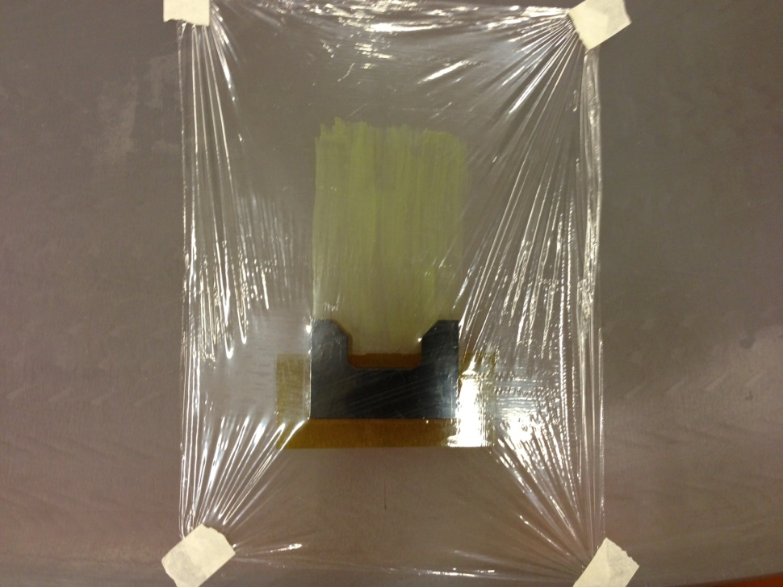
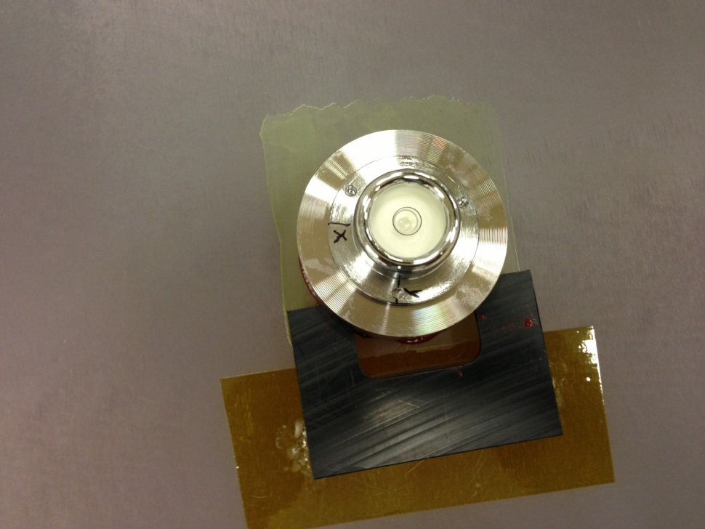
Puck Bonding
Reference circle
= 2.25arcmin
Primer
Bubble level
V-block
Actual puck

Slide 13
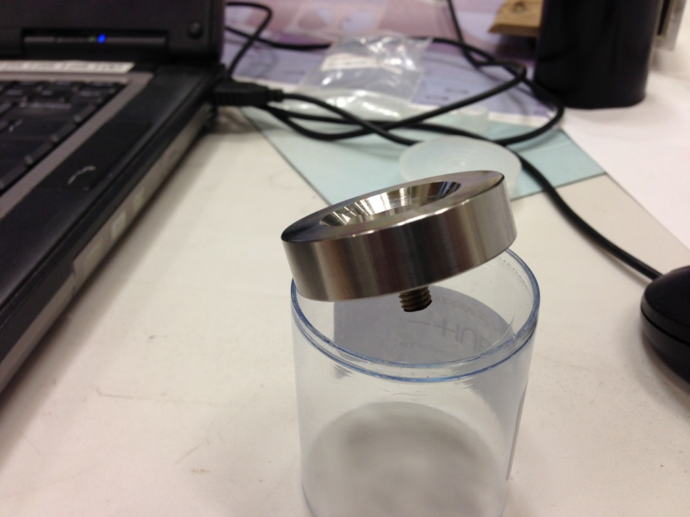
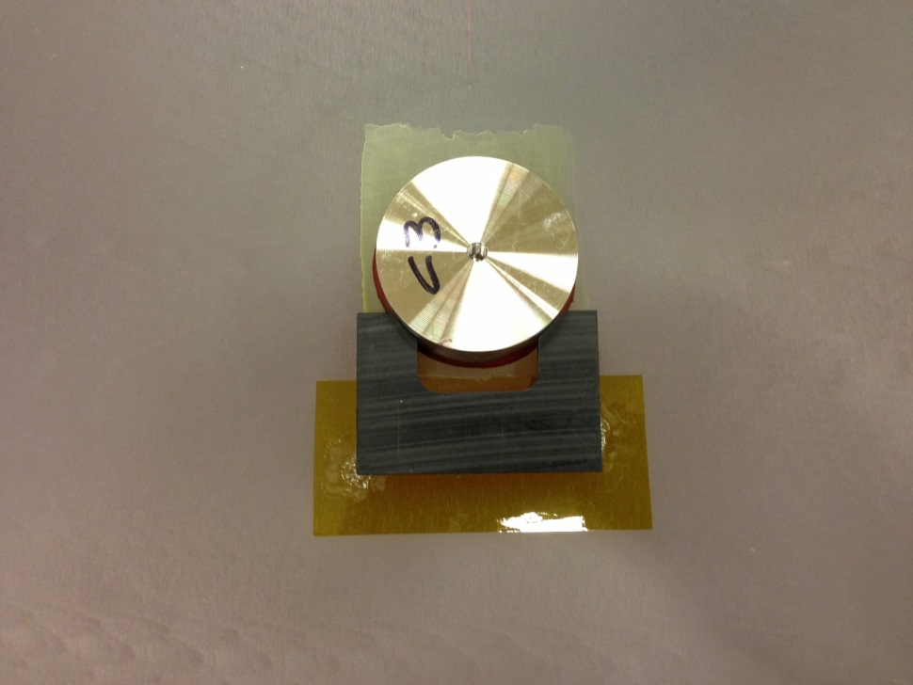
Puck Bonding
SMR nest with M6 thread for
puck position check
Bonded puck

Slide 14
Zone C
Zone A
Zone B
UA wants to get approval from ATST

Slide 15
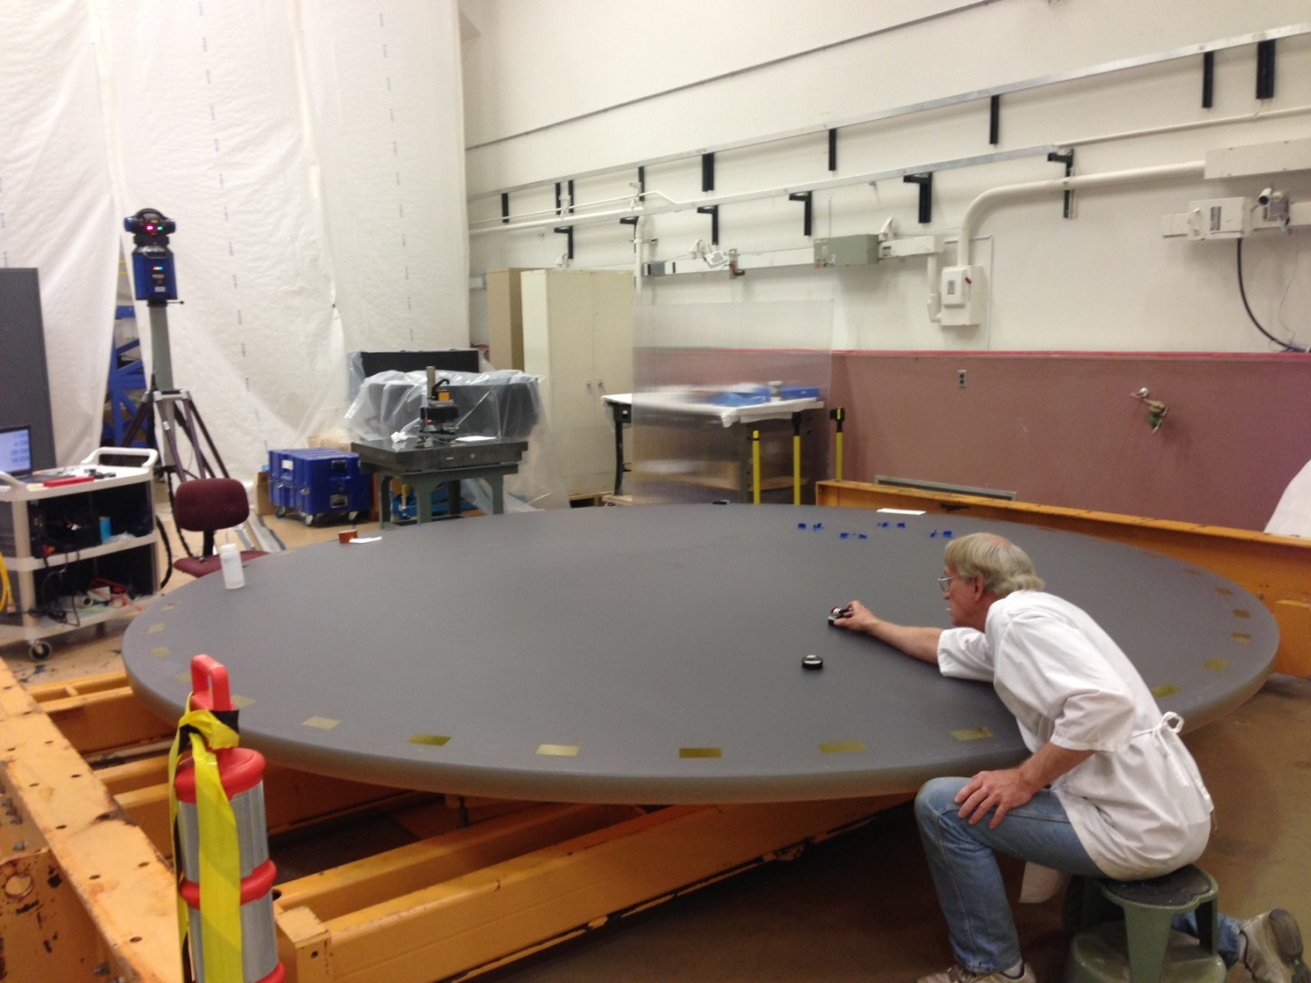
Puck positioning
Laser
Tracker
SMR and Surrogate puck

Slide 16
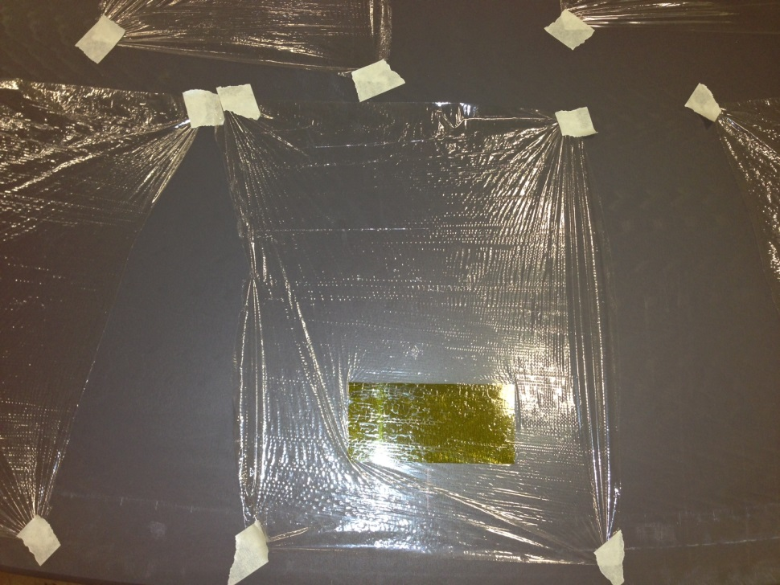
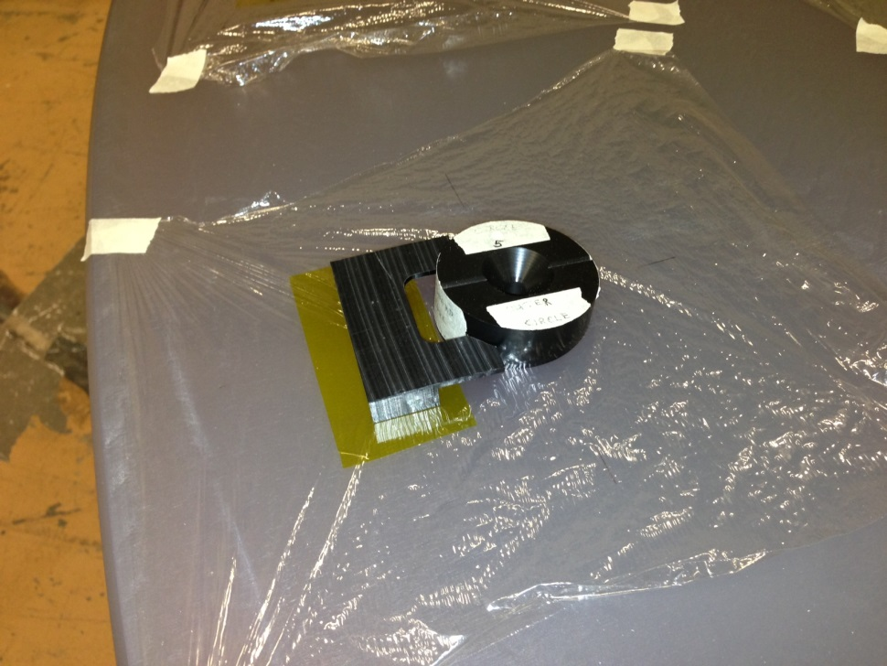
Surface Preparation
Surface prepared and protected
Kepton tape
V-block
Surrogate puck

Slide 17
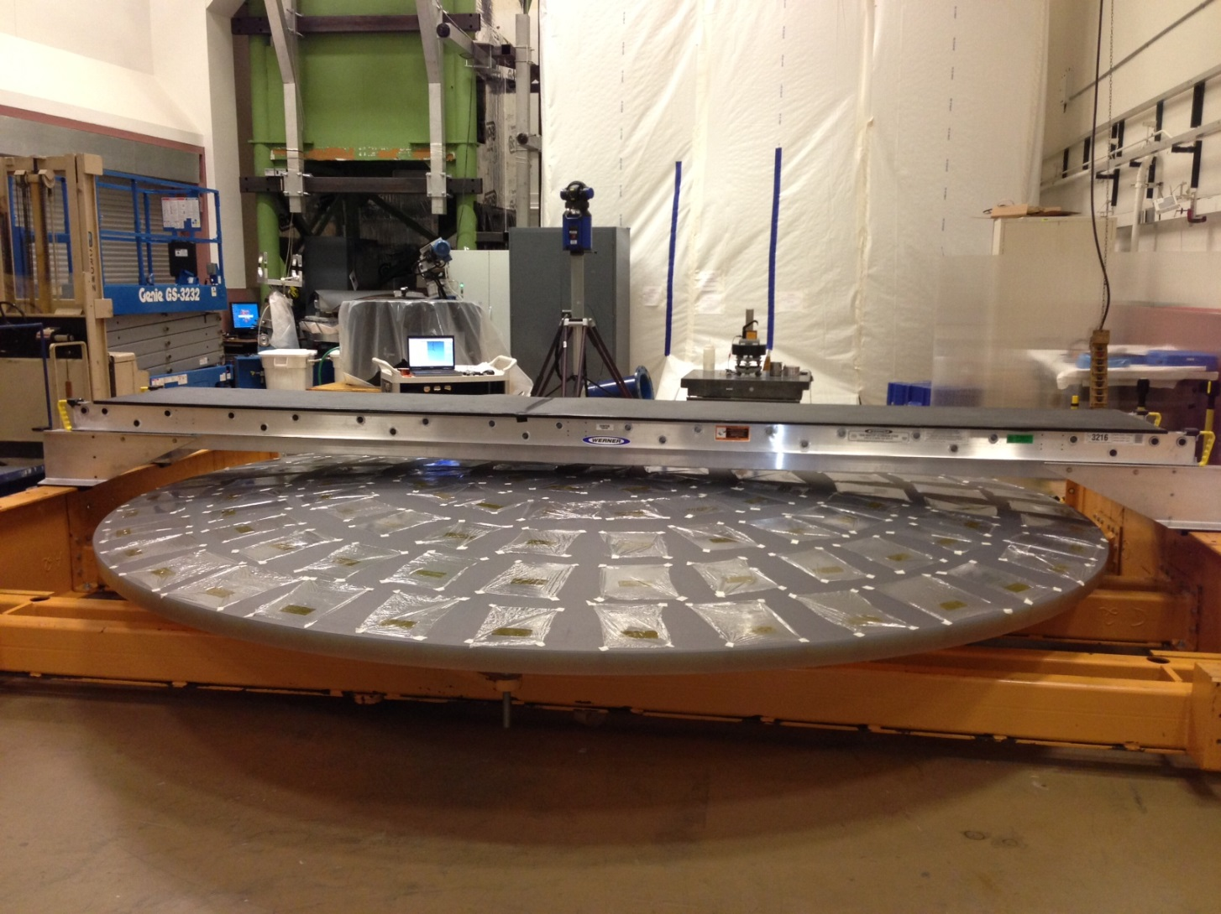
Puck Bonding Prep.

Slide 18
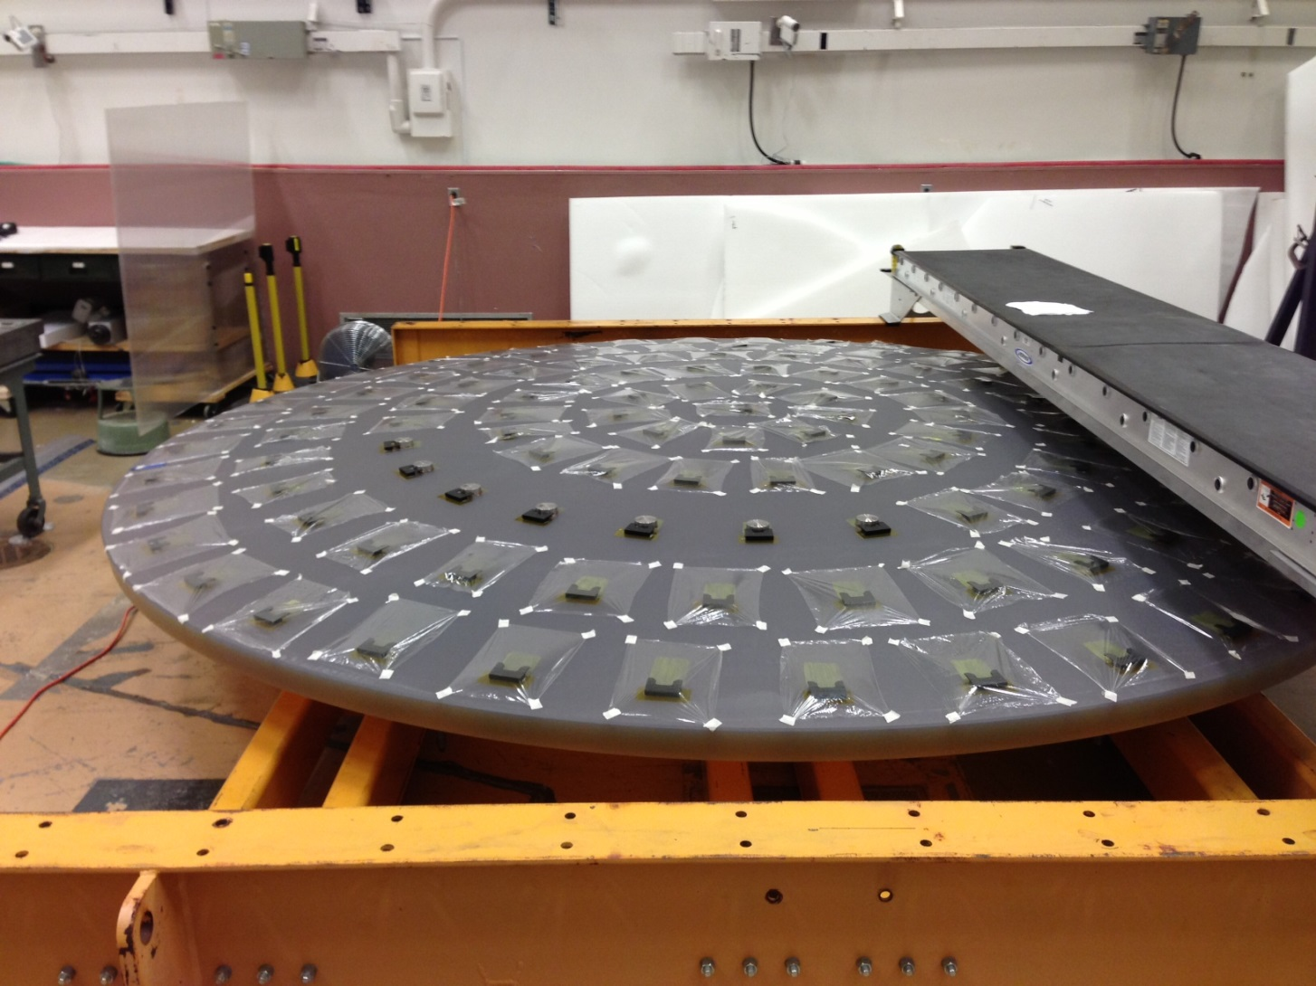
Puck Bonding

Slide 19
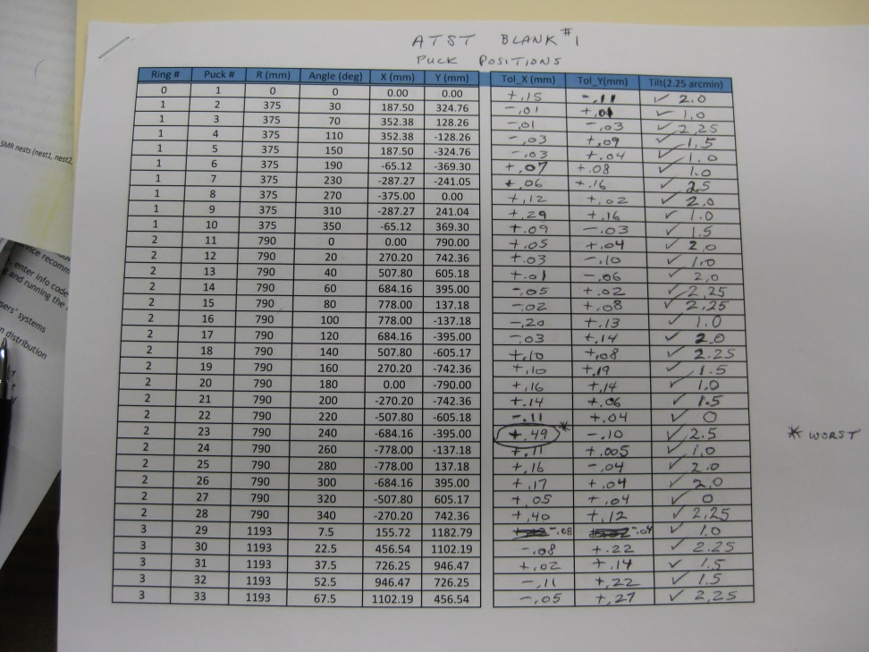
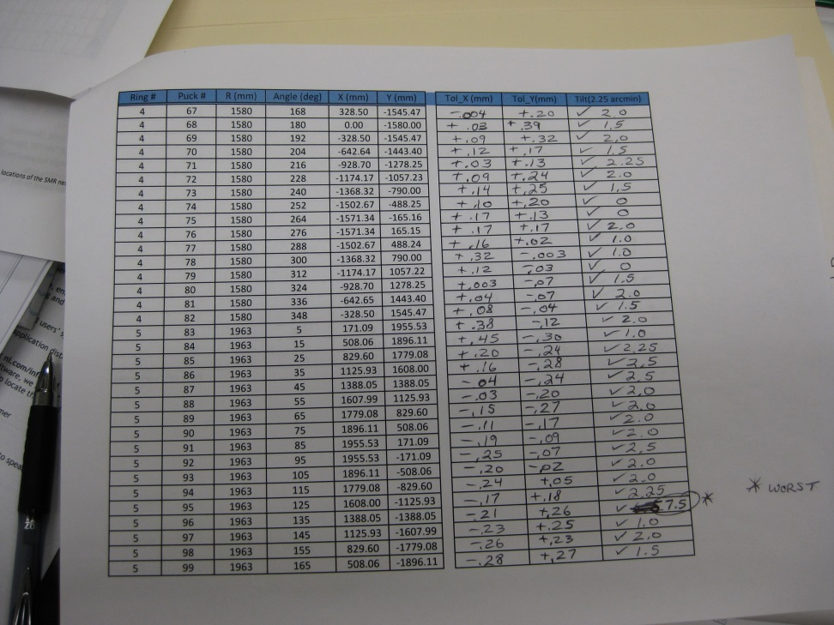
Quality Assurance
Puck Position and Tilt

Slide 20
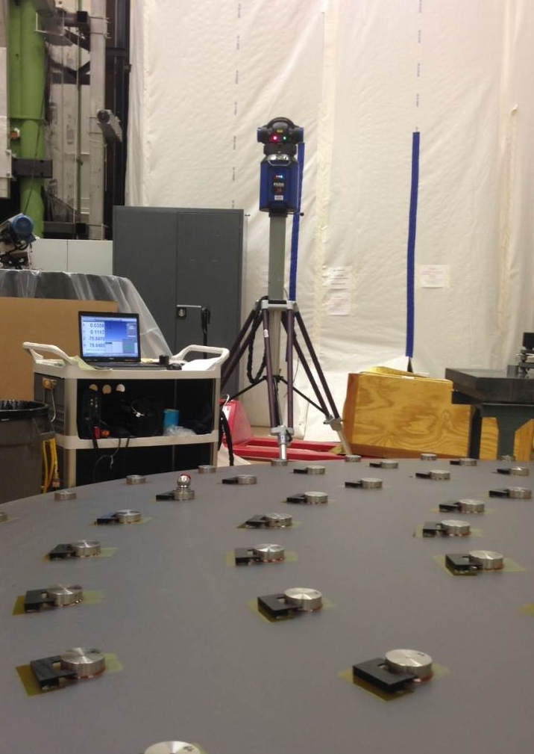
Quality Assurance

Slide 21
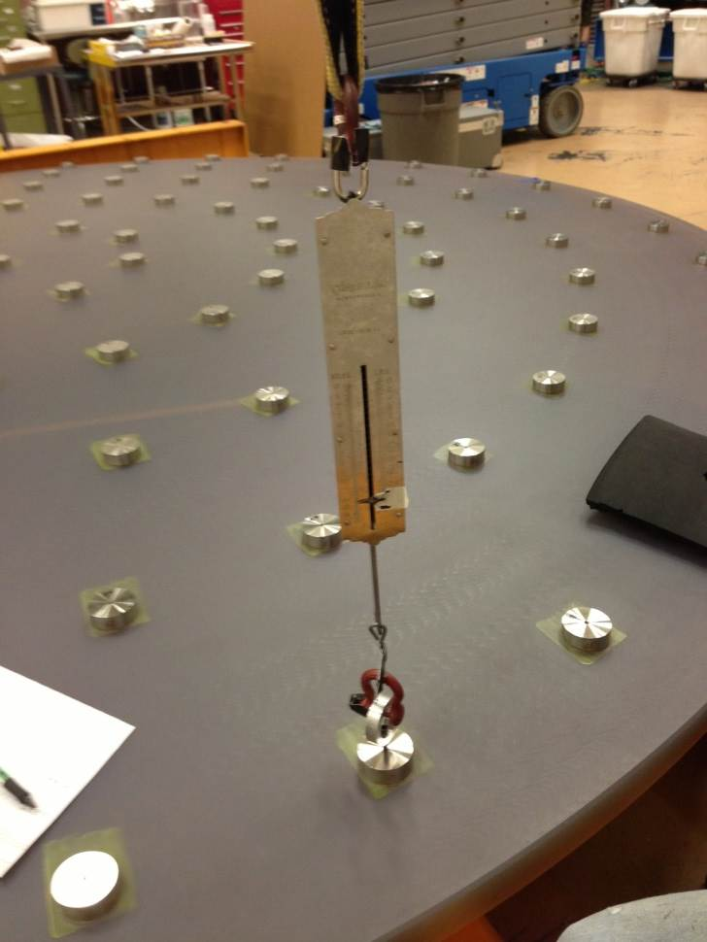
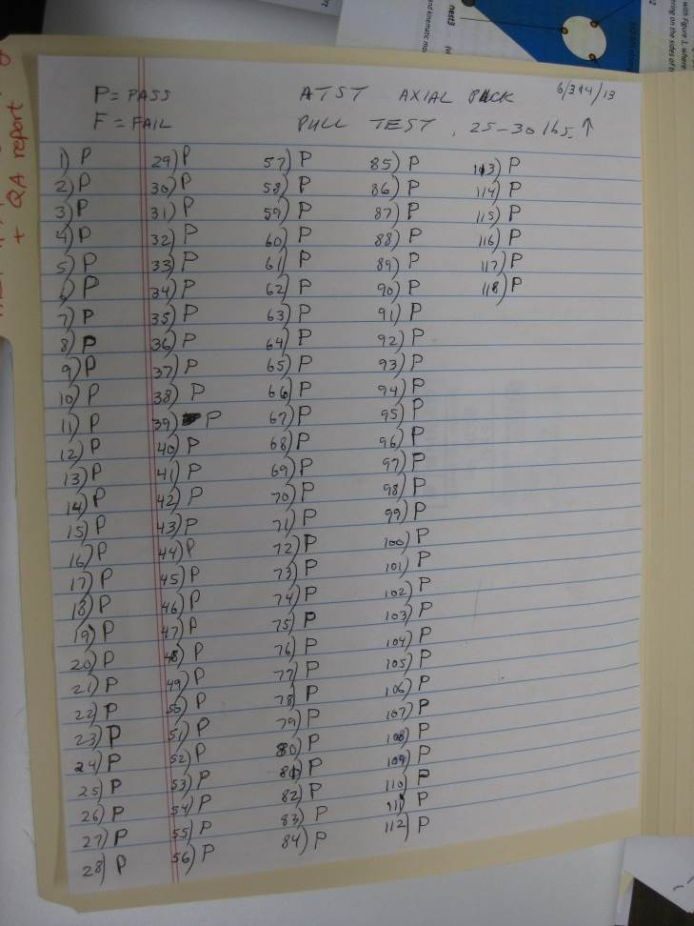
Quality Assurance
Proof load test at 120% of normal loading

Slide 22
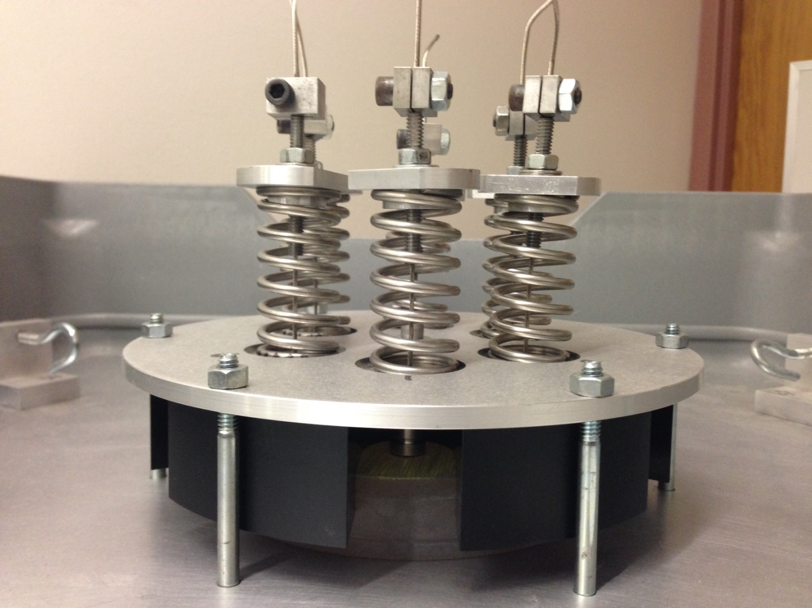
Long Term Creep Test

Slide 23
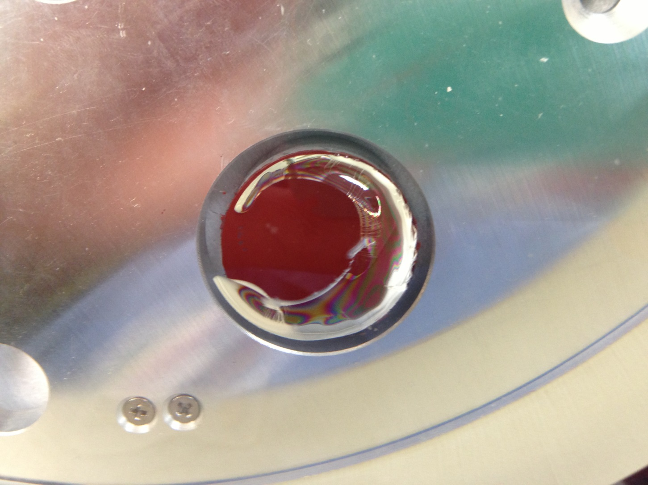
Typical failure mode
Cohesion vs Adhesion

Slide 24
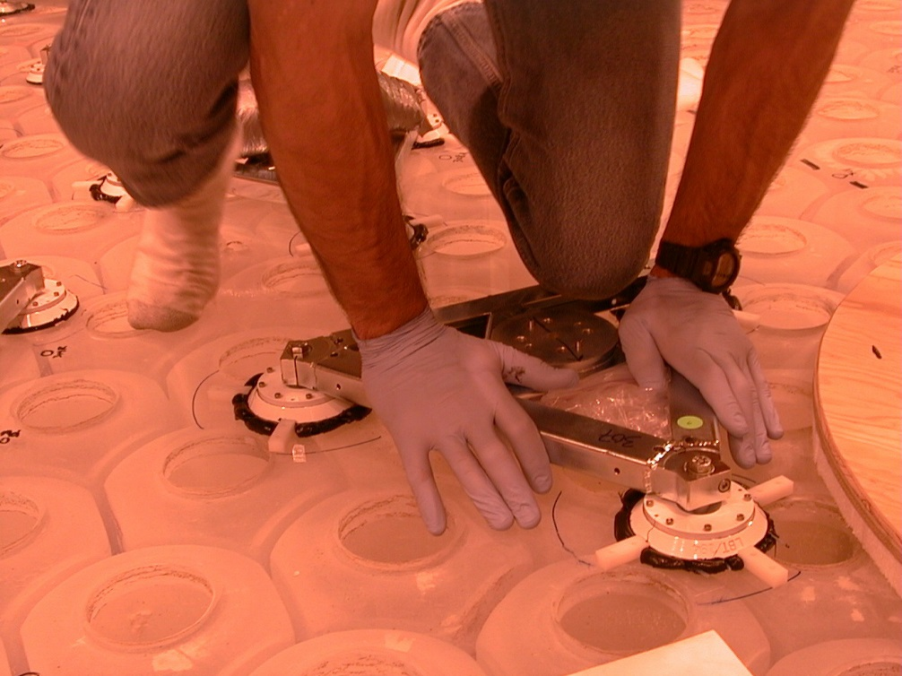
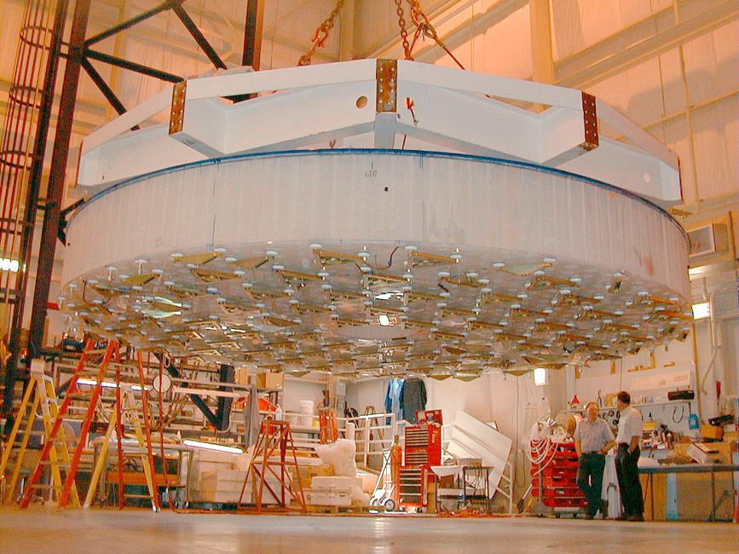
Mirror Support System
Left: Bonding of pucks to the mirror backplate; note the squeeze-out bead of Q3-6093 RTV around the perimeter of each puck (white disks). Right: Pucks & mirror support loadspreader frames on the backplate of an 8.4m honeycomb mirror.

Slide 25
Creep

Slide 26
Test

Slide 28
Creep behavior of RTV-566

Slide 29
Secondary stage
Model vs Experiment

