Slide 1
Final Lab
Janelle Pilar and Isaac Trumper
OPTI521L—Optomech Lab

Slide 2
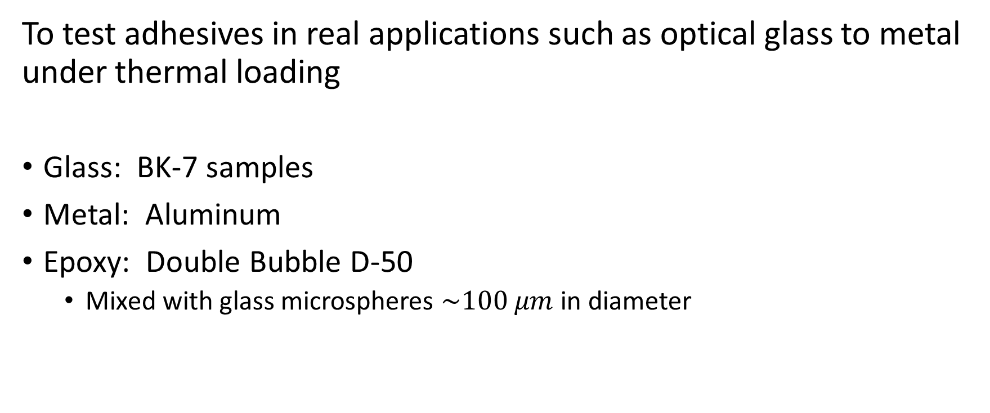
Goal
To test adhesives in real applications such as optical glass to metal under thermal loading
Glass: BK-7 samples
Metal: Aluminum
Epoxy: Double Bubble D-50
  Mixed with glass microspheres $\sim 100 μm$ in diameter

Slide 3
Background
  Bonding glass to metal needs soft adhesive
  Urethane – soft but tough with some give
  Thick bond line (but thick bond will be weak in shear)
  Failure Modes – Cohesion vs. Adhesive
Notes:
Cohesion failure since the two materials did not bond together

Slide 4






Thermal Stress
  Bonding dissimilar materials will create shear in the bond due to different coefficients of thermal expansion.
A
$$α_{1}$$
$$ΔT$$
$$G,t$$
$$α_{2}$$
$$γ$$
$$γ=\frac{A}{2t}\left(α_{1}−α_{2}\right)ΔT$$
$$τ=Gγ$$

Slide 5
Assumptions
Surface preparation for adhesive
Smaller glue joints require less force for failure
Heat or high thermal load will weaken bond strength
Instron machine pulling aluminum from glass on same load line
Use microspheres for thin and even thickness bond line

Slide 6
Double Bubble D-50 Specifications
Urethane D-50
Maximum Service Temperature – 79 °C
Lap Shear Strength
  -40 °C – 4580 psi
  25 °C – 2960 psi
  82 °C – 470 psi
  149 °C – 380 psi
Data sheet measurements are based on Aluminum to aluminum bonds
T-Peel Strength
  -40 °C – 4.0 pli
  25 °C – 62.0 pli
  82 °C – 2.5 pli

Slide 7
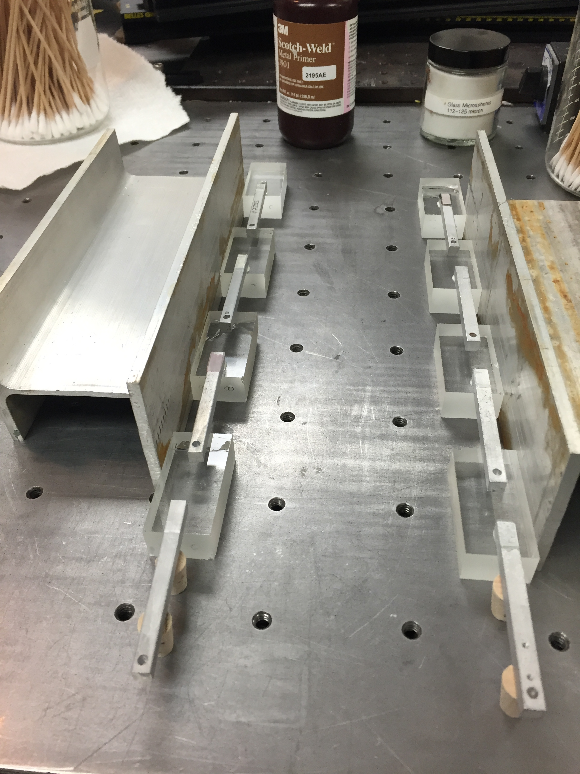
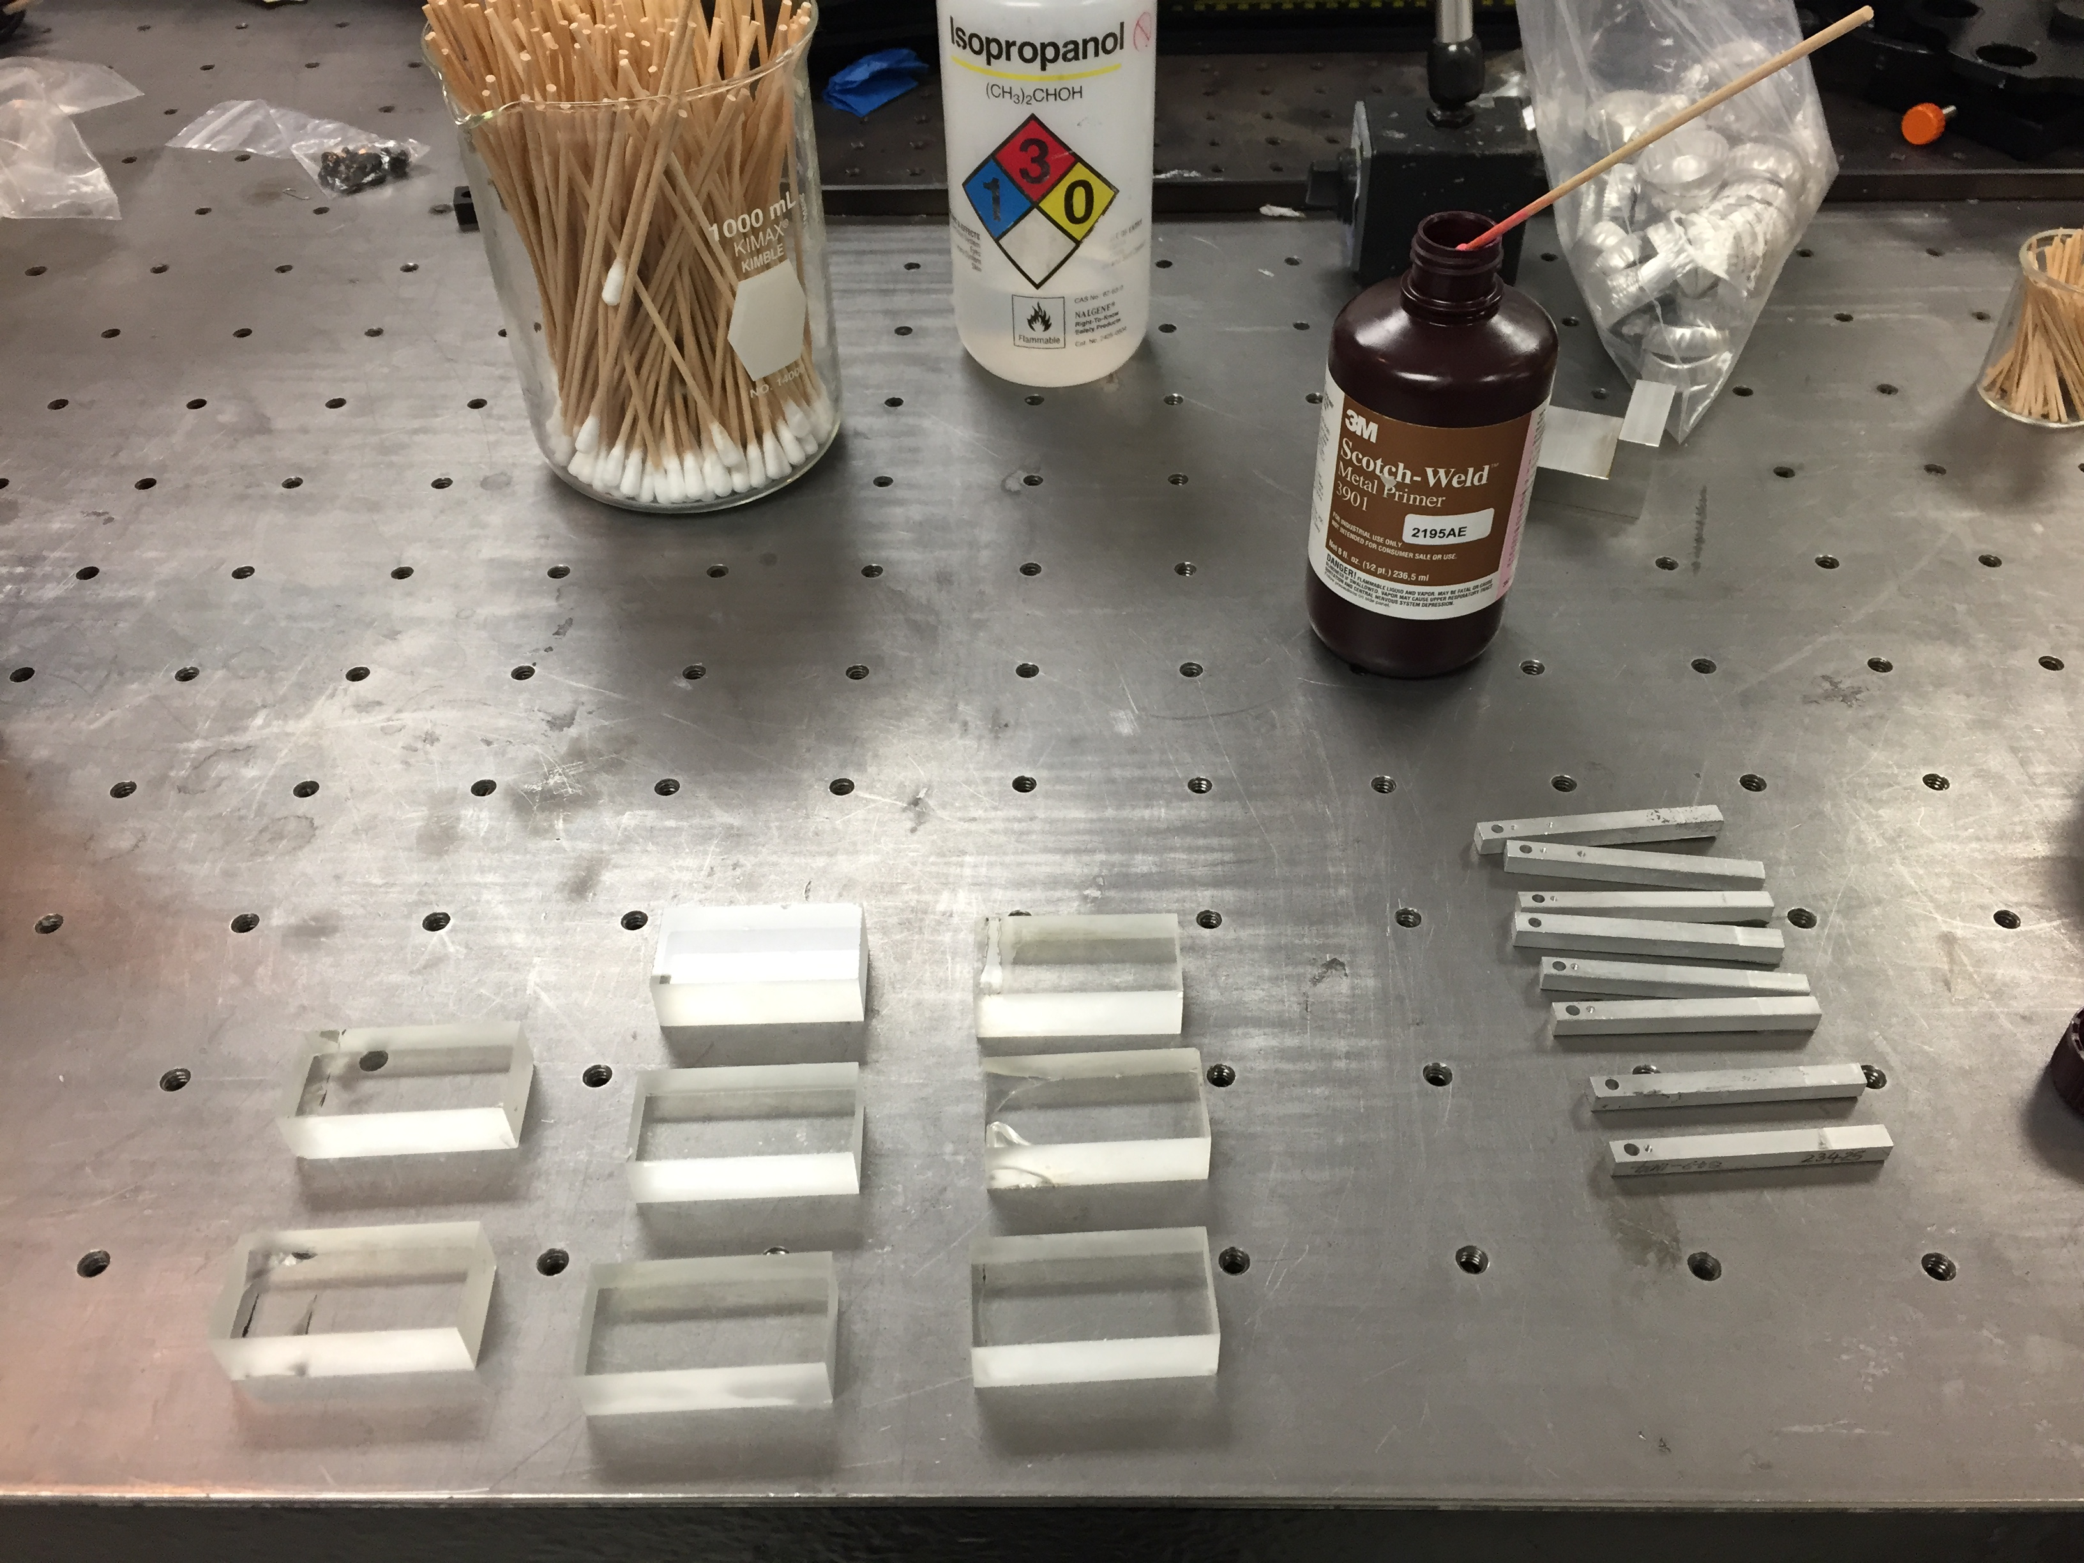
Sample Prep
Notes:
Cleaned glass and aluminum with isopropanol
Used 3M Metal Primer
Easier with smaller glue joints – less amount of force needed for failure
Cure for at least an hour (day before)

Slide 8
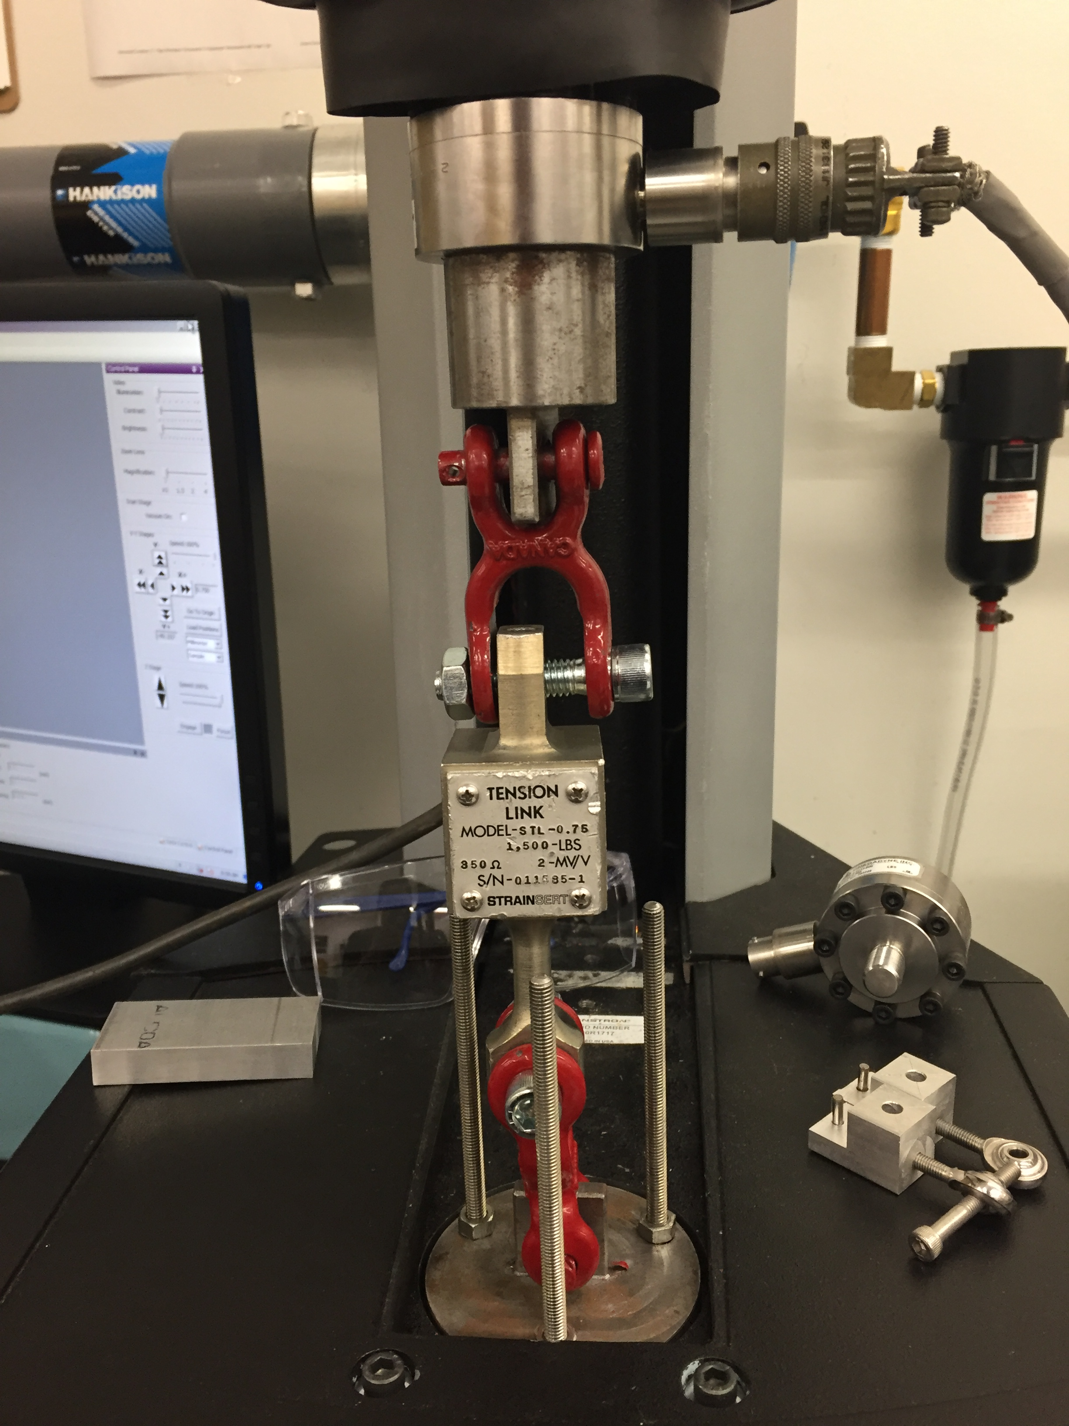
Load Cell Calibration
Compare measurement data between the Tension Link and the load cell used in the Instron
Tension Link is already calibrated
Notes:
Cleaned glass and aluminum with isopropanol
Used 3M Metal Primer
Easier with smaller glue joints – less amount of force needed for failure
Cure for at least an hour (day before)

Slide 9
Calibrating the Load Cell
Instron load cell needs an offset and scale factor (slope) to measure accurately.
Compare against Tension Link and use the ratio as the scale factor.

Slide 10
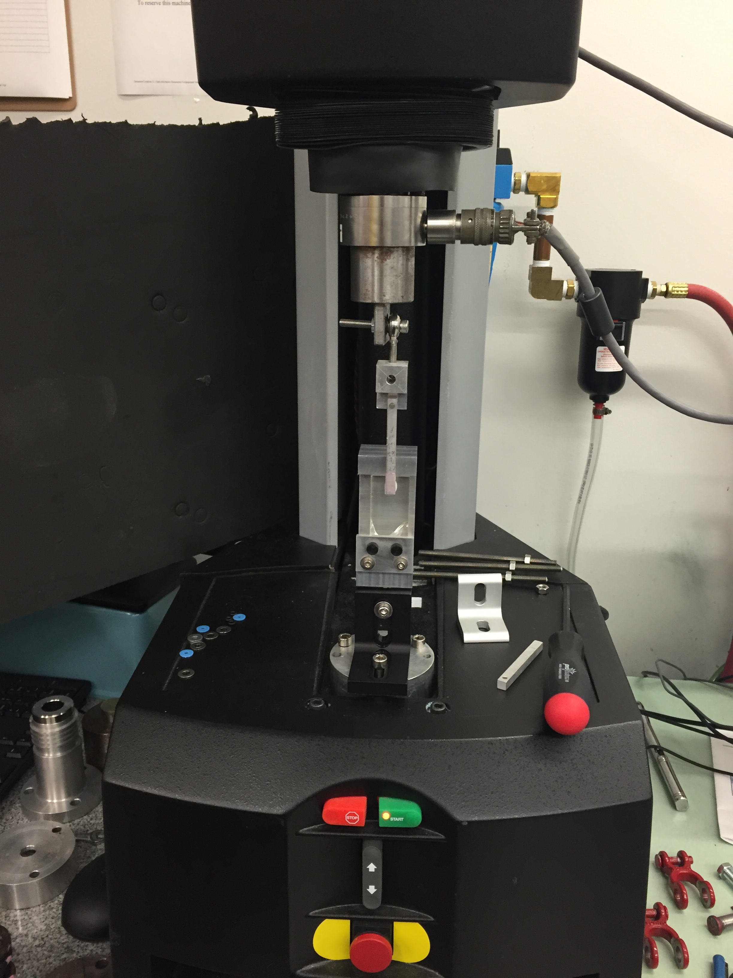
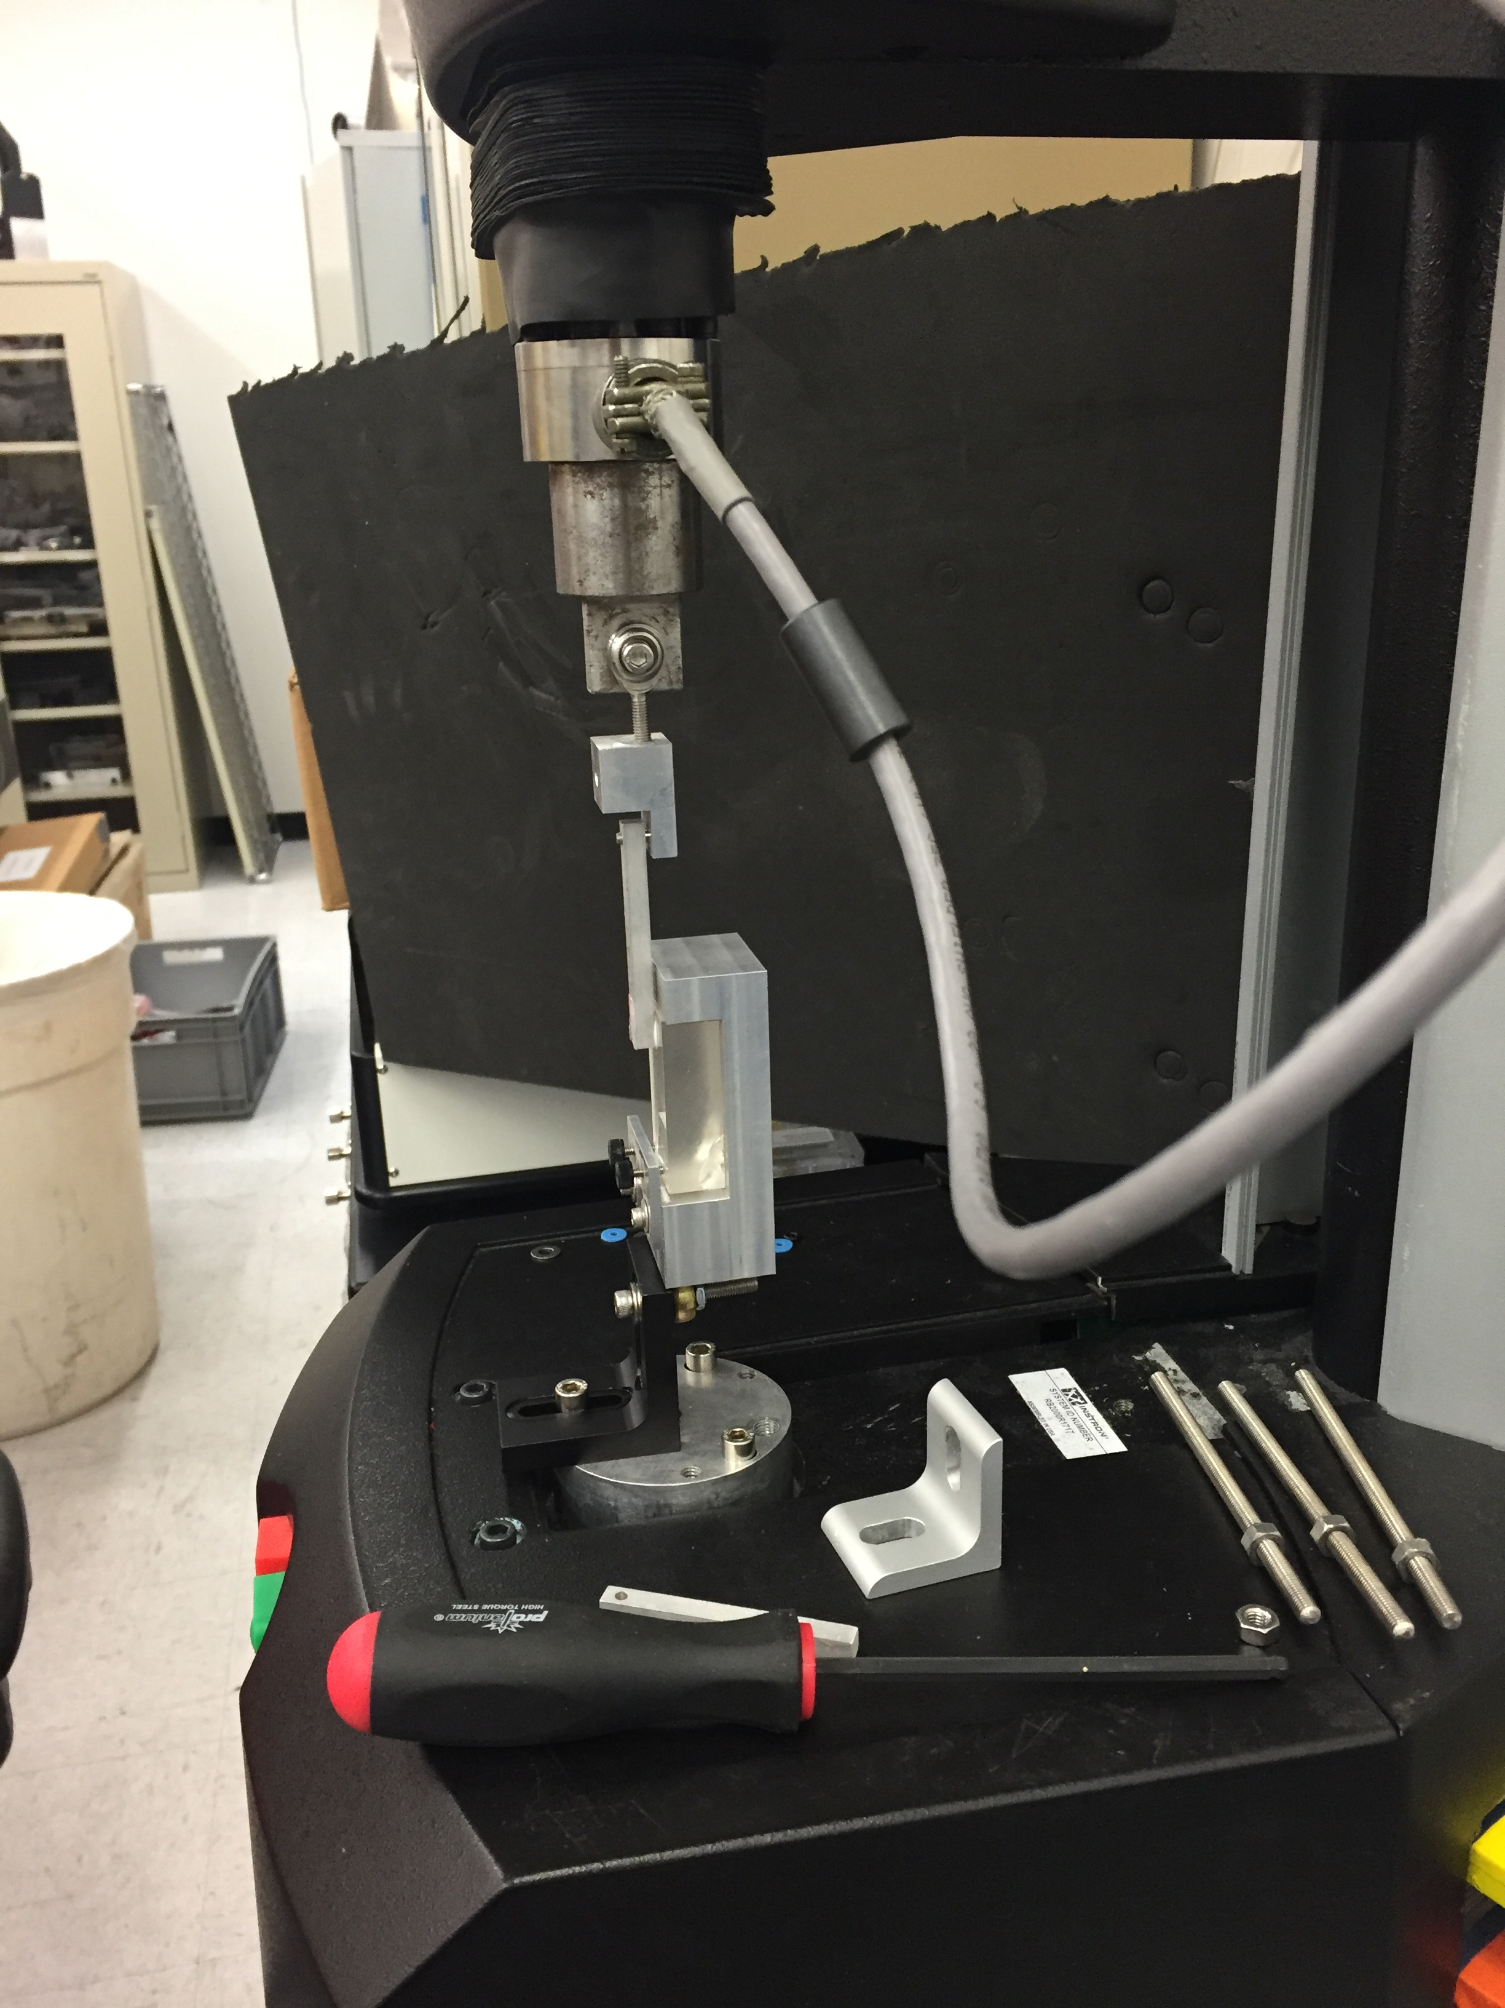
Load Methods
Notes:
- Describe kinetic mounts or degrees of freedom?

Slide 11
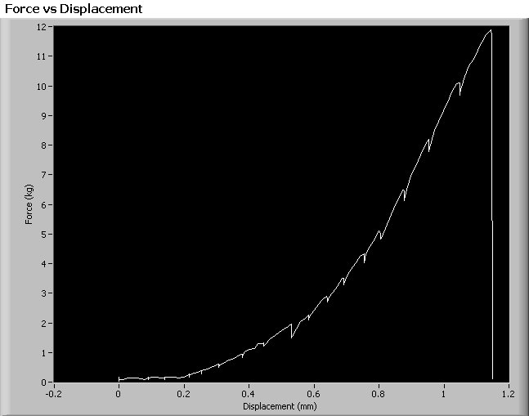
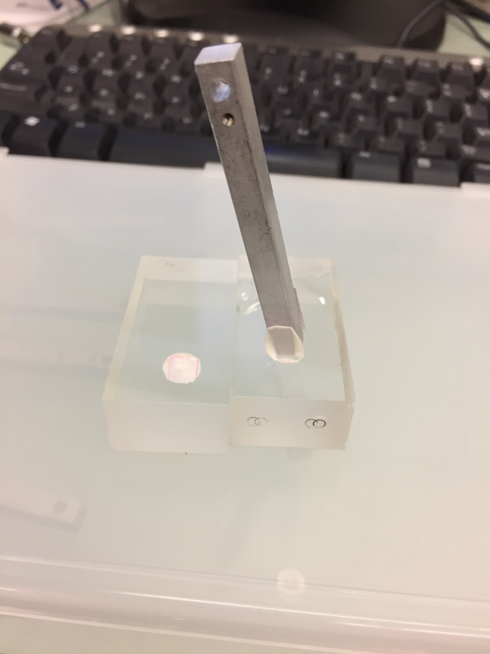
Testing the Glue Joint
Failure due to peeling, caused by improper load path. The glue joint has much lower strength in this mode.
Notes:
Instron and data sample you get from different modes
Failed from load path

Slide 12
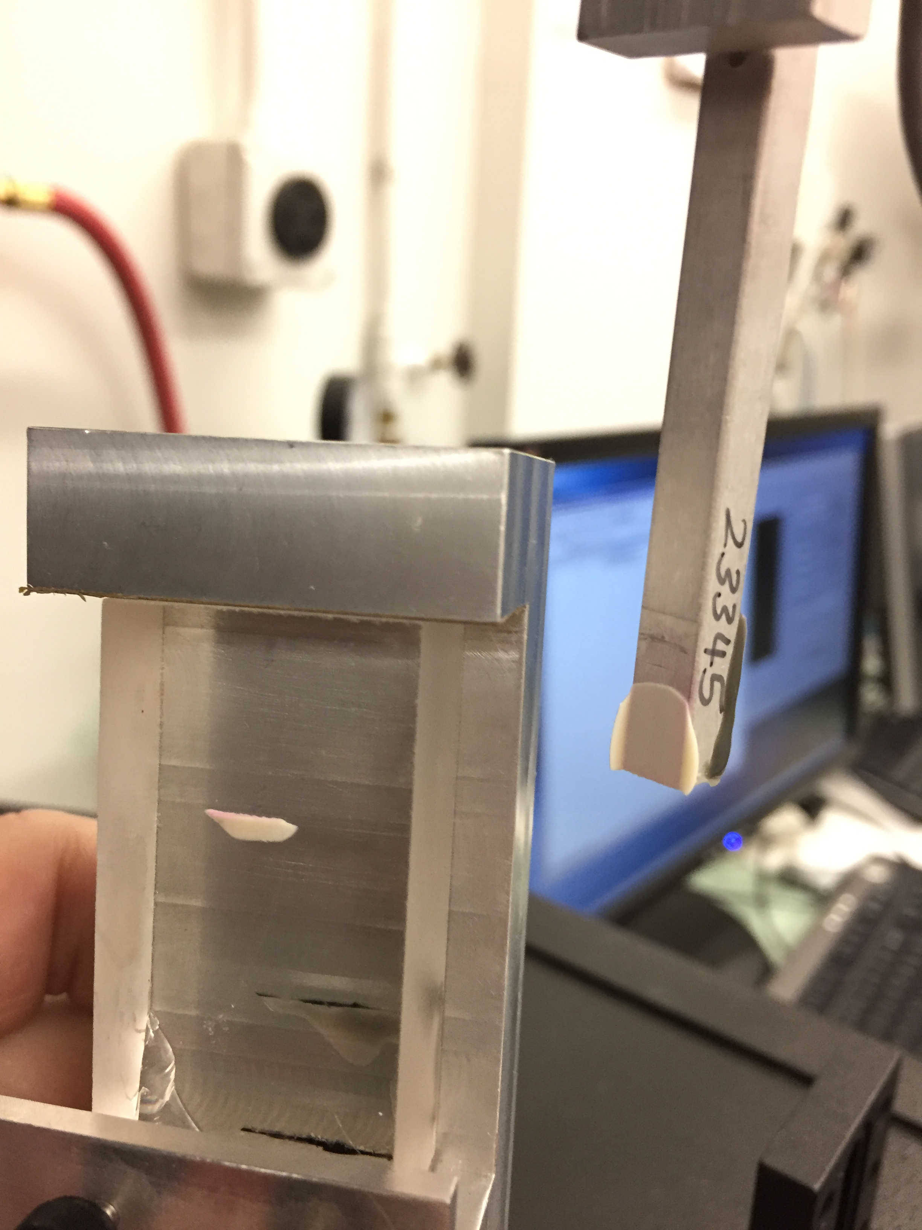
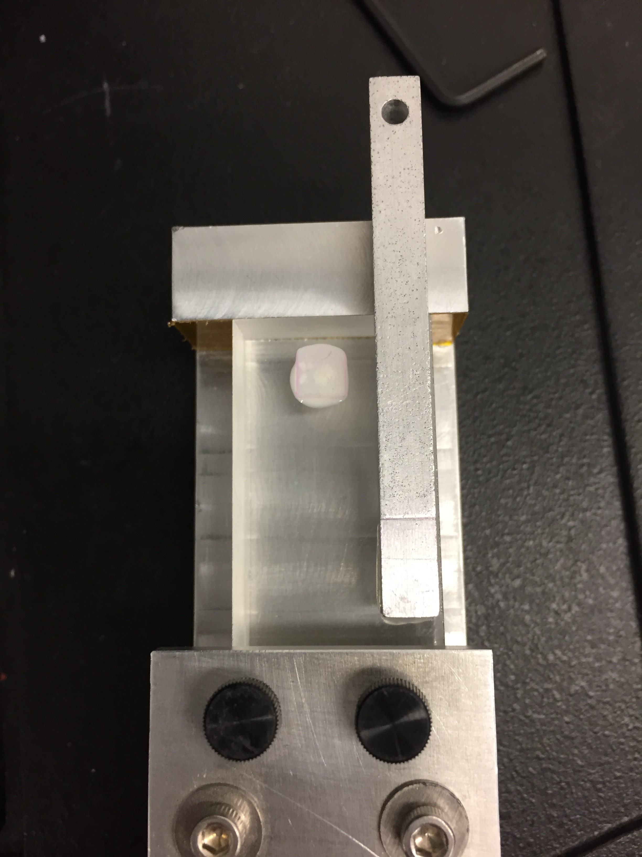
Two Failure Modes
During our experiment, we observed two failure modes for the glue joint. Both were due to cohesion, but the surface that it failed at changed between the aluminum and glass.

Slide 13
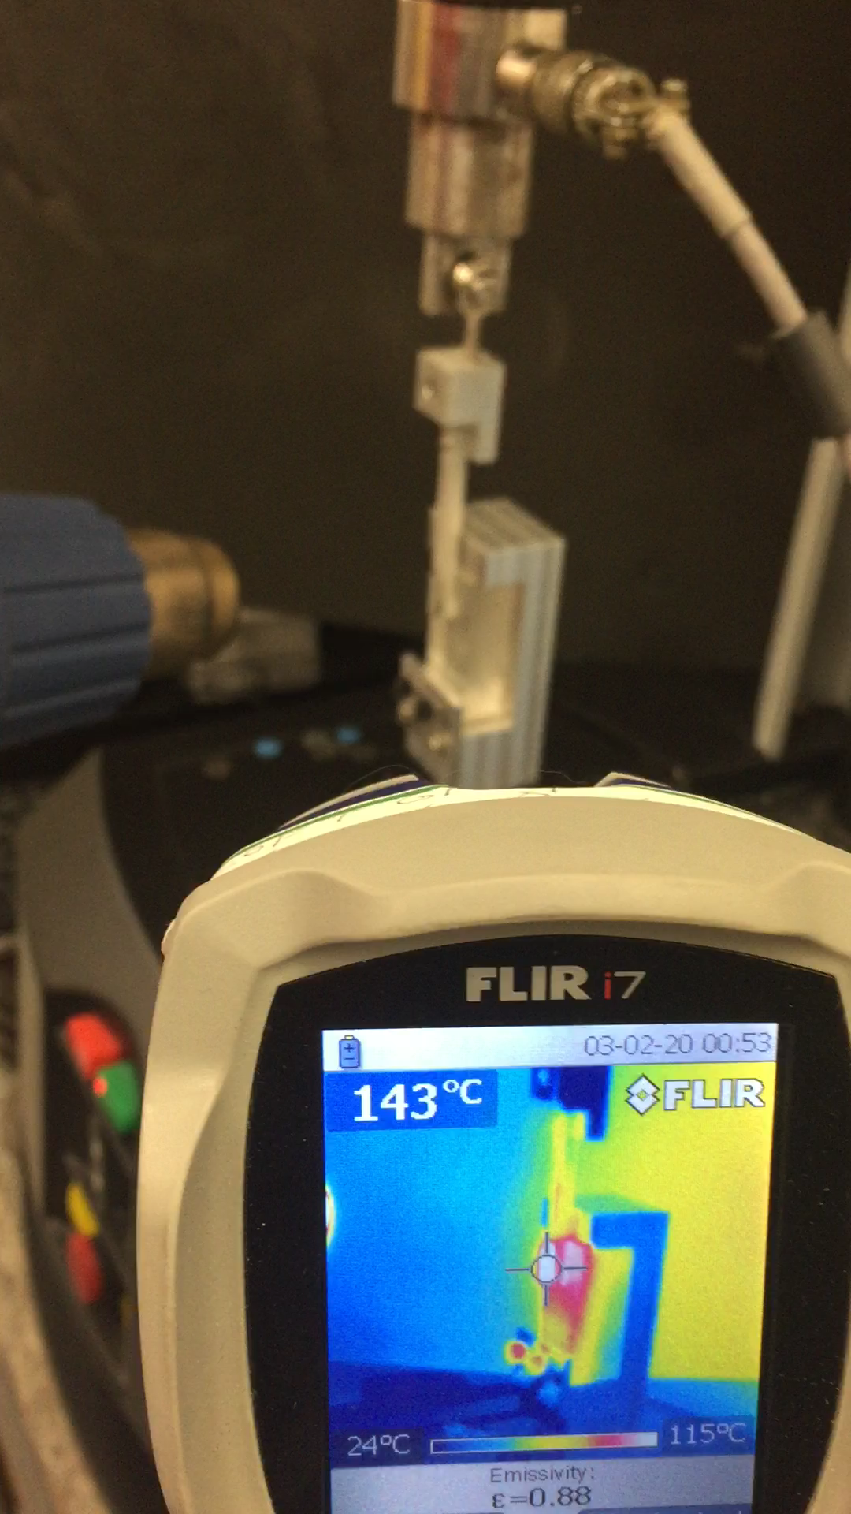
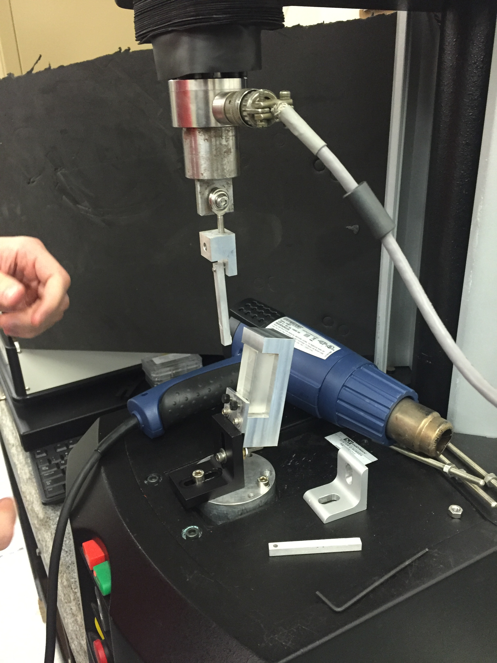
Testing the Glue Joint with Heating
Applied a thermal load to the glue joint using a heat gun and measured a continuous temperature using a FLIR camera

Slide 14
Failure Due to Excessive Heating
Glue joints failed under cohesion, bonding glass to aluminum is not a good application for D-50.
Fairly linear relationship between temperature and force at which the joint fails.

Slide 15
Sources of Error
Our experiment had a few key sources of error
Load path not constrained
Glue joint consistency
Excess glue around bond area
Temperature measurement location
Non-ideal bonding surfaces
Notes:
- Glue joint may have moved while curing and somewhat broken bond
Did not clean excess glue so different areas of glue may change bond strength

Slide 16
Conclusion
From our experiments, we can conclude that D-50 does not bond well between aluminum and glass.
Further, the peel strength of a glue is significantly lower than its shear strength.
Due to thermal expansion, the bond will break under large thermal loads.

