Slide 1
OPTI 421L Final Project: Modal Testing for Secondary Mirror Mount
Jacob Garan, Jacob Boyer, James Hernandez

Slide 2
Introduction
In Lab 9: Vibration and Modal Testing, we analyzed the frequency response of a cantilever beam at multiple points
In doing so, the mode shapes and resonant frequency of the system was identified
The results may be compared to what theory predicts to estimate the accuracy of the testing results

Slide 3
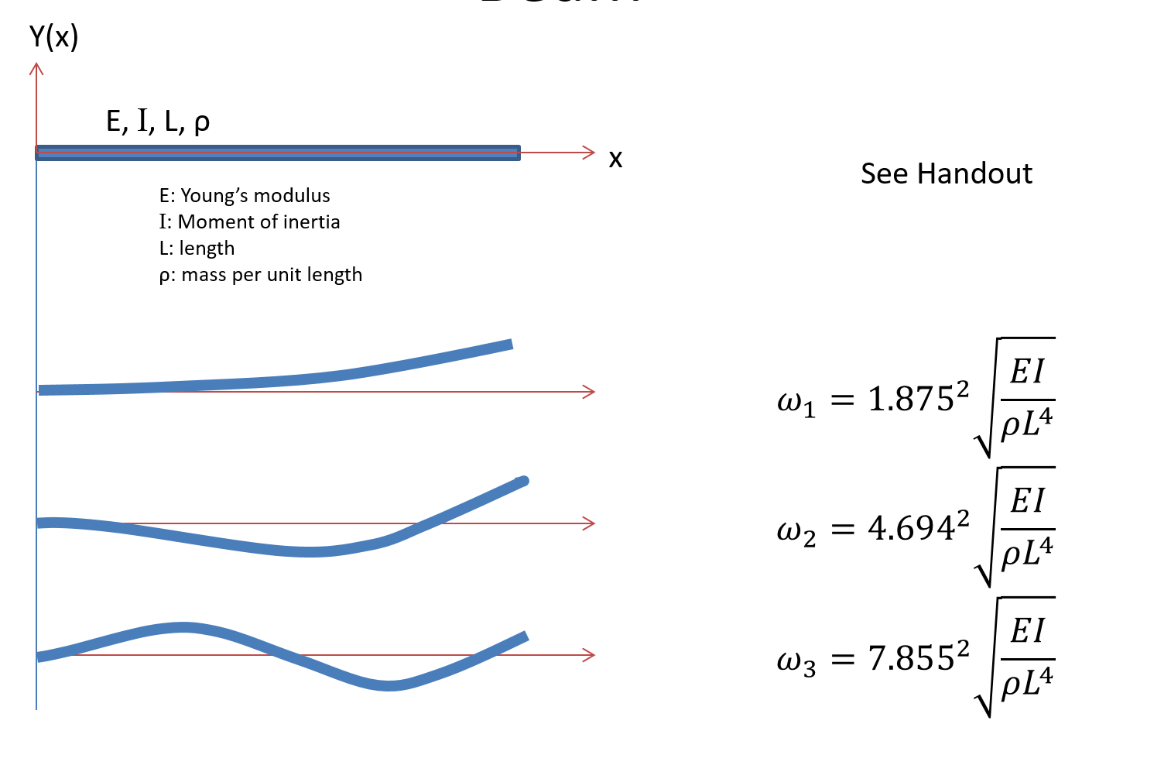
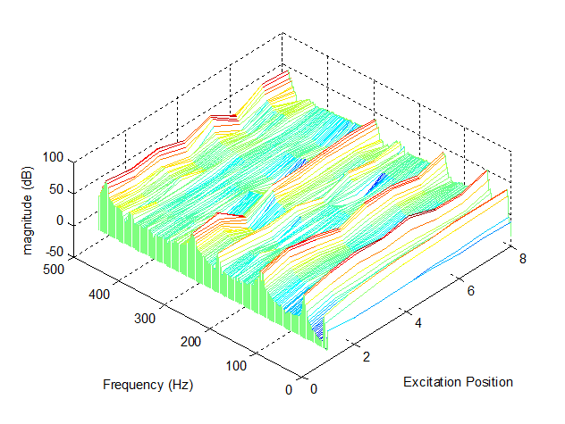
Example

Slide 4
Introduction
To extend and build upon this topic, a new system was analyzed, but one that was a bit more complex and relevant to real-life applications!

Slide 6
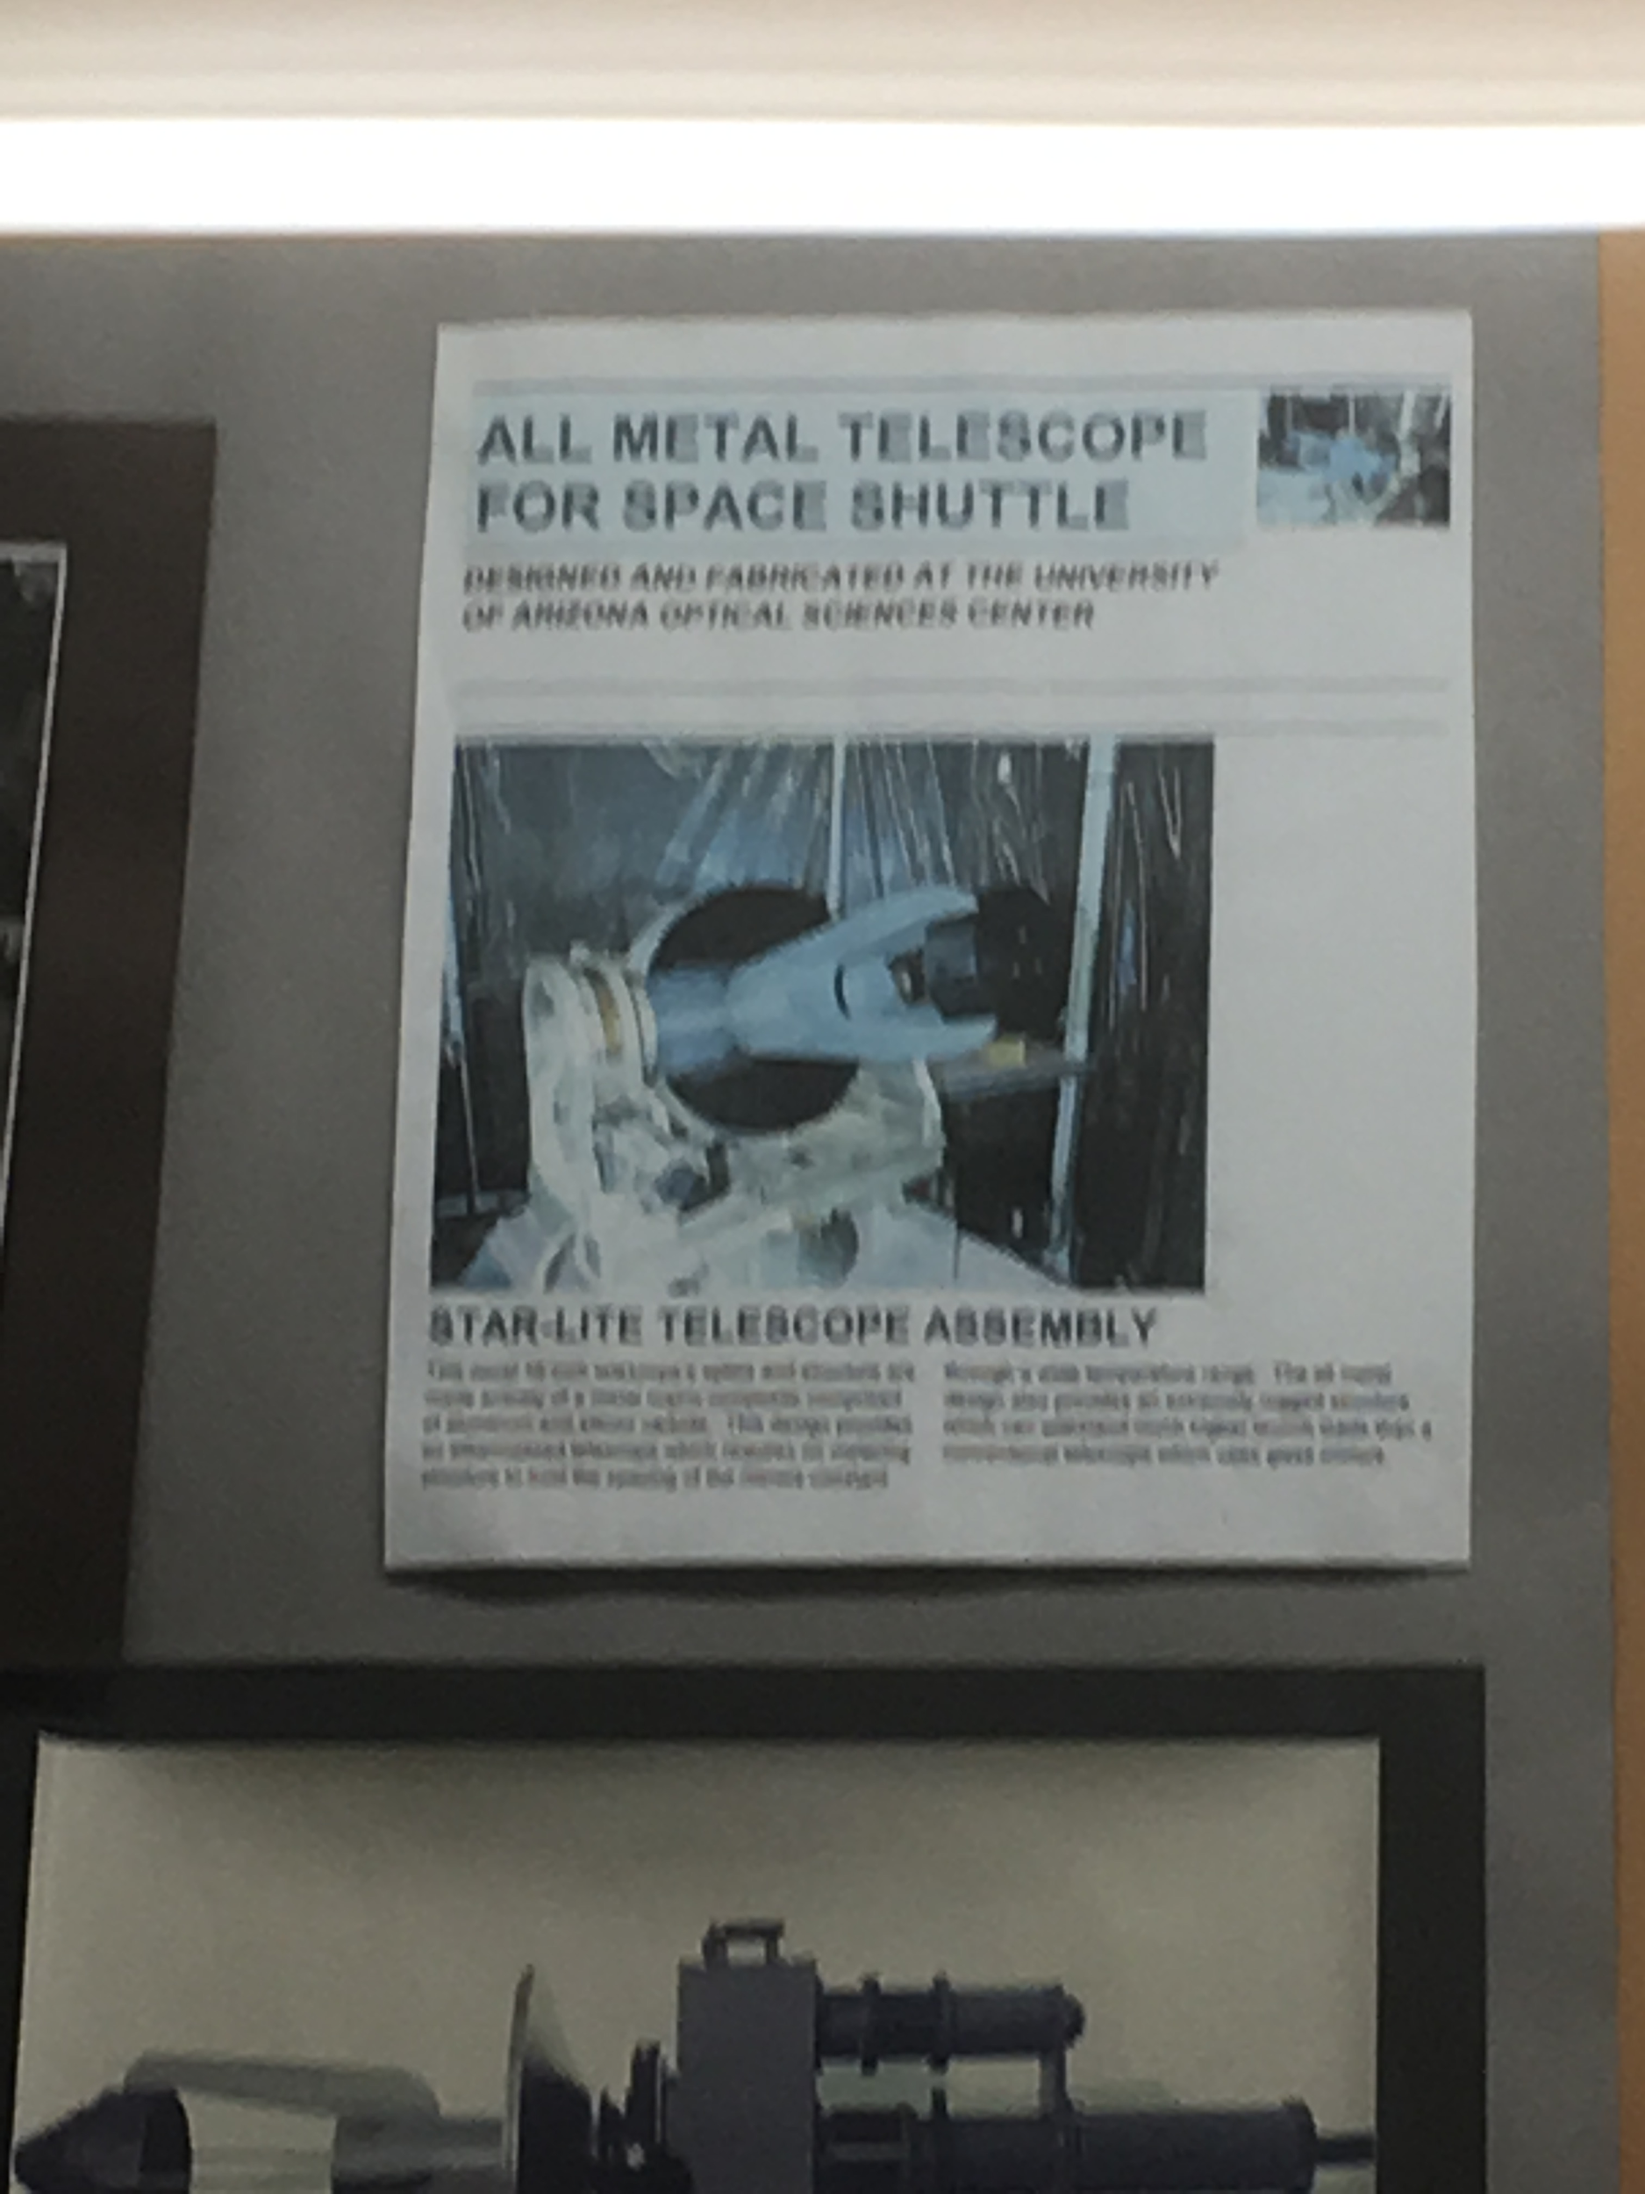
Introduction
The mount under analysis is for a secondary mirror, athermalized and constructed out of Aluminum
The application is not known for sure, but the design may have been intended for use on a telescope for a space shuttle

Slide 7
Introduction
Since the system and geometry is a bit more complex than a cantilever beam, a finite element analysis (FEA) can provide insight into how realistic modal testing results actually are
The goal of this project is to perform modal testing on the mount to determine its vibrational modes in both torsion and lateral deflection, and compare these results to an FEA from SolidWorks

Slide 8
Materials
Material | Quantity | Weight (g) | Notes
Secondary Mirror Mount | 1 | - | -
¼-20 Hex Bolt | 3 | - | -
Weight | - | 4335 | Simulates mirror
1-¼ Hex L-Wrench | 1 | - | -
Triangular Base Plate | 1 | 1360 | For weight placement
C-Clamps, Style 1 | 2 | 106 | For plate mounting
C-Clamps, Style 2 | 1 | 297 | For weight mounting
PCB Piezotronics Impulse Hammer | 1 | - | Sensitivity: 10.02 mV/lb
PCB Piezotronics Accelerometer | 2 | - | Sensitivity: 5.11 mV/g

Slide 9
Procedure
Using the provided through-holes at its base, the mount was mounted down onto the optical bench using 3 ¼ -20 hex bolts
To simulate the effect of a mounted mirror, a triangular plate was mounted on the top of the mirror mount using two C-clamps, and the weight was subsequently mounted on top and centered
Once on the plate, the weight was mounted down by utilizing the secondary C-clamp (see previous slide)

Slide 10
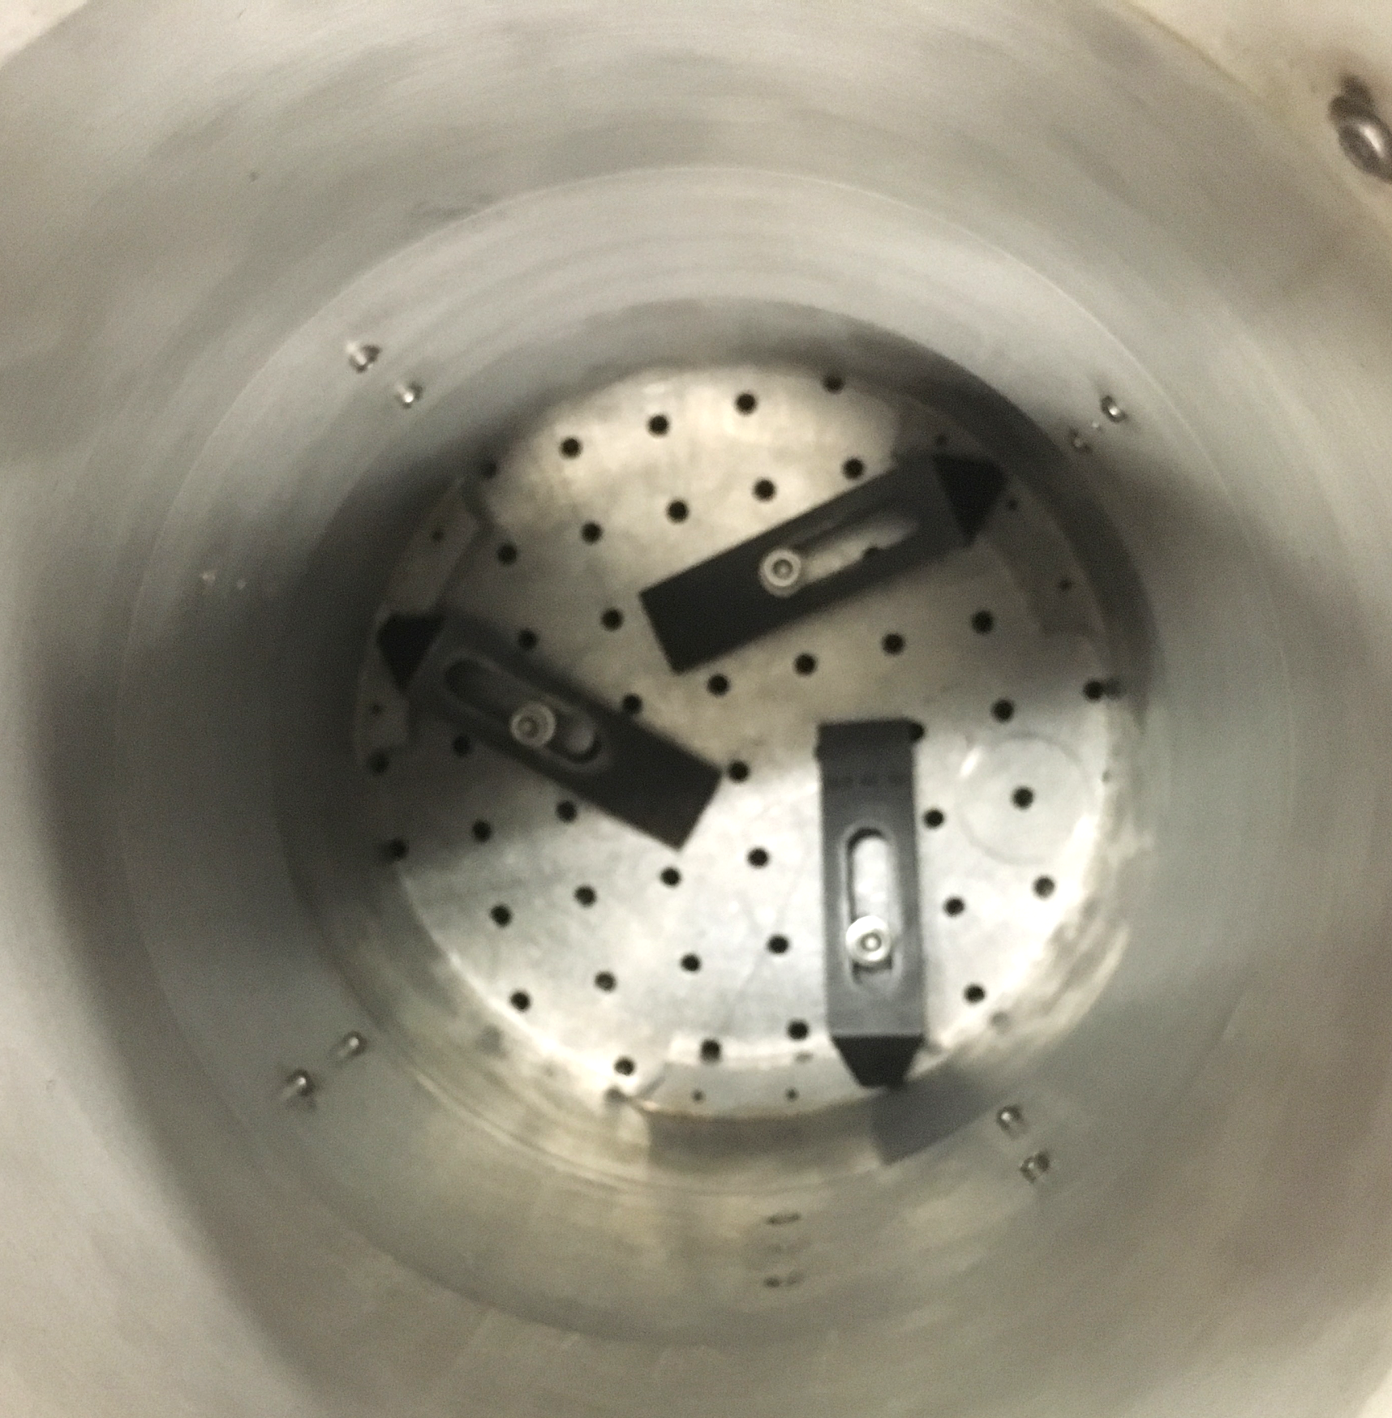
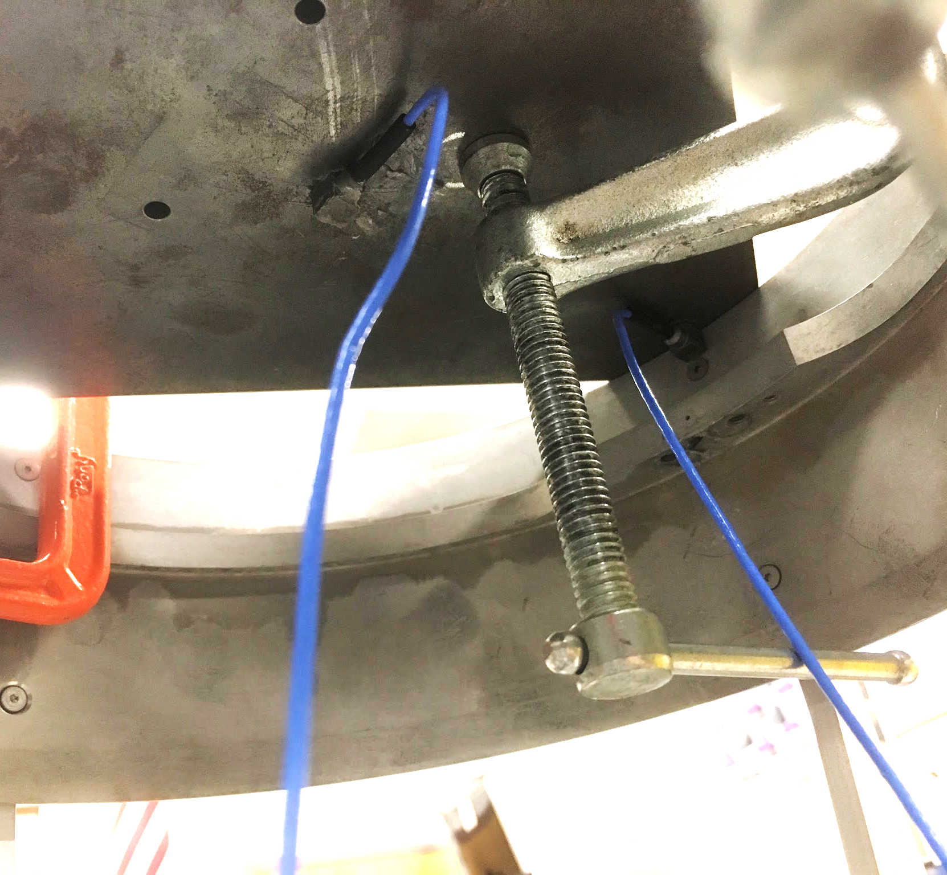
Mounting the System

Slide 11
Setup w/ Weight Attached

Slide 12
Procedure
With the setup complete, the accelerometers were attached to the bottom side of the triangular plate, one of the edge to track torsional modes, and the other at the center to track lateral modes
Note, the placement and orientation of the accelerometers was critical, since an appropriate coordinate frame was needed

Slide 13
Determining the Coordinate Frame
T: Direction of hammer hit for torsion mode simulation
(-Y): Direction of hammer hit for lateral mode simulation
T
X
Z
Y

Slide 14
Procedure
With the accelerometers mounted (using glue, of course), the leads were fed into the NI system
Center was installed into Module 6
Edge was installed into Module 5
The sensitivity values of the accelerometer and impulse hammer were entered into the system, and testing commenced!

Slide 15
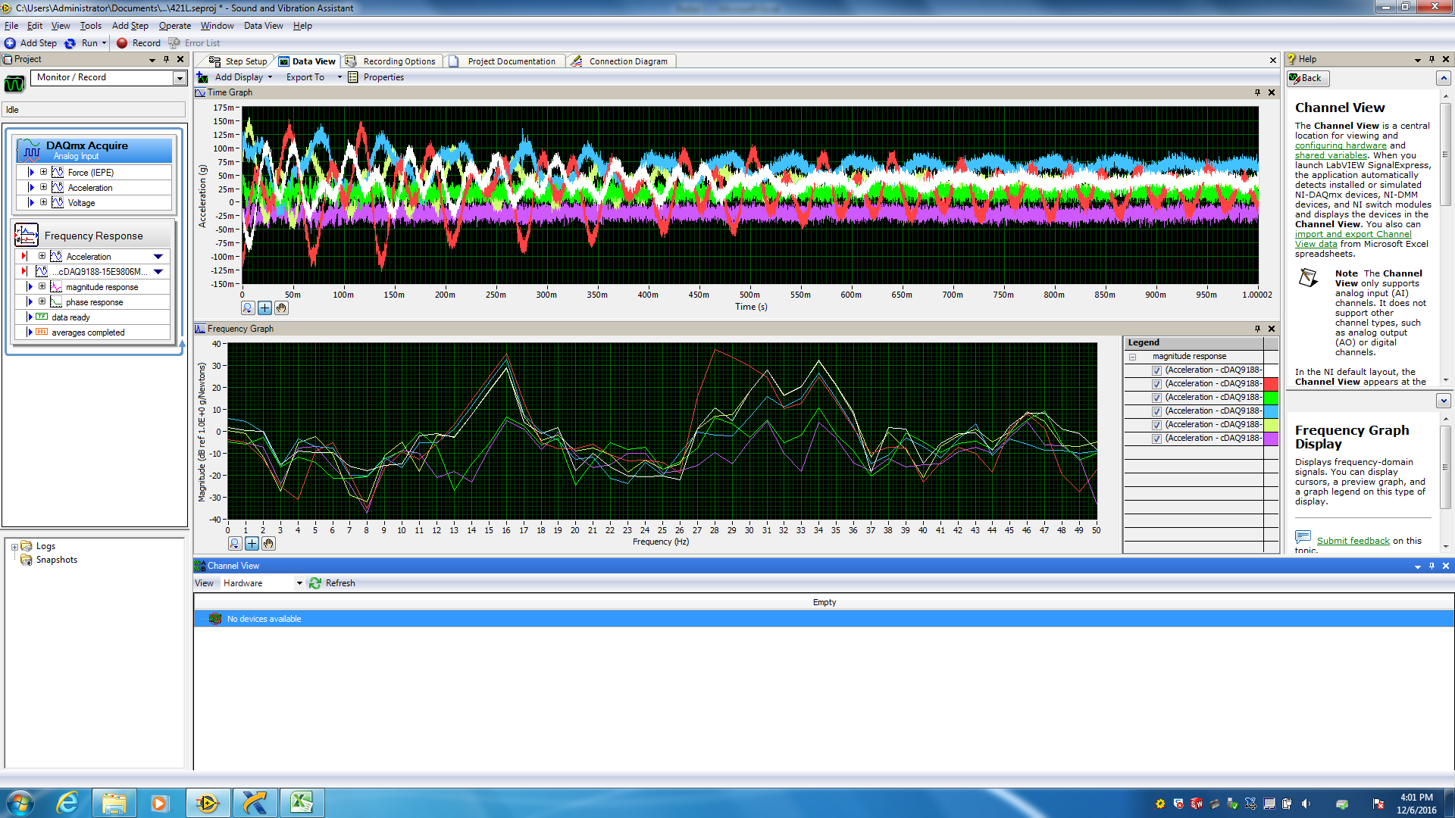
Modal Testing: Lateral Modes

Slide 16
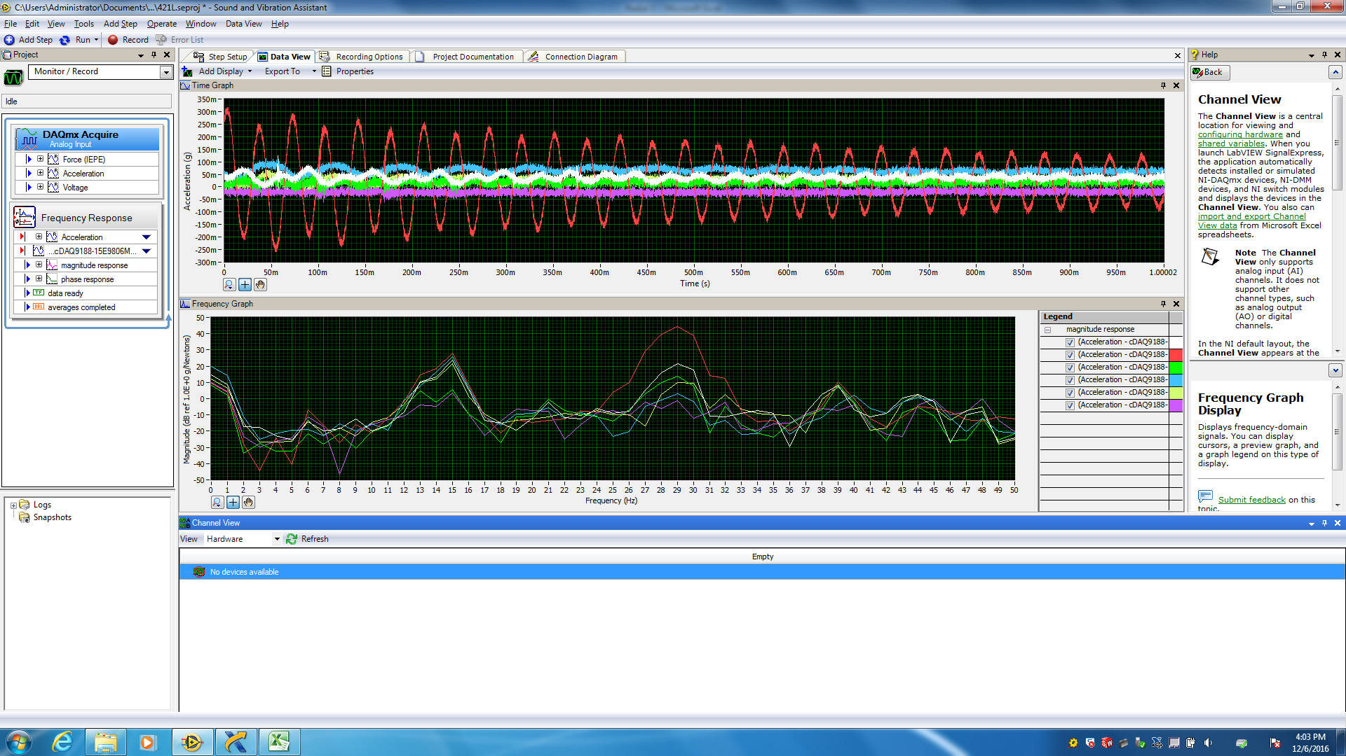
Modal Testing: Torsional Modes

Slide 17
Procedure
Three trials were conducted for each mode, and an average was taken between all three data sets
The averaged data was imported into MatLab for post-processing, and plots of the frequency spectra were produced
As comparison, the mount was modelled in SolidWorks, and a frequency analysis on the system was conducted
Note: The weight of the mounted components was summed and added into the model.

Slide 18
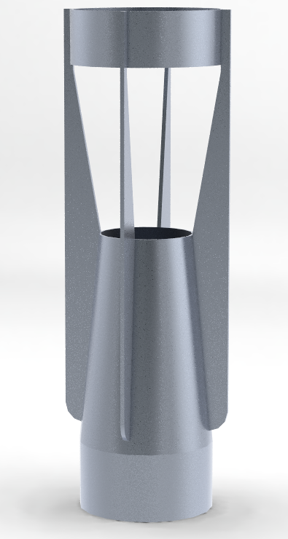
FEA Model

Slide 19
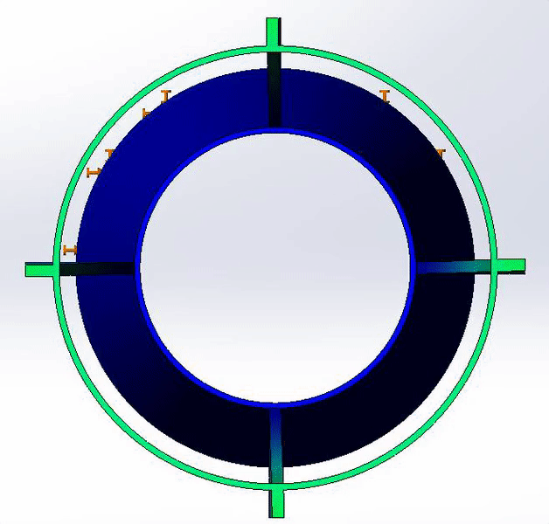
FEA Model
Mode 1: Torsion
16.996 Hz

Slide 20
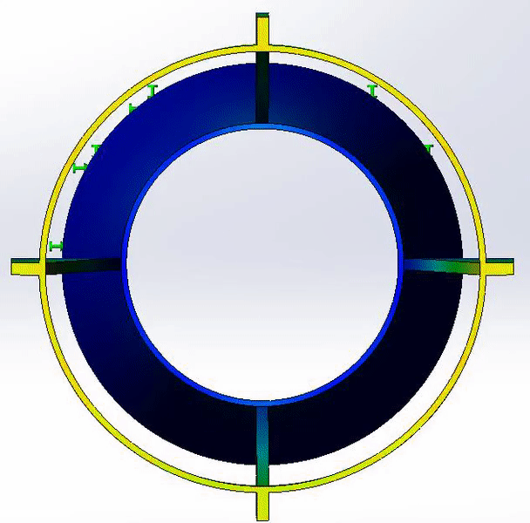
FEA Model
Mode 2: X-Shear
30.735 Hz
Mode 3: Y-Shear
30.785 Hz

Slide 21
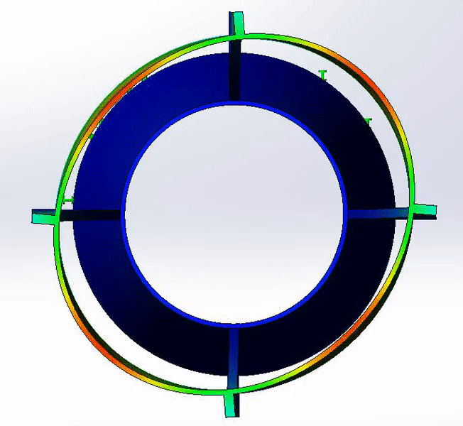
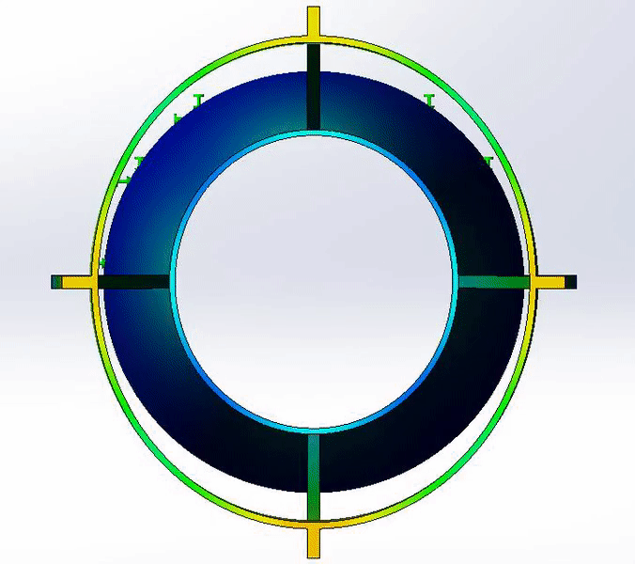
FEA Model
Mode 4: XY @ 45°
38.984 Hz
Mode 5: XY
49.288 Hz

Slide 22
Frequency Response
1: X direction
2: Y direction
3: Z direction

Slide 23
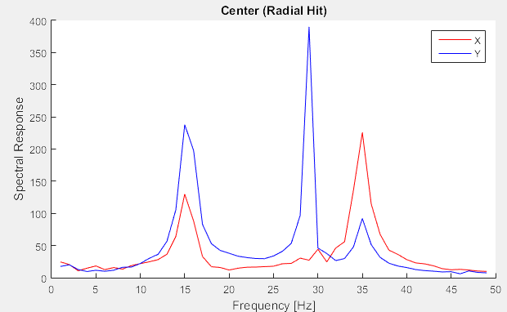
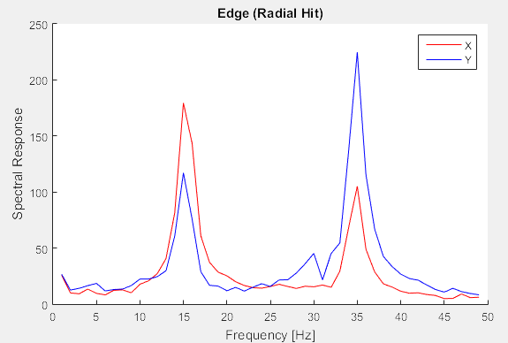
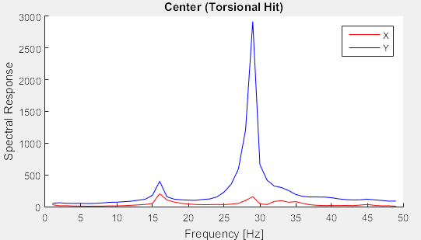
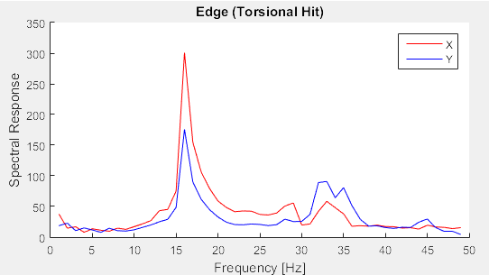

Slide 24
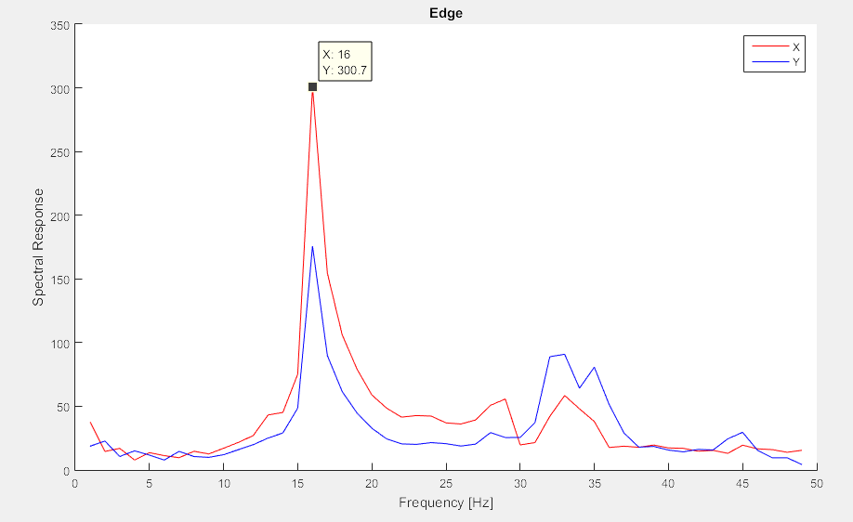
Measurement Response
Mode 1: Torsion
16 Hz
% Error w/ FEA
5.3%

Slide 25
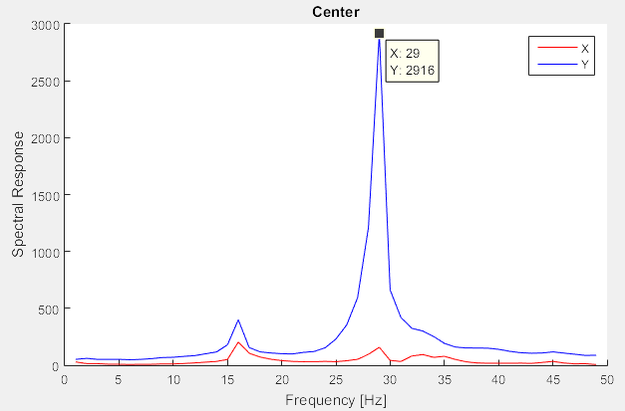
Measurement Response
Mode 2: Shear
29 Hz
% Error w/ FEA
5.5%

Slide 26
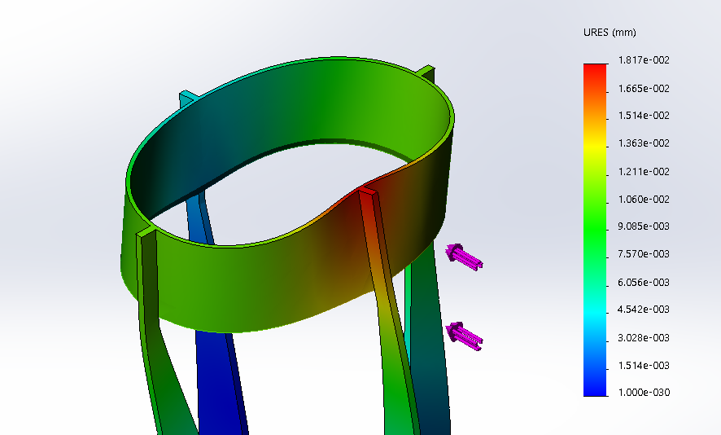
FEA Behavior w/ Other Materials
 | Aluminum (1060 Alloy) | Titanium (UNS R50400) | Beryllium
Mode 1 [Hz] | 17.00 | 20.37 | 37.08
Deflection with 5 lb radial force [𝜇m] | 78.63 | 50.97 | 18.17
Weight [lbs.] | 10.13 | 16.91 | 6.92

Slide 27
Applications & Conclusion

Slide 28
Resonant Frequency
Analyzing the modal response can let us know what the resonant frequency of system is for different directions
While the system is in use, the resonant frequency will not be reached before it becomes inoperable... most likely
The use of knowing the resonant frequency? A large response (vibrations) can break the system!
Can happen during handling, for example
So, having this data can help the engineer/designer create a mount for the system to ensure it does not reach its resonsant frequency in any direction

Slide 29
Resonant Frequency
https://www.youtube.com/watch?v=j-zczJXSxnw
This is what happens when you ignore the resonant frequency..

Slide 30
Deflection
Some of the information that could also be found from this test would be the effects on the resultant image
The deflection or decenter of the mirror could be detrimental to the optical system... if substantial, it could make the telescope useless
Mirror deflection could also result in stresses greater than the yield strength... causing it to permanently deform

Slide 31
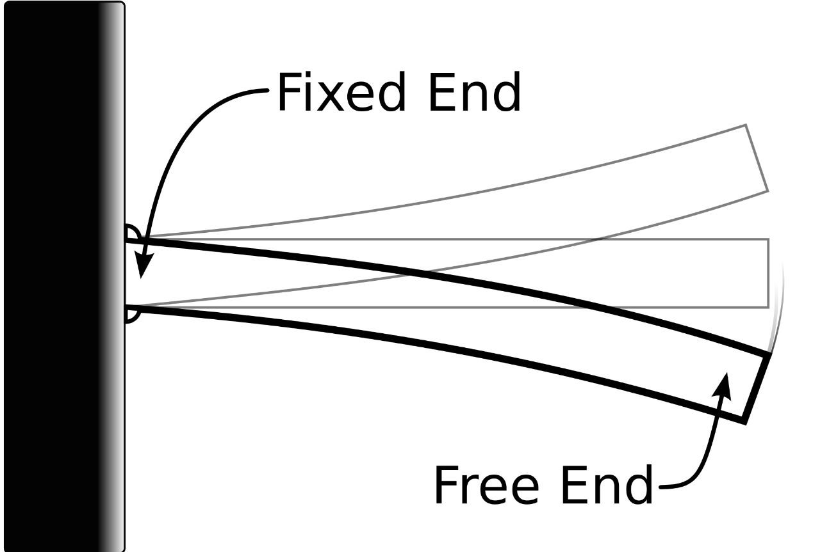
Tilt
Besides decenter, tilt could also begin to factor into system performance
Image shift and aberrations can come into play
While tilt may not have too much of an effect on image decenter, this is not the case with a mirror

Slide 32
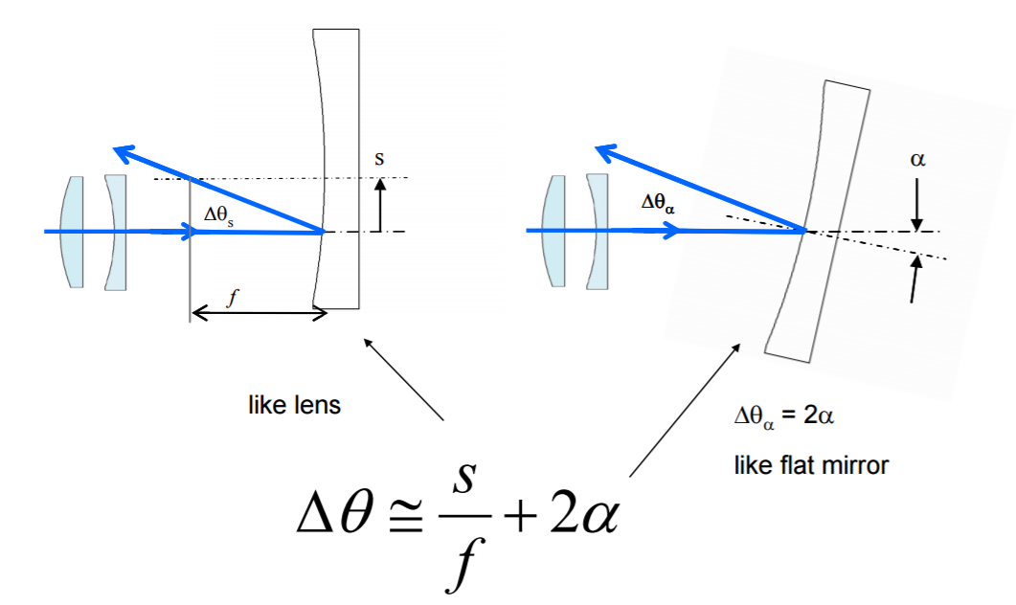
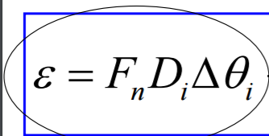
Decenter and Tilt Theory
The equation below relates the deviation in the center ray to the actual impact on the image motion. Remember, besides image motion, aberrations can also come into play!
These are the effects of tilting and decentering the mirror. Decenter is shown on the left, and tilt is shown on the right.

