Slide 1
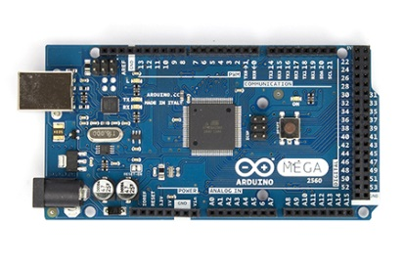
Arduino Microcontroller
Technical Details : Arduino (UNO R3) micro-controller
• ATmega 328 CPU (“industry-standard” micro-controller CPU)
• ?? MHz clock speed
• 5V TTL logic levels
• Input supply voltage: (USB cable supplied by the computer used to program)
(…or 7-12VDC supplied by a battery, for field use)
• General-purpose Input/Output (GPIO) pins:
(14 digital I/O pins including 6 PWM, 6 Analog inputs [10-bit])

Slide 2
Arduino Microcontroller
”Pluses/Minuses” : Arduino (UNO R3 or the MEGA) micro-controller
+ currently used by many ENGR 498 UA Sr. Design teams
+ ”dirt cheap!!” ($15-$20)
+ easy-to-use (free) Integrated Development Environment (IDE)
+ extensive software support www.arduino.cc / Learning / Reference
+ HUGE collection of Arduino libraries on-line (used to control things!)
+/- programmed using C++ (most commonly-used computer language)
+ Arduino computer can be used “stand-alone” (unplugged from laptop)
+ connects to a (cheap!) 2-line LCD display to monitor/display data

Slide 3
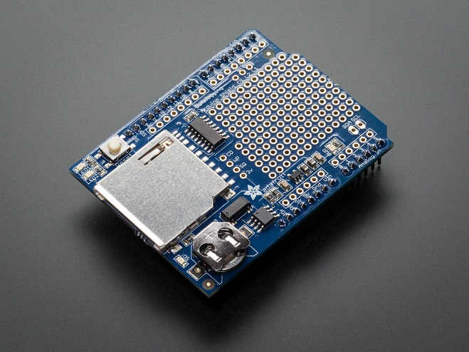
Data Logging
Technical Details : Data Logging shield
• $19.95 (www.adafruit.com)
• on-board SD (or SDHC) Memory Card slot
• on-board Real Time Clock (RTC) [DS1307 clock chip built-in]
”Pluses/Minuses” : Data Logging shield
+ no need to “wire up” a circuit…everything on the shield
- no need to “wire up” a circuit…(nothing learned about electronics)
+ SUPER EASY to program and use:
- store data on the SD card
- read the current date/time from the RTC

Slide 4
Data Logging
Digital Sampling :
• Arduino has a built-in Analog-to-Digital converter
• “A/D converter” or “ADC”
• 10-bit resolution = 2¹⁰ = 1024 number of possible digital output values
• Input range of analog voltages gets “mapped” into these possible outputs
• Output digital values ∴ range from 0 - 1023
• Use the analogRead(pin) function
- returns an integer (0 to 1023)
• The input range of analog voltage is set using the analogReference() function
- analogReference(DEFAULT) default value of 5V
(no need to actually use this command)
- analogReference(EXTERNAL) voltage applied to the AREF pin
(0 to 5V ONLY)

Slide 5
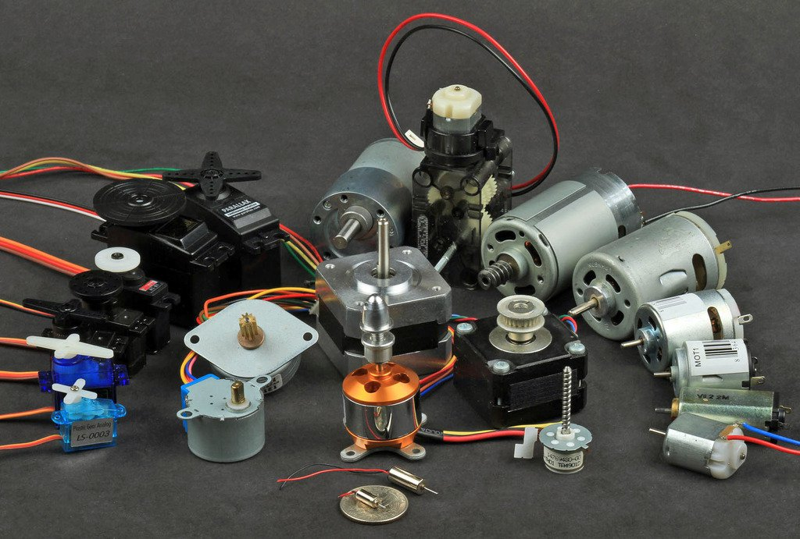
Motors

Slide 6
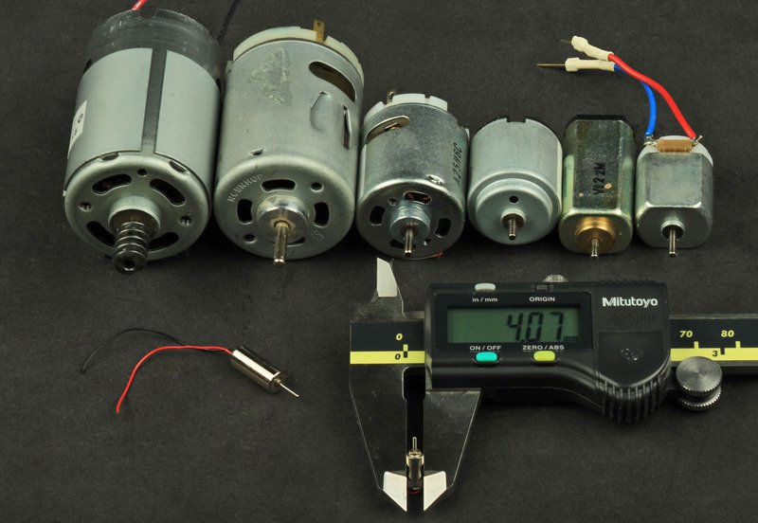
Brushed DC Motors
Technical Details :
• controlled by varying the supplied DC voltage
- reverse direction by reversing the polarity of the applied voltage
Applications :
• Toys !!
• Cell Phone Buzzers
• Cordless Tools
• Toyota Prius…..
”Pluses/Minuses” :
+ DC “hobby” motors readily-available
+ $DIRT-CHEAP (e.g. $5 - $15)
+ Good low-speed torque
- brushes create LOTS of electrical noise (i.e. “sparking”)

Slide 7
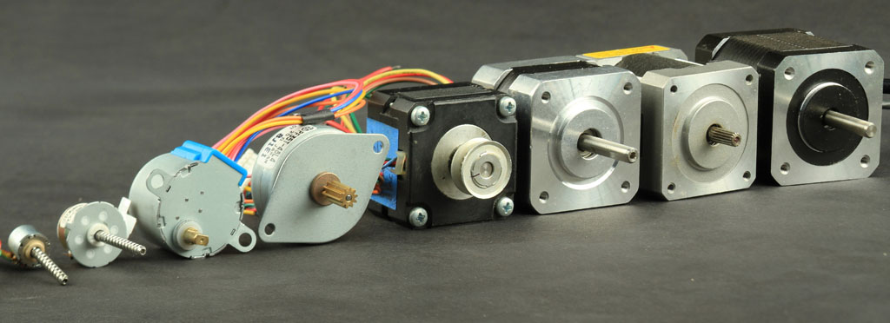
Stepper Motors
Technical Details :
• DC motors that move in discrete steps
• controlled by supplying pulses of current at a fixed DC voltage
Applications :
• 3D printers
• CNC machines
• Printers
”Pluses/Minuses” :
+ Precise, repeatable positioning
+ Precise speed control
+ Excellent low-speed torque
+ Excellent ‘holding torque’ to maintain position
- Low electrical efficiency
- Subject to “missed steps”

Slide 8
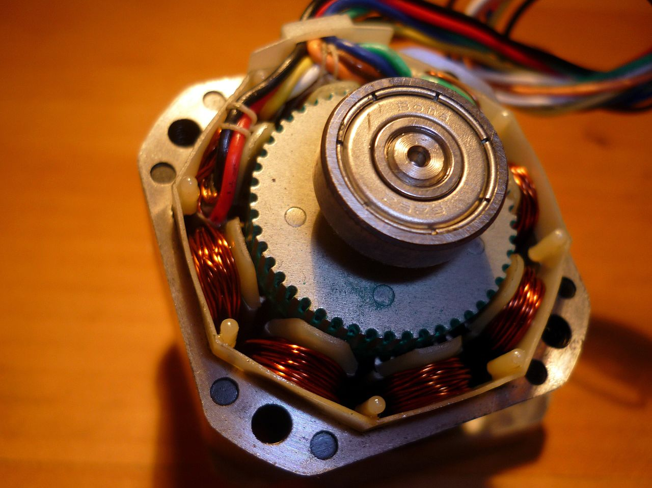
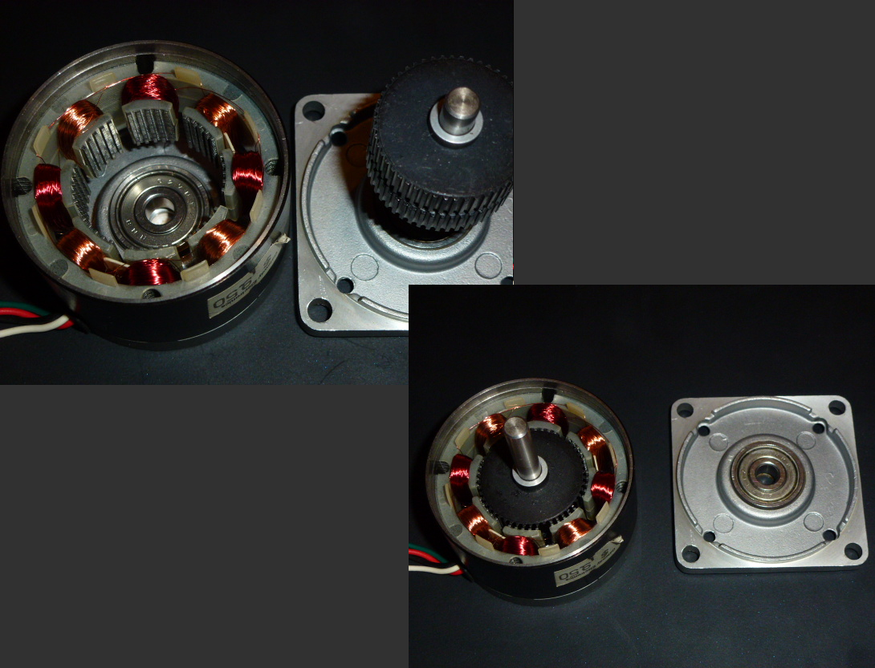
Stepper Motors
Technical Details :
• How they’re made

Slide 9
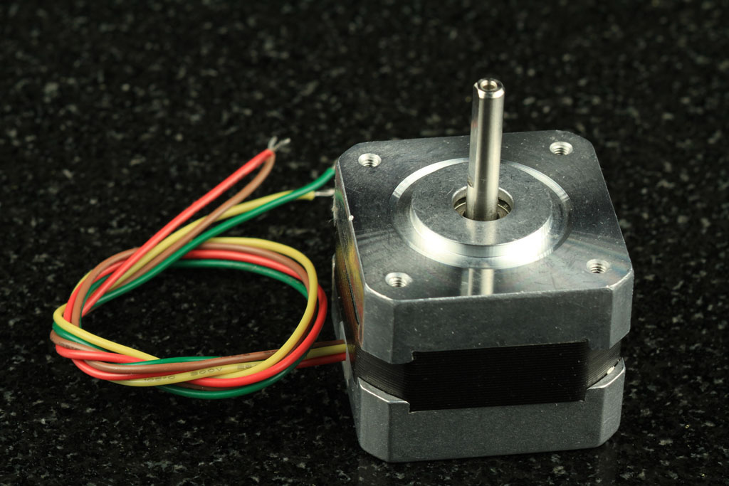
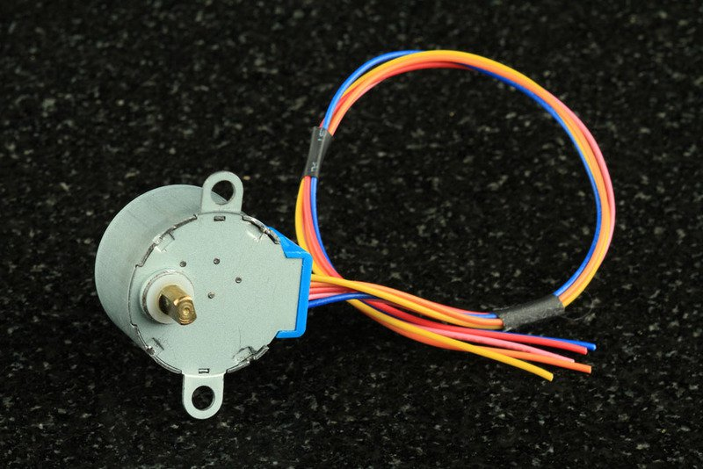
Stepper Motors
Technical Details :
• NEMA case sizes
- spec’d in 0.1”
- NEMA-17 case dia. = 1.7”

Slide 10
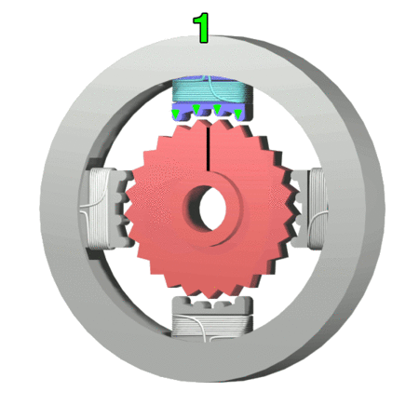
Stepper Motors
Technical Details :
• Unipolar motor in action

Slide 11
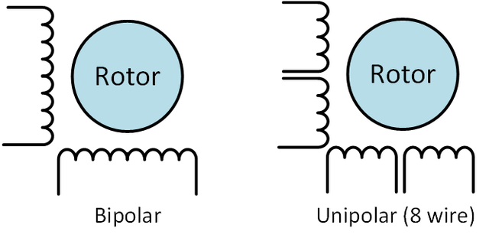
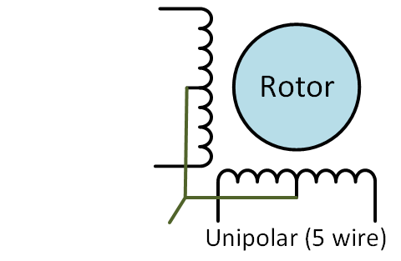
Stepper Motors
Technical Details :
• How they’re wired—Unipolar vs. Bipolar

Slide 12
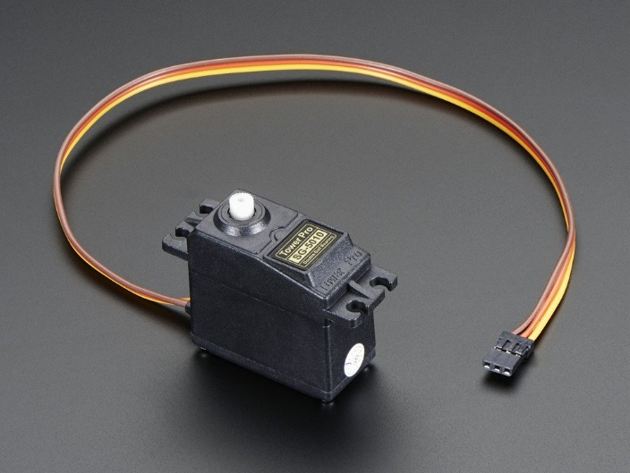
Servo Motors
Technical Details : Servo Motors
• controlled with a PWM digital signal
- programmed with a simple digital.Write(pin#, PWM_value); command
- timing completely taken care of by
electronics inside of the servo
”Pluses/Minuses” : Servo Motors
+ “hobby” servos readily-available
+ $DIRT-CHEAP (e.g. $5 - $15)
+ ”free”—no shield needed
+ servo motors inherently provide ‘positive-feedback’ on their angular position
(stepper motors do not)
- prone to noise and “jitter”

Slide 13
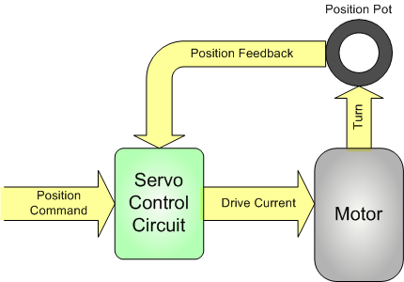
Servo Motors
Technical Details : Servo Motors
• controlled with a PWM digital signal
- programmed with a simple digital.Write(pin#, PWM_value); command
- timing completely taken care of by
electronics inside of the servo

