Slide 1
OPTI 202L Lab #11 – Photoconductors and Basic Electrical Measurements
Dr. Mike Nofziger
Professor
College of Optical Sciences
University of Arizona

Slide 2
Lecture #11 Outline: ● Basics of Electrical Measurements - Voltage, Current, Resistance - DC vs. AC - Ohm’s Law ● Basic Electronic Instrumentation - How to use a Digital Multimeter ● Basic Circuit Construction - How to use a breadboard (the electrical kind!) ● Build Simple Electronic Circuits—Resistive Divider ● Photoconductors - V

Slide 3
Basics of Electrical Measurements: ● Voltage, Current, Resistance - Voltage (EMF) is the force that causes electrons to flow in a circuit. It has units of volts [V, mV, μV, kV, MV, etc.]. It is the equivalent to the water pressure in a garden hose. - Current is the flow of electrons per second, past any given point in an electrical circuit. It has units of amperes. [A, mA, uA, etc.] It is the equivalent to how much water flows out of the garden hose per second. - Resistance is what restricts the flow of electrons in an electrical circuit. It has units of ohms. [Ω, mΩ, kΩ, MΩ, etc.] It is the equivalent to a restriction in the garden hose that limits the flow of water (the diameter of the hose, a kink in it, etc.)

Slide 4
Basics of Electrical Measurements: ● DC ≡ “Direct Current” (also DCV for “DC” voltage) DC circuit ≡ an electrical circuit where the voltage (and therefore the current) is constant as a function of time: • batteries • a power supply • the +5V supplied by a USB computer connector • …? ● AC ≡ “Alternating Current” (also ACV for “AC” voltage) AC circuit ≡ an electrical circuit where the voltage (and therefore the current) varies with time: • the 120VAC supplied by your power company • the output of a transformer • the output of a DC-AC converter (a power inverter) • …? → Wall “plug-in” transformers (“a.k.a. wall-warts) can supply either an AC or a DC voltage…!?!

Slide 5
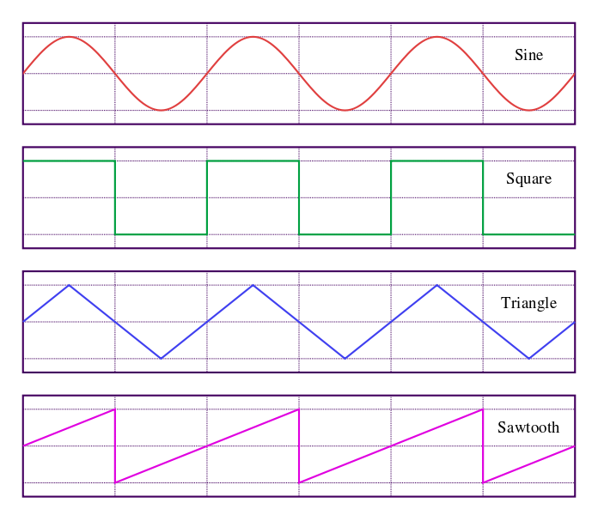
Basics of Electrical Measurements: ● Some AC waveforms: NOTE: A photoconductor can be used to measure time-varying optical signals (producing an AC voltage), or a constant level of light (producing a DC voltage. In our lab, we will only work with constant light levels.)

Slide 6
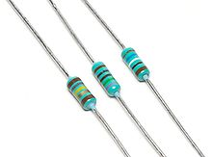
Basics of Electrical Measurements: ● Ohm’s Law: Connects voltage, current, and resistance at any point in an electrical circuit: also: - applies (as written) to DC circuits ● Ohm’s Law for AC circuits:

Slide 7
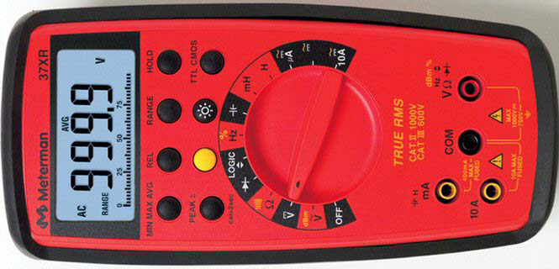
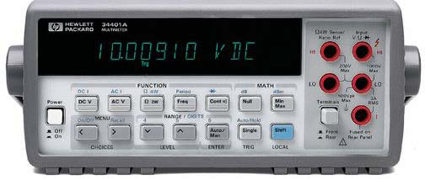
Basic Electronic Instrumentation: ● How to use a Digital Multimeter (DMM)

Slide 8
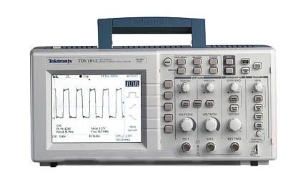
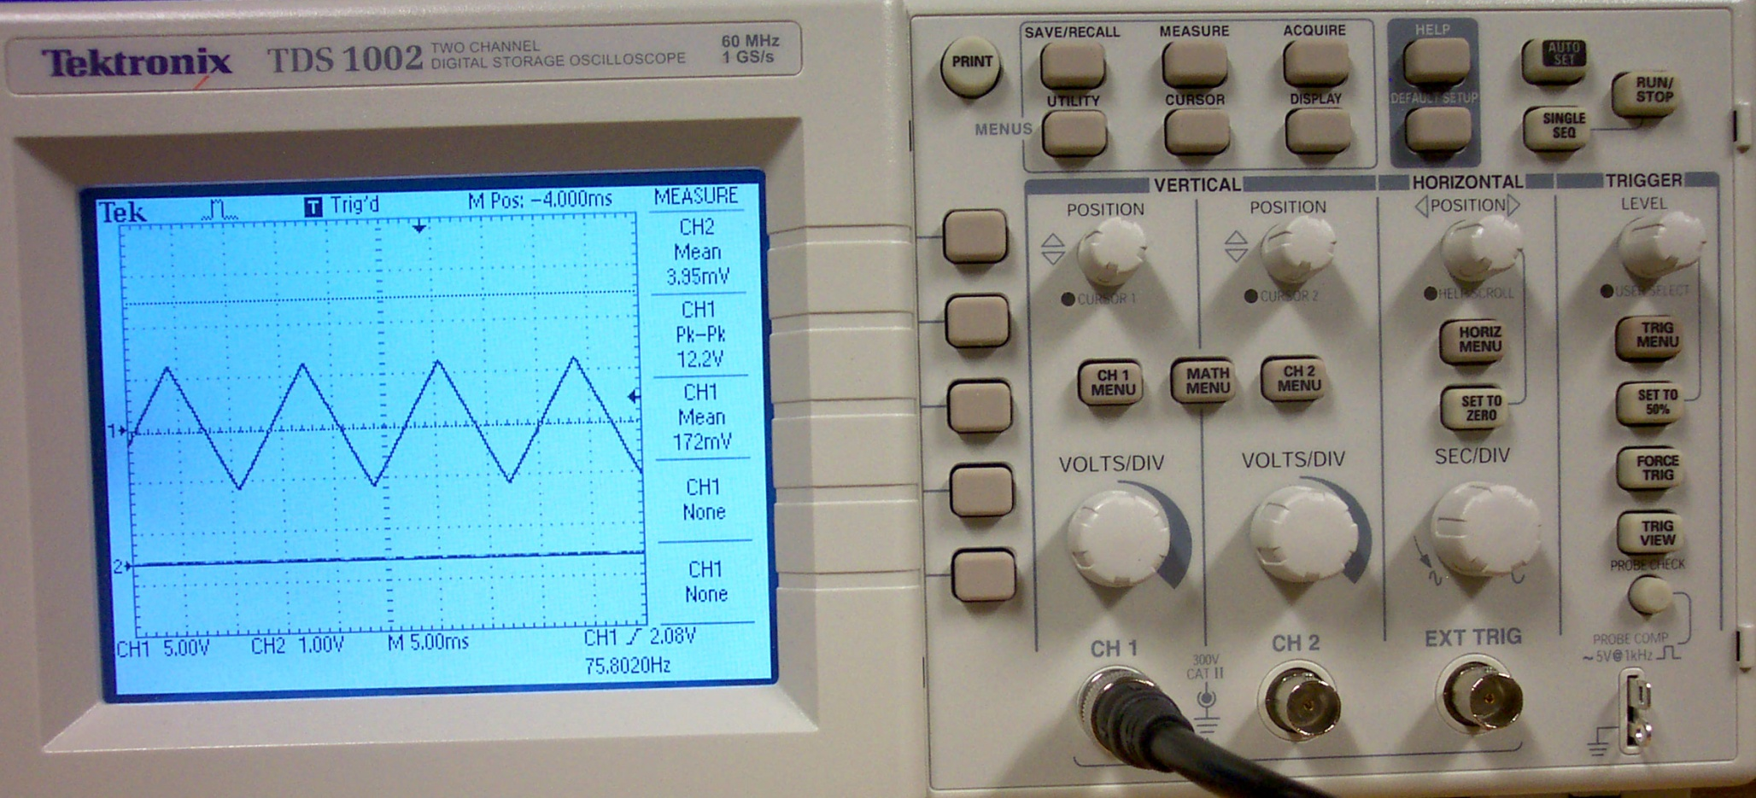
Basic Electronic Instrumentation: ● How to use an Oscilloscope:

Slide 9
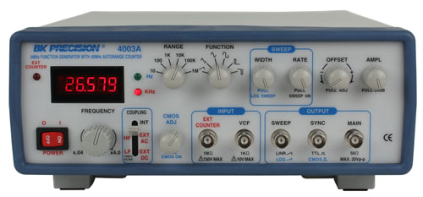
Basic Electronic Instrumentation: ● How to use a Function Generator:

Slide 10
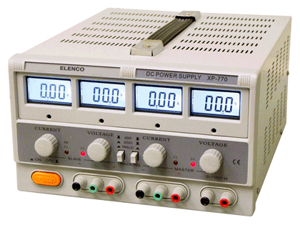
Basic Electronic Instrumentation: ● How to use a Power Supply:

Slide 11
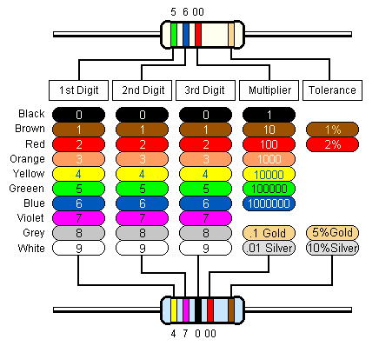
Basic Electronic Instrumentation: ● How to read the resistor code:

Slide 12
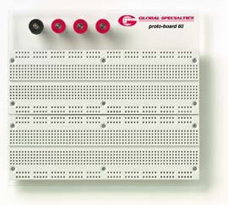
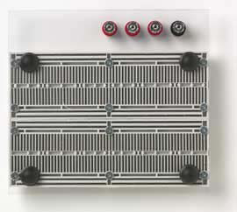
Basic Circuit Construction: ● Layout of an electronic Breadboard:

Slide 13
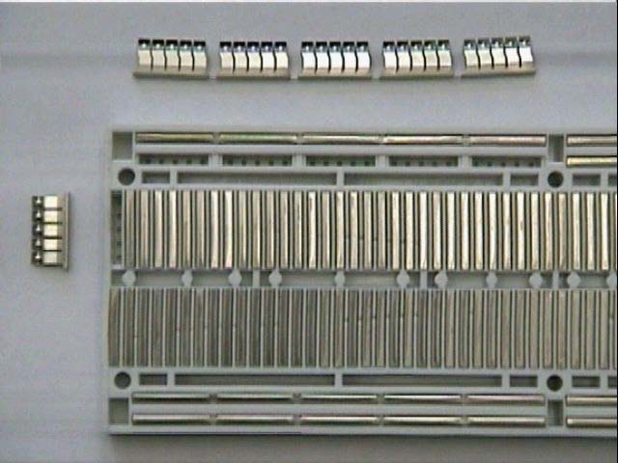
Basic Circuit Construction: ● Layout of an electronic Breadboard:

Slide 14
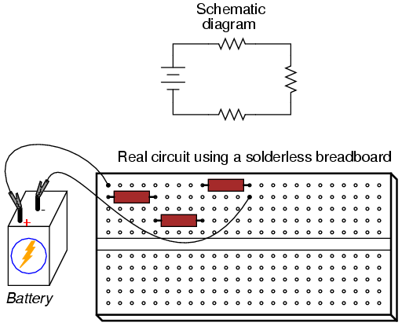
Basic Circuit Construction: ● How to use a Breadboard:

Slide 15
Basic Circuit Construction: ● How to use a Breadboard:

Slide 16
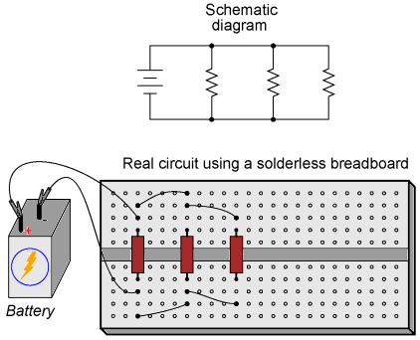
Basic Circuit Construction: ● How to use a Breadboard:

Slide 17
Basic Circuit Construction: ● How to use a Breadboard:

Slide 18
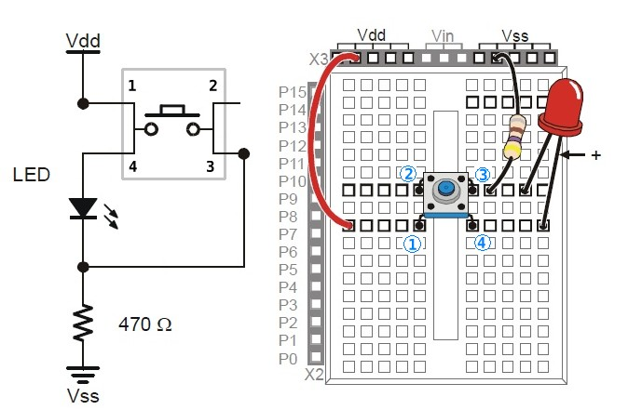
Basic Circuit Construction: ● How to use a Breadboard:

Slide 19
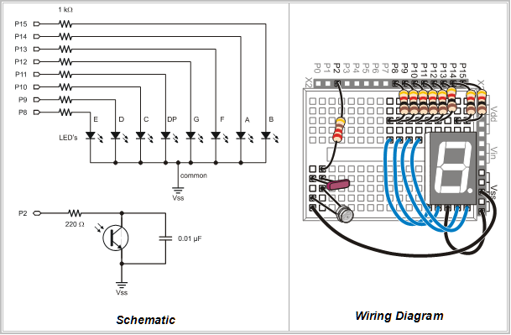
Basic Circuit Construction: ● How to use a Breadboard:

Slide 20
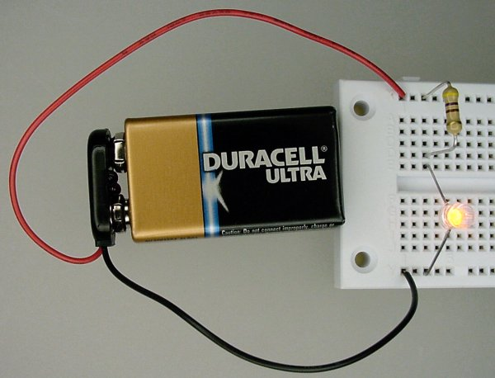
Basic Circuit Construction: ● How to use a Breadboard:

Slide 21
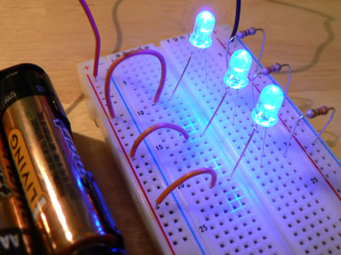
Basic Circuit Construction: ● How to use a Breadboard:

Slide 22
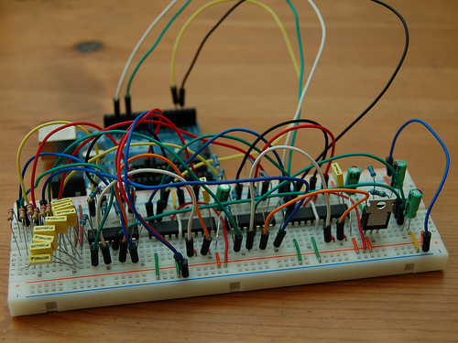
Basic Circuit Construction: ● How to use a Breadboard:

Slide 23
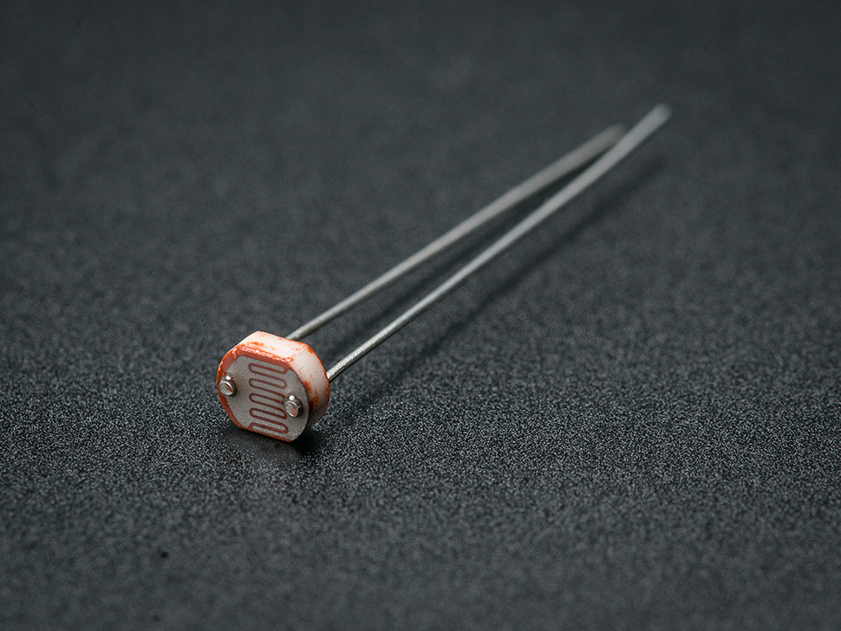
Photoconductors—Physical Construction:
Known as: “Photoresistors”, “Light-Dependent Resistors (LDR)”
“Photocells” …………. Photoconductors!

Slide 24
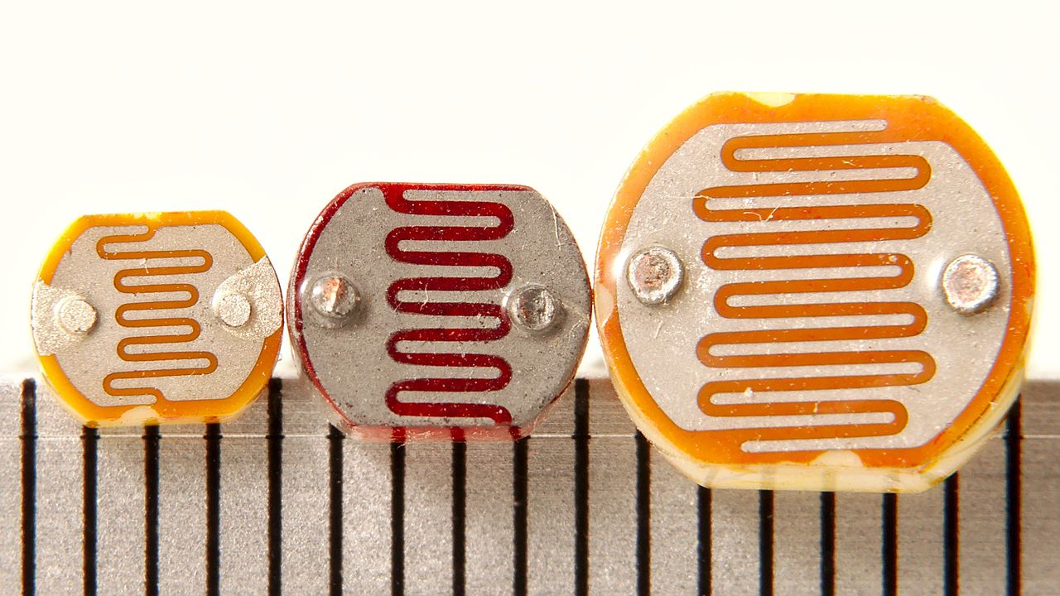
Photoconductors—Physical Construction:
Three photoresistors with scale in mm
Reference

Slide 25
Photoconductors—Basic Physics:
Most common semiconductor material used for detection of
visible light is CdS (also CdSe).

Slide 26
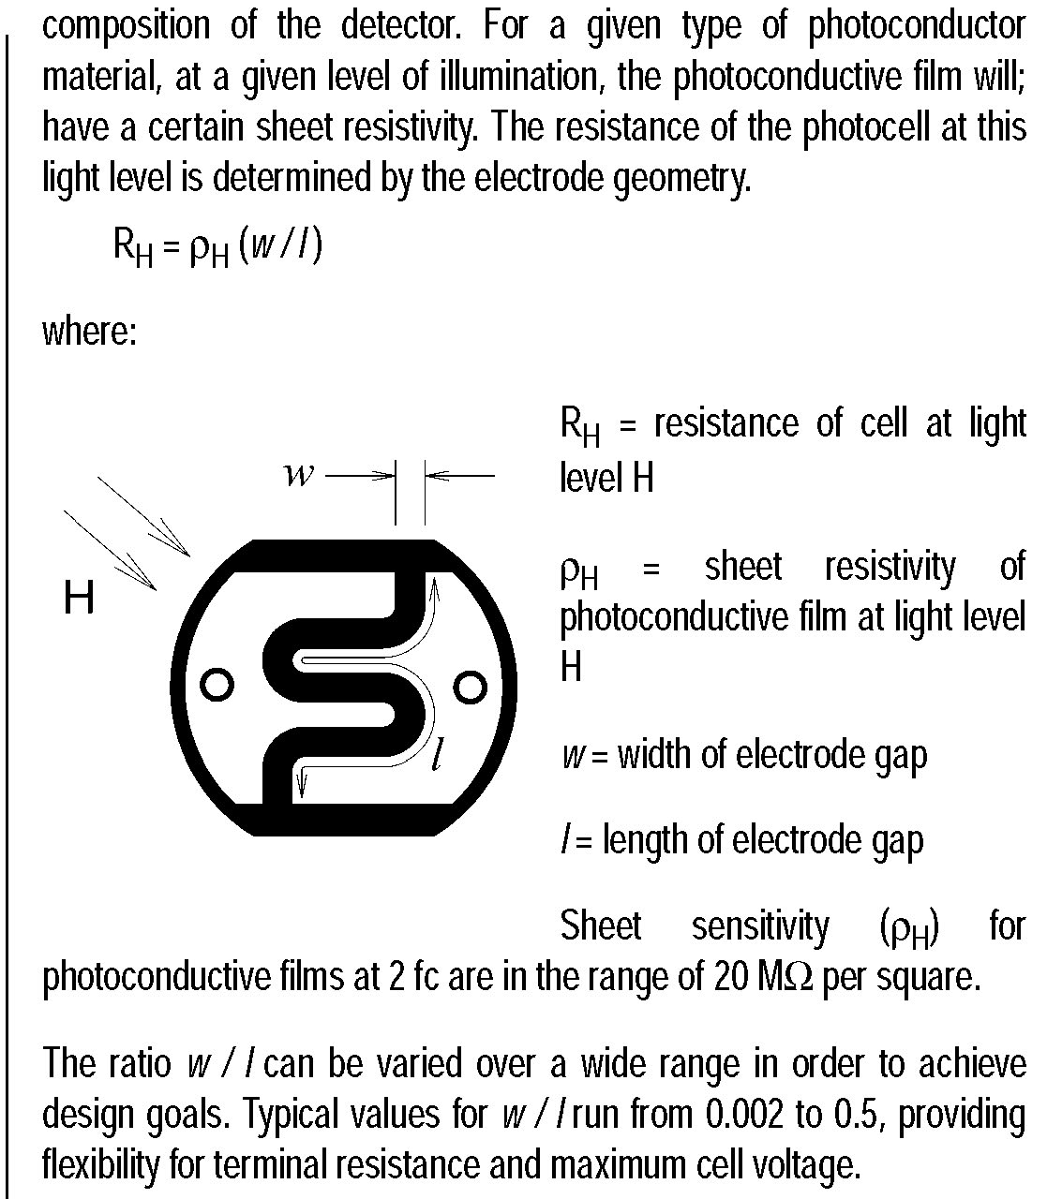
Photoconductors—Physical Construction:
Ref: “Photoconductive Cells”

Slide 27
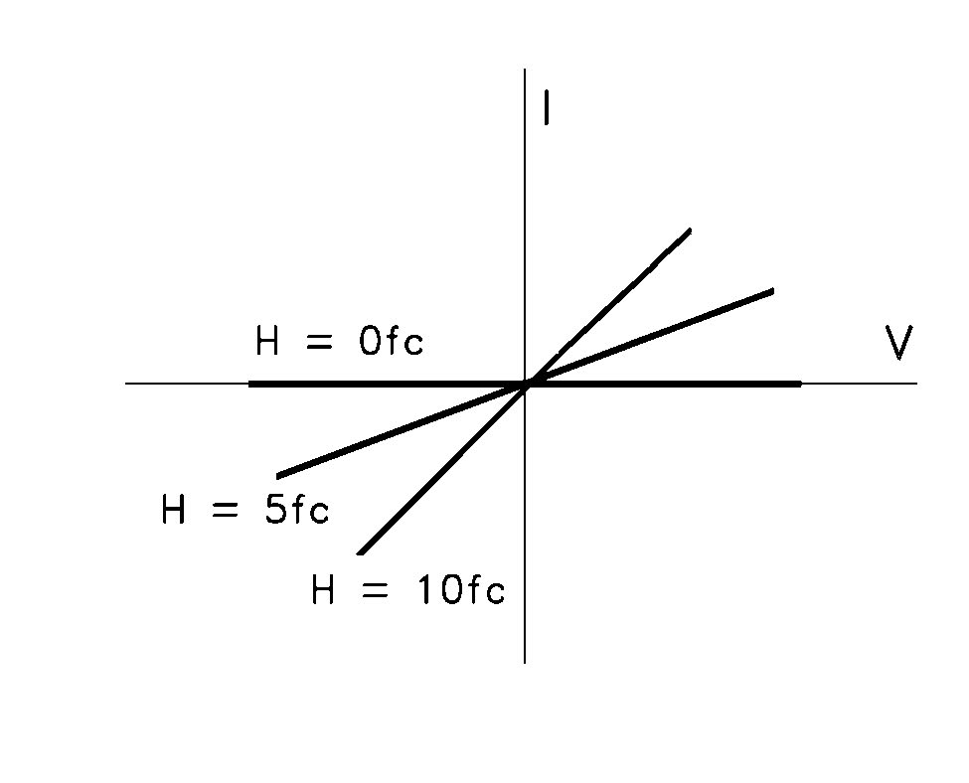
Photoconductors—Current-Voltage (I-V) Characteristics:
where: fc ≡ “foot-candles” is a measure of the amount
of visible light per unit area
The resistance is the inverse of the slope of the I-V curve.

Slide 28
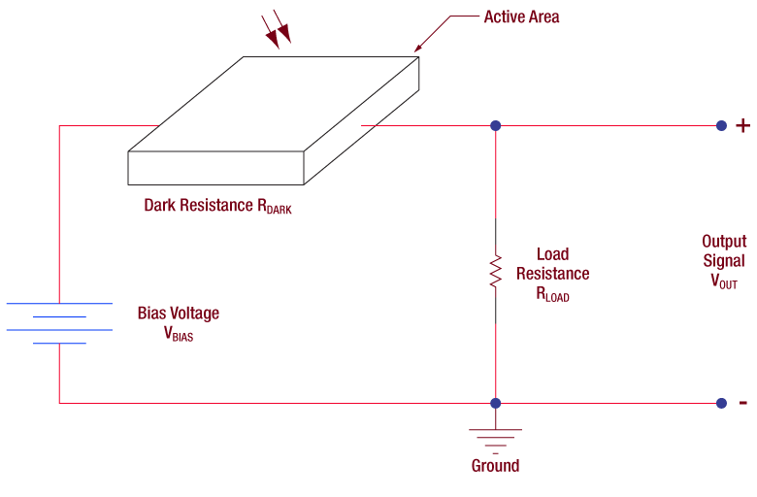
Photoconductors—Use in an Electrical Circuit:
Reference

Slide 29
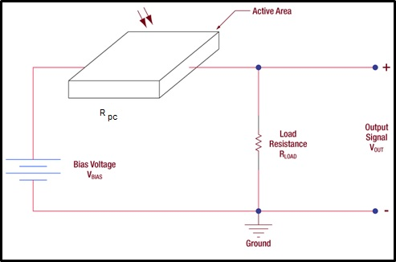
Photoconductors—Use in an Electrical Circuit:
How does V_{out} vary with the amount of light
falling on the photoconductor?

